Slide 1
NACo Prescription Discount Card Program Overview For Counties

Slide 2
A Historical Background
Program Idea to Fruition
NACo's Process to Create the Program
Committee Review, RFP, Finalist Interviews, Pilot
Stage of the Program
Early Success Resulted in NACo Board Approval for a Full Rollout of the Program

Slide 3
Where The Program Is Today
Since December 2004:
  More than 1,400 counties have joined the NACo Prescription Discount Card Program
  Over 40 million prescriptions have been processed
  Over $500 million has been saved
Based on all claims adjudicated by CVS Caremark for NACo 12/01/04 through 12/31/2012.

Slide 4
Who Can Use a Prescription Discount Card?
The NACo Prescription Discount Card can be used anytime a prescription is not covered by insurance – even for pets!
Uninsured residents
When a prescription is not covered:
  Underinsured residents
  Medicare Plan D participants non-covered drugs
Pet prescriptions
Incarcerated individuals

Slide 5
CVS Caremark Experience
CVS Caremark has administered prescription discount card programs since 1992
  Currently more than 18 million discount card program participants
  CVS Caremark is Ranked 18th on Fortune 500
  CVS Caremark is the number one provider of prescriptions in the nation – more than one billion prescriptions filled or managed annually

Slide 6
Participating Pharmacy Network
“Pharmacy-friendly” network contracting philosophy
  More than 65,000 participating pharmacies nationwide = over 9 out of 10 pharmacies
All major chain pharmacies participate, including: Rite-Aid, Walgreens, CVS, Wal-Mart, Target, grocery store chains, most independents
Solid reputation with participating pharmacies since 1969
  Optional agreement to accept the prescription discount card
  Acceptance of online claims processing system

Slide 7
Real Value -- NACo Program 2012
Average savings of $13.12 per prescription
Actual average savings of 27.7%
Savings up to 75%
Generic medication average savings
  34.4% off retail
  $12.33 per prescription
Brand medication average savings
  14.2% off retail
  $19.00 per prescription
Based on all claims adjudicated by CVS Caremark for NACo 01/01/2012 through 12/31/2012.

Slide 8
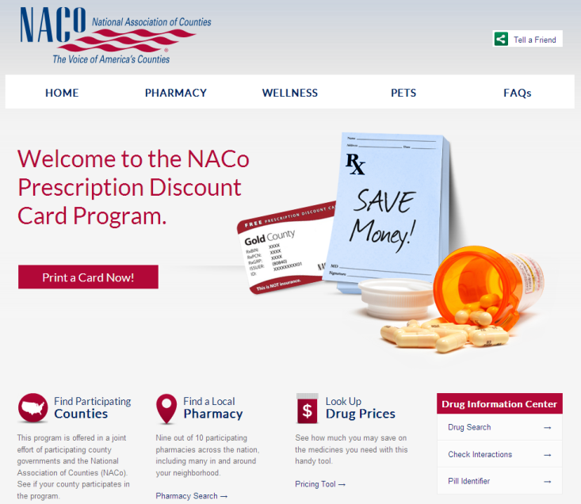
Service For Residents
Toll-free phone number to the award winning CVS Caremark Customer Care
Pharmacy help desk
Flexible enrollment process – no paperwork
By visiting www.nacorx.org, residents have access to:
  Print ID card
  Locate a pharmacy
  Check drug pricing

Slide 9
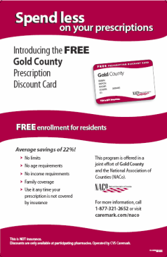
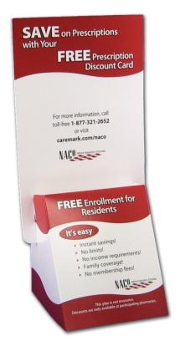
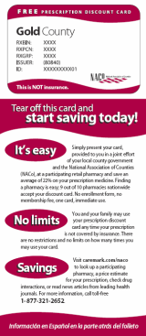
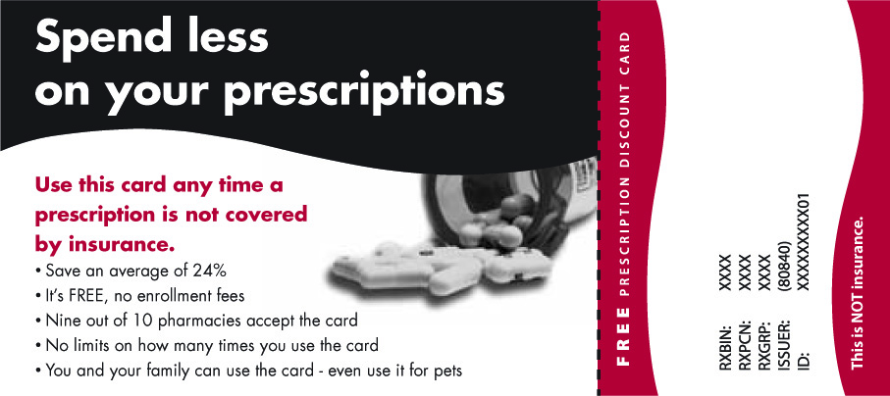
Resident Communication Materials
CVS Caremark continues to provide standard participant materials at no charge to the county
  ID card/brochures, Posters, Display stands
Bill Insert cards are now available

Slide 10
Service for Counties
Dedicated implementation team
Communication materials
Monthly reports
Review and approval of marketing materials
Program link for county websites (www.nacorx.org)
Marketing support
  Press releases
  Press conference support
  Pharmacy mailings
  Bill inserts
  QR codes
  Text cards

Slide 11
County Benefits
No cost to the county
  Program provided at no cost
  Standard marketing materials provided at no cost
Easy to administer
  No enrollment paperwork
  No eligibility transmission required
  NACo and CVS Caremark provide full support for the program
  Customer Care managed by CVS Caremark
Proven results
  Average savings of 27.7% in 2012
  Over 1,400 counties participate in the program with their residents savings over $500 million dollars on more than 40 million prescriptions
  Savings up to 75%
*Based on all claims adjudicated by CVS Caremark for NACo 01/01/2012 through 12/31/2012.
**Based on all claims adjudicated by CVS Caremark for NACo 12/1/2004 through 12/31/2012

Slide 12
County Support
NACo and CVS Caremark’s level of support and service to counties is unmatched, developing custom marketing plans for each county fitting their respective needs. Methods include:
  Press releases
  Press conference support
  Pharmacy mailings
  Community facility mailings
  Bill insert mailings
  QR codes
  SMS – Text messages

Slide 13
County Support (cont.)
  Press releases
    NACo and CVS Caremark will develop and distribute press releases on behalf of the county, including:
      Announcing implementation
      Keeping program visibility high
      Marking savings milestones
      Ensuring county officials receive proper credit for helping residents

Slide 14
County Support (cont.)
  Pharmacy Mailings
    CVS Caremark and NACo work to distribute cards and display stands to local participating pharmacies
      Method leads to higher utilization
      Follows pharmacy protocols
      Hand delivering cards to pharmacies can compromise the network

Slide 15
County Support (cont.)
  Community Facilities Mailings
    CVS Caremark and NACo work to distribute cards and display stands to community facilities
      County simply needs to provide contact information for facilities and we’ll produce and ship the cards to the locations at our cost

Slide 16
County Support (cont.)
Bill Insert Mailings
  Bill Insert cards designed for county mailings
    Can be inserted in water bills, property tax statements and other various county mailings
    Weight of each insert is .063 ounces, or 1.79 grams and typically has no effect on postage

Slide 17
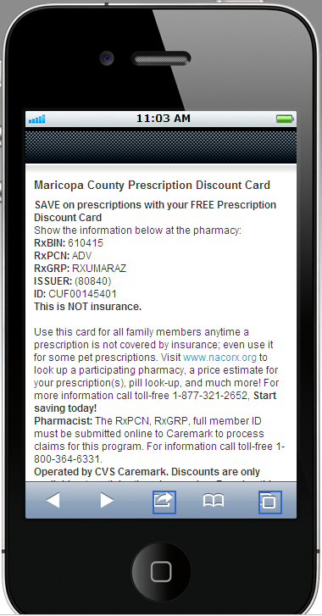
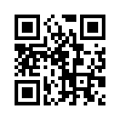
County Support (cont.)
Electronic Cards
  Two new types of electronic cards that make it easy for residents to receive a card. These cards can be advertised on posters, press releases, newspaper ads, etc.
    QR codes
    SMS text cards

Slide 18
County Benefits
The Marketing Fee Reimbursement Option
  Counties can now participate in the marketing fee reimbursement option to receive $1 per prescription when their card is used to receive a discount.
    Signing the County Agreement and a rider gets your county enrolled.

Slide 19
Our Advantages
Network – Largest prescription discount card network in the nation
Marketing – Extensive marketing support for your counties
Experience
Fully Integrated Health Organization – PBM, Pharmacy, Specialty
Resident Support – J.D. Power & Associates #1 award winning support for your residents
(use if county already has the program) Since (insert rollout date here) residents in (insert county name here) have saved over $(insert savings # here)!
(insert # and state here) counties already participate in the program, and so far have saved residents in (insert state here) over $(insert savings # here) million!

Slide 20
How Counties Get Started
Visit www.NACo.org :
  Go to: “County Solutions”
  Click on: “Cost Saving Tools”
  Click on: “NACo Prescription Discount Card Program”
  Click on: “Program Implementation Contract and Checklist”
  Review the documents related to the NACo Prescription Discount Card
  You will be able to access:
    - Sample press releases, card images, summary points, TV news coverage, interviews and articles on the program
NOTE: Logging in requires your email address and your password. Please call or email NACo if you need assistance with logging into the website.

