Slide 1

Social Security –
The choice of a lifetime
Understanding when and how to file for Social Security benefits
NRM-12743AO-NX

Slide 2
Disclosures
Information provided by retirement representatives for educational purposes only and is not intended as investment advice. Investing involves risk, including loss of principal.
Retirement Representatives are registered representatives of Nationwide Investment Services Corporation, member FINRA.
All information provided is from sources believed to be reliable and current, however, accuracy cannot be guaranteed. Past performance is not an indication of future results
Nationwide, Nationwide Financial and Nationwide Retirement Solutions are registered trademarks of Nationwide Mutual Insurance Company.
Nationwide Retirement Solutions (Nationwide) makes payments to the National Association of Counties (NACo), NACo RMA LLC and the NACo Financial Services Center Partnership (FSC) for services and endorsements that NACo provides for all its members generally related to Nationwide’s products and services sold exclusively in public sector retirement markets. More detail about these payments is available at www.nrsforu.com.
Mutual Fund Payments:
Nationwide Retirement Solutions, Inc. and its affiliates (Nationwide) offer a variety of investment options to public sector retirement plans through variable annuity contracts, trust or custodial accounts. Nationwide may receive payments from mutual funds or their affiliates in connection with those investment options. For more detail about the payments Nationwide receives, please visit www.nrsforu.com.

Slide 3

Nationwide Financial Retirement Institute helps build strong partnerships
To advance the collective thought leadership of Nationwide Financial to improve the retirement outcomes of America
The Retirement Institute Mission

Slide 4




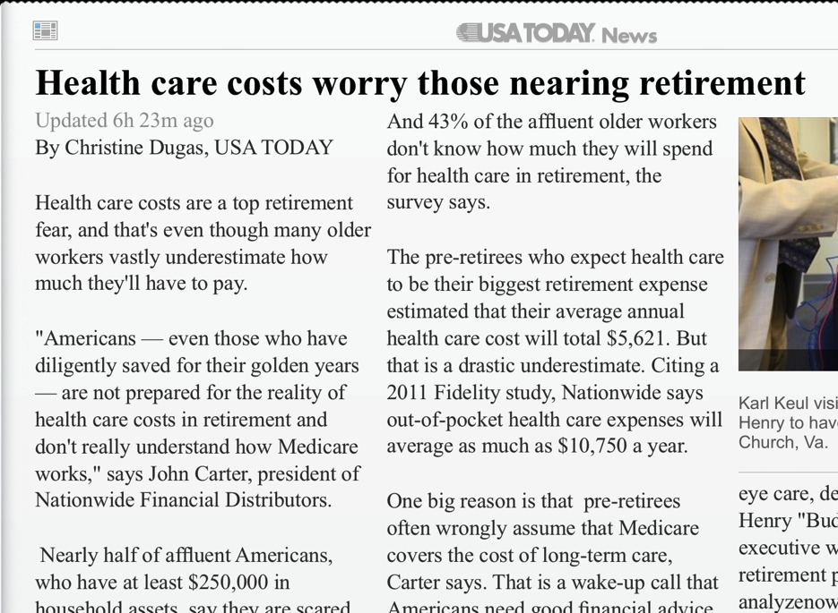






Retirement Institute helps to strengthen our reputation within the industry
More than 520 million media impressions in publications
Media turns to Nationwide as a thought leader to comment on trends

Slide 5
Today’s presentation
  Why your Social Security filing decision matters
  What you need to know about Social Security
  How to make a decision that works best for you

Slide 6
When does the filing decision happen?
New Social Security claimants in a calendar year¹
Less than one in three individuals filed for full benefits at FRA² or later
¹ Source: LIMRA, using 2012 data from the Social Security Administration
² FRA = Full retirement age. For this data, FRA is 66.

Slide 7
Meet Jim & Linda
$300,192
Cumulative benefit
lost by filing early
62-year-old
married couple
$2,300
Jim’s SS benefit at full retirement age.
$1,200
Linda’s SS benefit at full retirement age.
$973,428
Cumulative benefit if
both file for Social Security at 62³
$1,273,620
Cumulative benefit
if both optimize
SS benefits³
³ Assumes average life expectancy of 83 for men and 86 for women and 2.5% annual cost-of-living adjustments (COLA).

Slide 8




More than a monthly check
Old Age, Survivors and Disability Insurance (OASDI)
Guaranteed lifetime income
Spousal and survivorship
benefits
Indexed to inflation
Preferential
tax treatment

Slide 9
Social Security basics:
Filing rules for different situations
Spouses
Surviving spouses
Divorced spouses
Dependent children
Disabled individuals

Slide 10
Social Security filing options
Deemed filing
File for all eligible benefits
Benefits discounted if filing before FRA
More options if you wait….
Standard filing
File for all eligible benefits
File & suspend
Allows spouse to collect spousal benefits
File restricted
Allows you to begin spousal or survivor benefits only PIA

Slide 11
For government employees
Windfall elimination provision (WEP)
      Reduces individual benefit to prevent higher benefits
      on top of pension income
      Changes formula used to calculate PIA
        40% of first $816 instead of 90%¹⁰
        Reduction cannot be more than ½ of pension amount
¹⁰ Source: Social Security Administration. Based on 2013 formula

Slide 12
How GPO reduces benefits
Spouse 1:
Worked in government throughout career
Receiving $2,100 monthly pension
GPO = $1,400 (2/3 of $2,100)
Spouse 2:
Worked in private sector
Paid FICA taxes
PIA: $2,000/month
 | Spouse 1 benefit before GPO (If GPO didn’t apply) | Spouse 1 benefit after GPO (Reduction of $1,400)
Spousal benefit | $1,000 per month | $0
Survivor benefit | $2,000 per month | $600

Slide 13
Simplifying Social Security decisions
Nationwide® Social Security tool
  Identifies optimal filing strategies and allows you to adjust parameters to compare different strategies
  Provides instructions on how to file
  Helps you integrate Social Security into your comprehensive retirement income plan

Slide 14
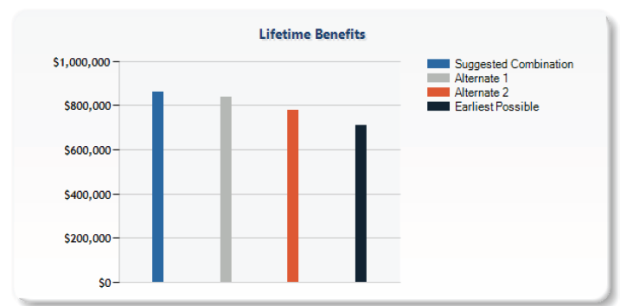
Compare filing strategies
The client’s Social Security report shows cumulative benefits of an optimization strategy vs. early filing and alternative filing strategies

Slide 15
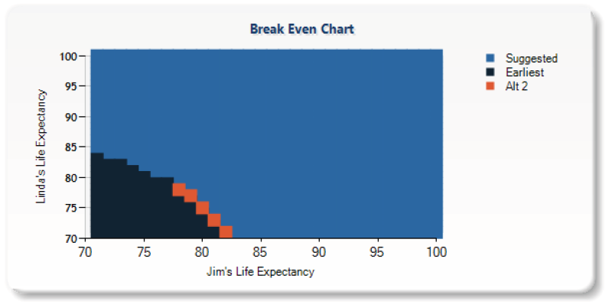
Analyze break-even points
Illustrates which of the outlined strategies provides the best outcome at any given set of whole year death age combinations.

Slide 16
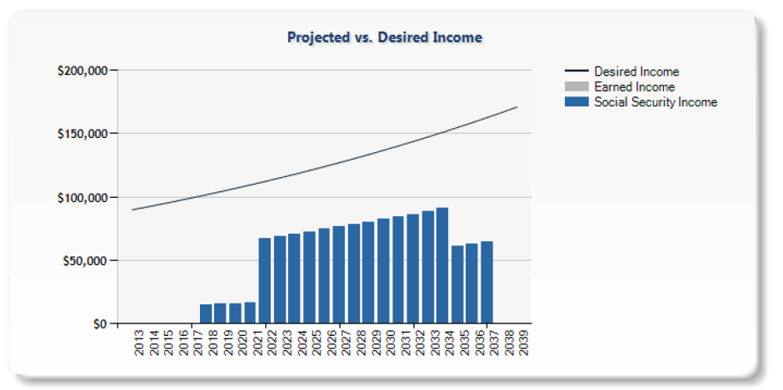
Identify income gaps
The report illustrates annual Social Security cash flow for the suggested filing strategy vs. projected retirement income needs.

Slide 17

Gathering inputs for your analysis
  Helps gather relevant information to prepare a filing strategy comparison
  Marital status
  Expected benefit amount
  Life expectancy
  Planned retirement date
  Desired retirement income
  Retirement goals, concerns, etc.

Slide 18
The choice of a lifetime
When and how you file for Social Security is an important decision.
Learn how to claim benefits for other family members and how to put the filing rules to work
Consider your filing decision in the big picture of your overall retirement income plan

