Slide 1
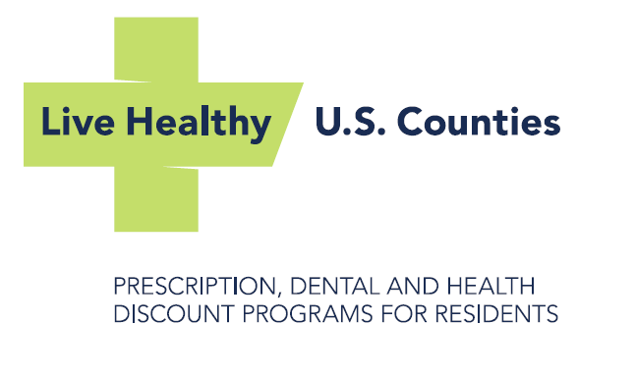

Slide 2
Disclaimers and Legal
The Live Healthy Discounts Program is NOT Insurance.
The Prescription Discount Card is operated by CVS/caremark. Discounts are only available at participating pharmacies.
The Discount Medical Organization for NACo Health and Dental Discounts is Alliance HealthCard of Florida, Inc.
This presentation contains confidential and proprietary information of CVS/caremark and cannot be reproduced, distributed, or printed without written permission from CVS/caremark.
2015 CVS/caremark. All rights reserved

Slide 3
Prescription Discount Program

Slide 4
Where the Program Is Today
Since December 2004:
More than 1,300 counties have joined the National Association of Counties (NACo) Prescription Discount Card Program
Over 47 million prescriptions have been processed
Over $633 million has been saved
Based on all claims adjudicated by CVS/caremark for NACo 12/1/2004 through 12/31/2015.

Slide 5
Who Can Use The Prescription Discount Card?
The NACo Prescription Discount Card can be used anytime a prescription is not covered by insurance – even for pets!
Uninsured residents
When a prescription is not covered:
Underinsured residents
Prescription not covered on resident’s plan
Resident has high front-end deductible
Medicare Plan D participants non-covered drugs
Pet prescriptions
Notes:
Underinsured residents are one of the most important demographics. With the ACA, it’s becoming more important to focus on the residents who have insurance but have huge gaps. We align our MAC list and our brand pricing to help cover gaps in Medicare Part D and ACA plans.
*MAC – An Acronym for Maximum Allowable Cost. It’s a list of generic drugs where “pricing ceilings” are put in place to control the cost of generic medications. For example if there are 7 generic manufacturers making one drug and four of them are pricing it between $0.10-$0.20/tablet and three of them are pricing it between $0.85-$0.98/tablet, the MAC list will only let pharmacies be reimbursed the MAC price which could be set at $0.20/tablet for all clinically acceptable alternatives. This prevents “price jacking” and also makes pharmacies buy smarter. The outcome is significant savings on generic drugs for residents.

Slide 6
Participating Pharmacy Network
“Pharmacy-friendly”
Prescriptions can be filled at more than 68,000 participating pharmacies nationwide = over 9 out of 10 pharmacies.
All major chain pharmacies participate, including: Rite-Aid, Walgreens, CVS, Wal-Mart, Target, grocery store chains, most independents
Solid reputation with participating pharmacies since 1969
Optional agreement to accept the prescription discount card
Acceptance of online claims processing system

Slide 7
Real Value Program 2015
Average savings of $20.24 per prescription
Actual average savings of 32%
Savings up to 75%
Generic medication average savings
37% off retail
$15.86 per prescription
Brand medication average savings
25% off retail
$61.69 per prescription
Based on 2015 claims adjudicated by CVS/caremark for NACo.

Slide 8
Health & Dental Discount Programs

Slide 9
Why are NACo Dental & Health Discount Programs Important?
Dental and vision care are NOT included in the Affordable Care Act
Over 100 million Americans lack dental and vision insurance coverage today.
Discount programs are a great way to offer discounted negotiated rates for service, without the commitment of an insured product.

Slide 10
What Are the Services?
Along with our Dental Discount program, we offer our Health Discount program that includes discounts on:
Vision Care
LASIK & PRK
Hearing
Prepaid Lab
Prepaid Diagnostic Imaging
Prescriptions
Diabetic Supplies

Slide 11
Who Can Be Helped By the NACo Dental & Health Discount Programs?
Individuals
Growing Families
Single Parents
Empty Nesters
Caregivers with parents over age 60
Anyone that does not have access to or cannot pay for auxiliary insurance
In other words, EVERYONE

Slide 12
What Does It Cost Residents?
Residents can save on dental and health care, whenever they need and as often as they need with:
NO annual limits
NO claims to file
NO waiting periods
Flexibility to move in and out of program as needed
Both Dental Discount and Health Discount Programs have the same monthly and annual fees:
 | Monthly | Annually
Individual | $6.95 | $69.00
Family | $8.95 | $79.00

Slide 13
Dental Network
Cigna and Aetna Dental Savings
Save 15% to 50% off most dental procedures
Over 110,000 general dentists and specialist to choose from
Covers everything from routine check-ups, to filling and crowns and even dentures, braces and cosmetic procedures
Benefit Summary
NO claim forms
NO deductibles
NO age limits
NO waiting periods
NO maximums
NO frequency limitations, and
NO pre-existing condition limitations
Residents of MD, ND, SD and WY
All other states
Dental Savings Network Exclusions: AK, WA, VT

Slide 14
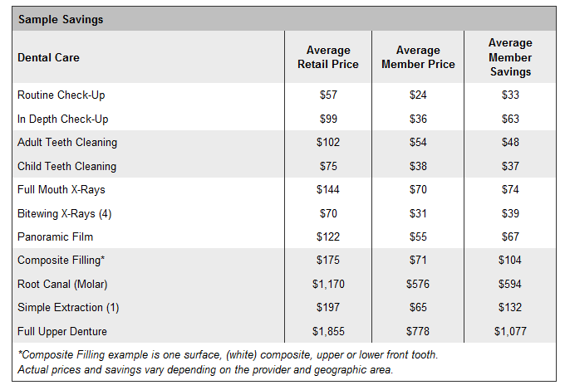
Sample Savings – Dental

Slide 15
Real Solutions for Everyday Health Problems
 | SAVINGS | PROVIDER NETWORK
VISION CARE | 35% off retail price of frames with purchase of complete pair. Discounts on other products and services in the program include exams, lenses, accessories, contact lenses & more. | More than 50,000 participating providers including LensCrafters, Pearle Vision, Target Optical, and independent optometrists, ophthalmologists & opticians
LASIK & PRK VISION | 15% off retail prices and 5% off promotional pricing | More than 600 participating locations
PRESCRIPTIONS | Save up to 75% with average savings of 24% off of the retail price of prescription medications | More than 68,000 participating retail pharmacies, available for residents & their pets
DIABETIC SUPPLIES | Save on prescription and over-the-counter diabetic supplies | More than 68,000 participating retail pharmacies, available for residents & their pets
PREPAID LAB | 20-70% off a wide variety of physician approved lab testing services, with confidential results | More than 4,000 participating service centers
PREPAID DIAGNOSTIC IMAGING | 40-75% off MRI and CT scans | More than 2,900 radiology centers
HEARING | 35% off hearing aid prices & complimentary screenings | More than 3,000 participating locations

Slide 16
Vision Network
EyeMed Vision Care
Save 35% off retail on frames
Save 20% of lenses and lens add-ons
Over 45,000 providers including LensCrafters, Pearle Vision, Sears Optical, Target Optical, JCPenney Optical, and independent optometrists, ophthalmologists, and opticians
Benefit Summary
Visit multiple participating providers at any time, for any reason
No limit to the number of visits
No waiting period, no paperwork to file
Vision Network Exclusions: AK, WA, VT and Puerto Rico

Slide 17
Hearing Network
Connect Hearing
Over 3,000 locations
35% off hearing aids
3 year extended warranties
Complimentary hearing exam, follow up hearing aid fittings & routine cleanings
3 year supply of hearing aid batteries
Price match guarantee
Benefit Summary
One of the largest national networks of independent audiologists
Hearing Savings Network Exclusions: AK, IL, WA, VT & Puerto Rico

Slide 18
Prepaid Lab & Diagnostic Imaging Network
Galaxy Health Network
Over 2,900 radiology centers nationwide
Save 40%-75% off MRI and CT scans
Save 20%-70% off blood tests, allergy tests, cardiac & cholesterol screens, maternity & infertility tests
Benefit Summary
Personalized scan scheduling with a service representative
Lab results are confidential
Results for most tests are available via email within 48 hours (Cultures, reflex and specialty test results typically 14-28 days)
Lab & Diagnostic Network Exclusions: AK, NY, NJ, MA, RI, VT, WA & Puerto Rico

Slide 19
Program Marketing
NEW design for FREE prescription cards
NEW displays & posters
www.NACoHealth.org
NEW plastic membership ID cards & keyfobs for NACo Health Discount Program members

Slide 20
Easy For Residents To Join and Save
Resident Enrollment is easy
Online at www.NACoHealth.org or by phone 1-877-573-2395
Start Saving Today
Check your email for your temporary membership card
Save Again & Again
Check your mailbox for your permanent member materials

Slide 21
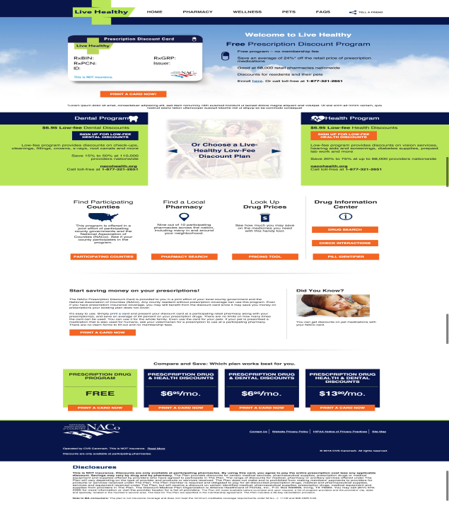
Resources for Residents
Toll-free phone number to the award winning CVS/caremark Customer Care
By visiting www.nacorx.org, residents have access to:
Print ID card
Locate a pharmacy
Check drug pricing

Slide 22
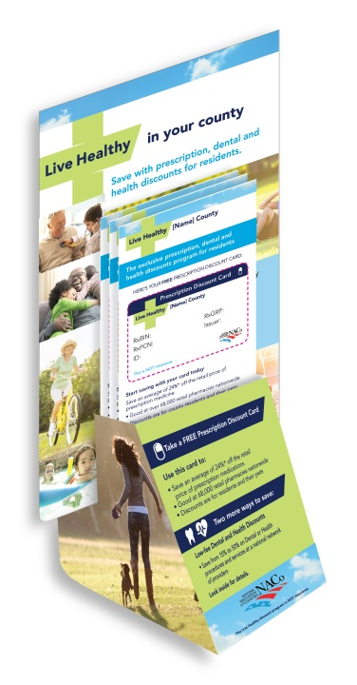
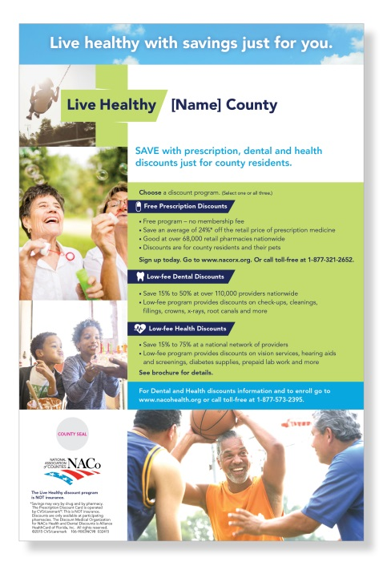
Resident Communication Materials
CVS/caremark continues to provide standard participant materials at no charge to the county
ID card/brochures, posters, display stands, and mailing inserts

Slide 23
County Benefits
No cost to county
Program provided at no cost
Standard marketing materials provided at no cost
Easy to administer
No enrollment paperwork
No eligibility transmission required
NACo and CVS/caremark provide full support for the program
Customer Care managed by CVS/caremark
Proven results
Average savings of 32%*
Over 1,300 counties participate in the program with their residents savings over $633 million dollars on more than 47 million prescriptions*
Savings up to 75%
*Based on 2015 claims adjudicated by CVS/caremark for NACo.

Slide 24
Our Advantages
Experience – Administrating the first and best discount card program since 1992!
Pricing – Our Prescription Discount Card, Dental Discount and Health Discount programs are the best priced program in the country!
Network – Largest prescription discount card network in the nation
Marketing – Extensive marketing support for your county
Resident Support – J.D. Power & Associates #1 award winning support for your residents
Legal Support – Legal expertise regarding U.S. laws and registration requirements.

