Slide 1
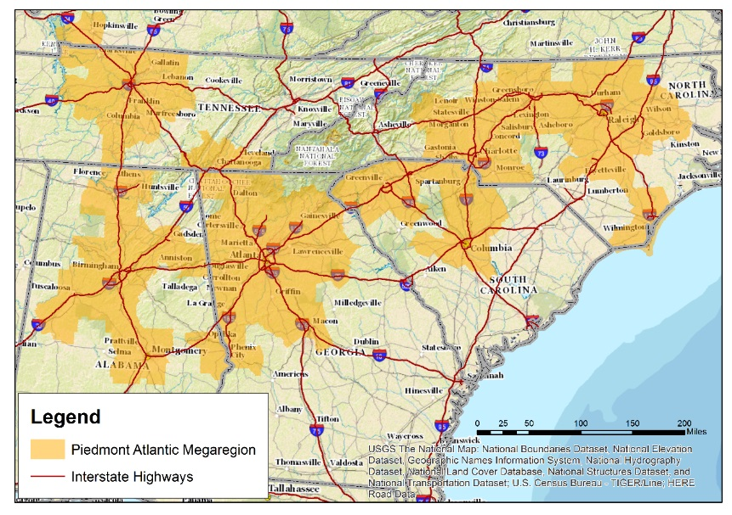
The Emergence of Megaregions and the Connection to Local Economies
National Association of Counties
Transportation Peer Exchange
March 23, 2017
Savannah, Georgia

Slide 2
Overview
Regional Models of Cooperation
Visualizing Megaregions
Summaries from Megaregions Workshops
Spotlight on the Piedmont Atlantic Megaregion
Counties and their role
Resources

Slide 3
Regional Models of Cooperation
Issues Span Organizational Boundaries
International
Borders
Rural Planning
Adjacent TMAs
Intercity Passenger and Rail
Freight Planning
Enhancing Economic Development and Transportation…
…and recognizing mutual needs, goals, and objectives
of the geographic region
as a whole…

Slide 4
Key Issues Surrounding Megaregions
Infrastructure/Congestion
Freight
Environment/Air Quality
Economic Vitality
Safety

Slide 5
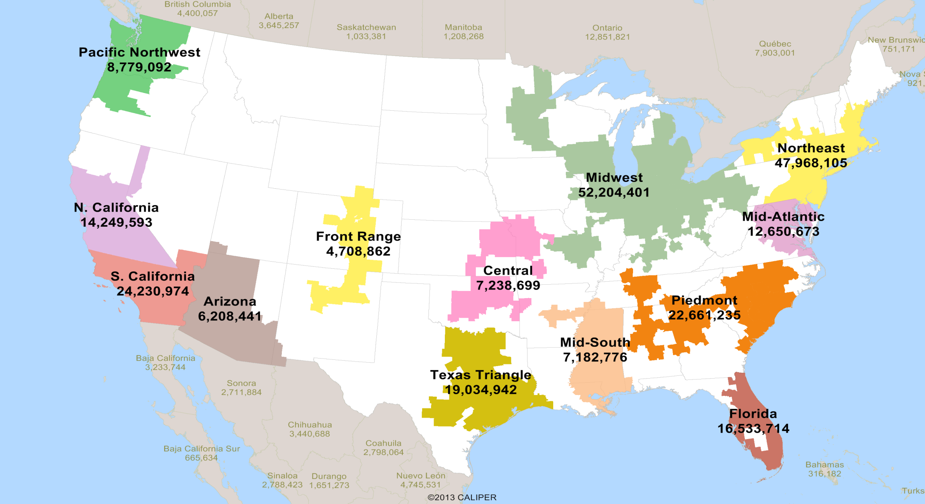
Megaregion Boundaries by Population

Slide 6
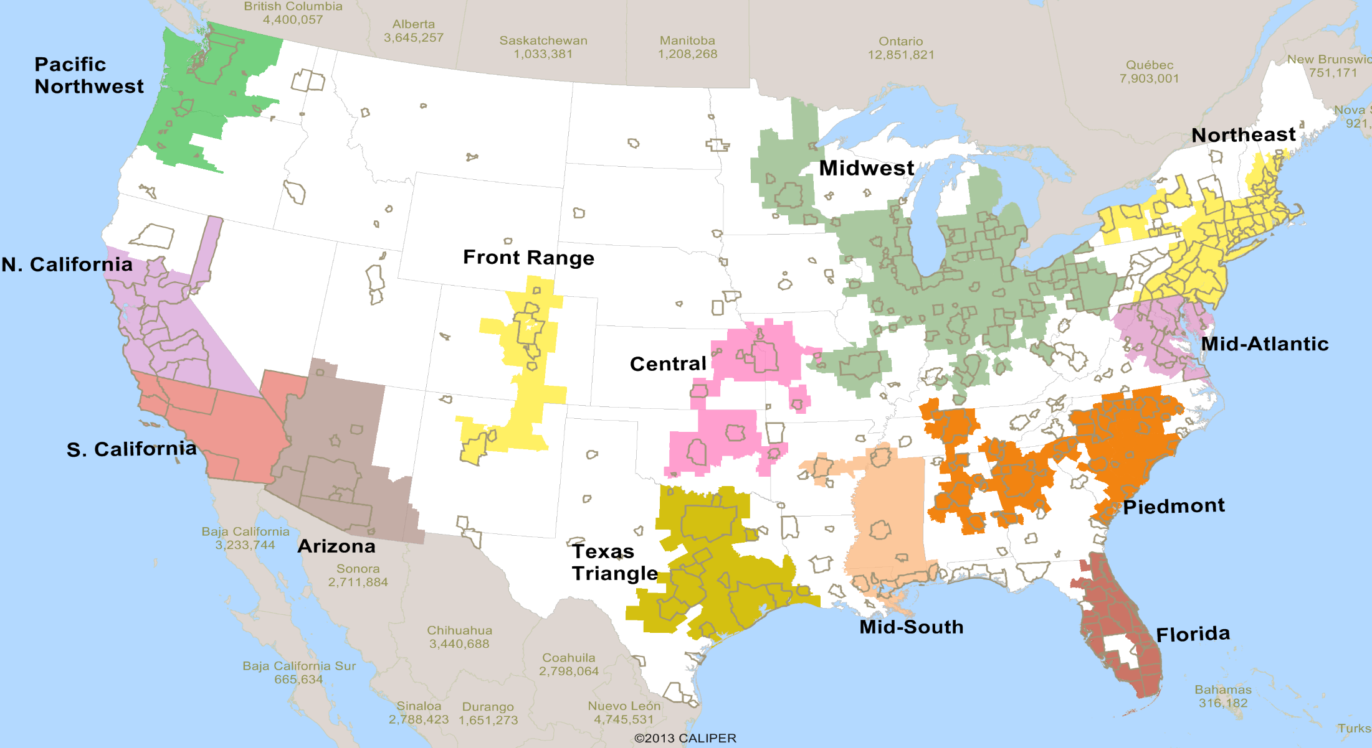
Megaregions and MPO Boundaries

Slide 7
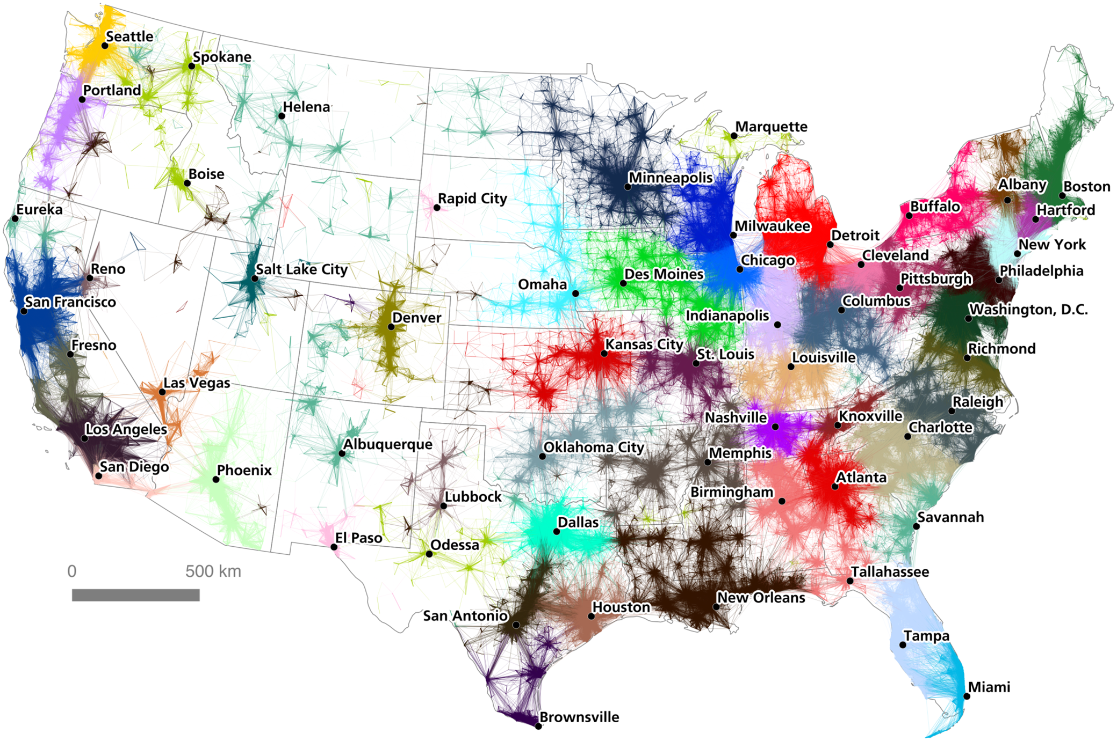
Metropolitan/Megaregional Clusters in the U.S.
Source: Nelson and Rae, Economic Geography of the United States from Commutes to Megaregions, 2016

Slide 8
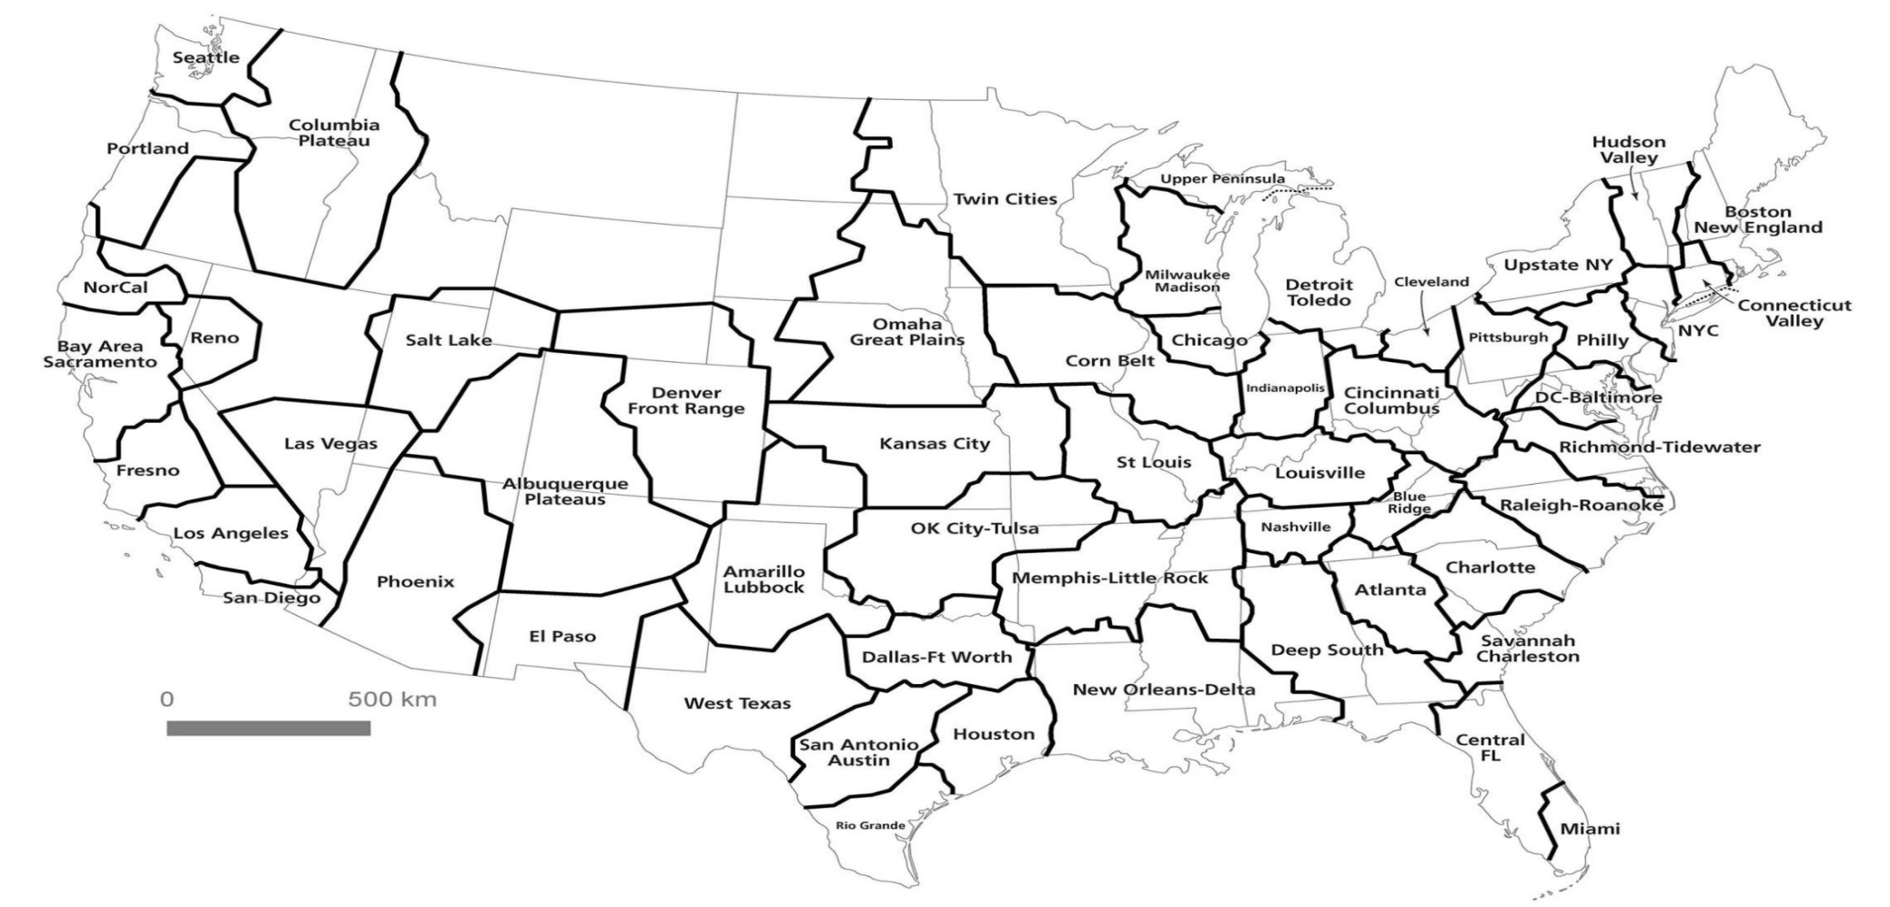
Commuting for Economic Opportunities
Source: Nelson and Rae, Economic Geography of the United States from Commutes to Megaregions, 2016

Slide 9
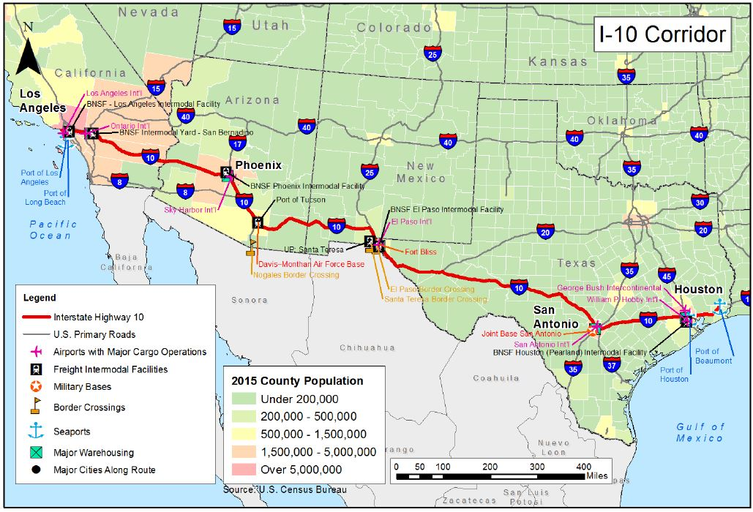
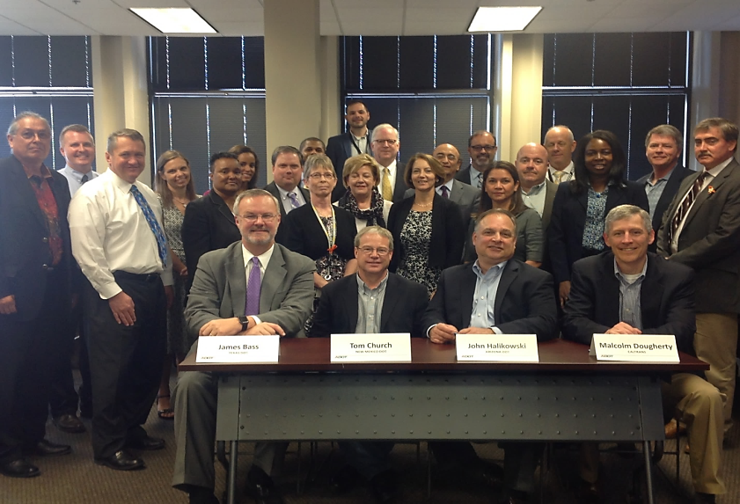
I-10 Corridor Coalition Peer Exchange
Key Points
A shared vision for the I-10 Corridor Coalition by the Chief Executive Officers from each of the four State DOTs
Signature of the coalition charter by each of the four State DOT CEOs
Identify elements of a Concept for Operations (ConOps)
Action plan and next steps to sustain the coalition

Slide 10
Freight and Connected Autonomous Vehicles

Slide 11
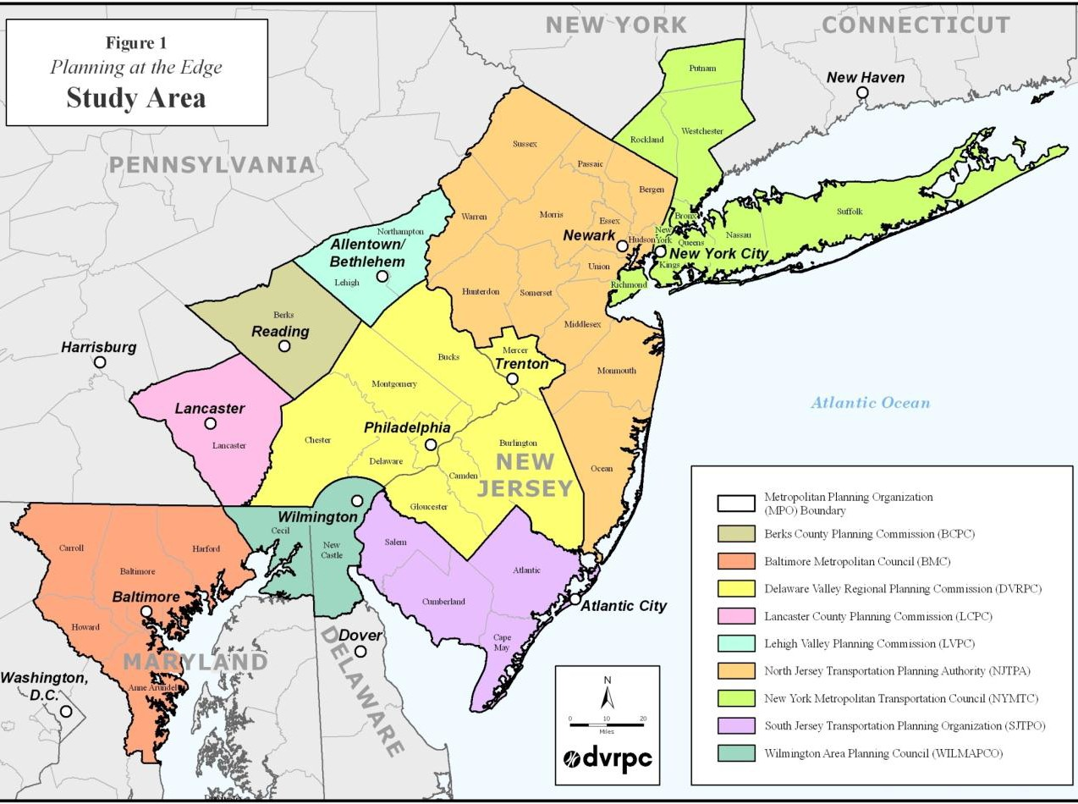
Mid-Atlantic Megaregion: Key Points
Key Points
Opportunities to Share Data and Resources
  Truck Parking Access/Information
  Autonomous Vehicles Technologies
Freight Shipment Information
  Goods O/D and Types of Goods Moving
Impact of Autonomous Trucks on Freight Movement

Slide 12
Focus on Freight

Slide 13
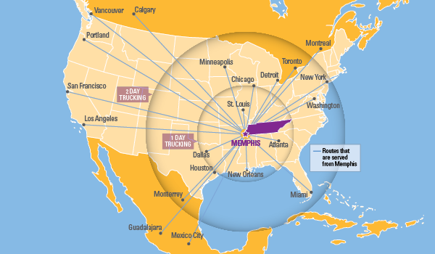
Mid-South Megaregion: Key Points
Agreement among regions on large Federal Projects to increase Competitiveness
Improving Collaboration between States and MPOs, and Freight Shipment Information
  Goods O/D and Types of Goods Moving
Understand various laws impacting technology
Source: Georgia Tech CQGRD

Slide 14
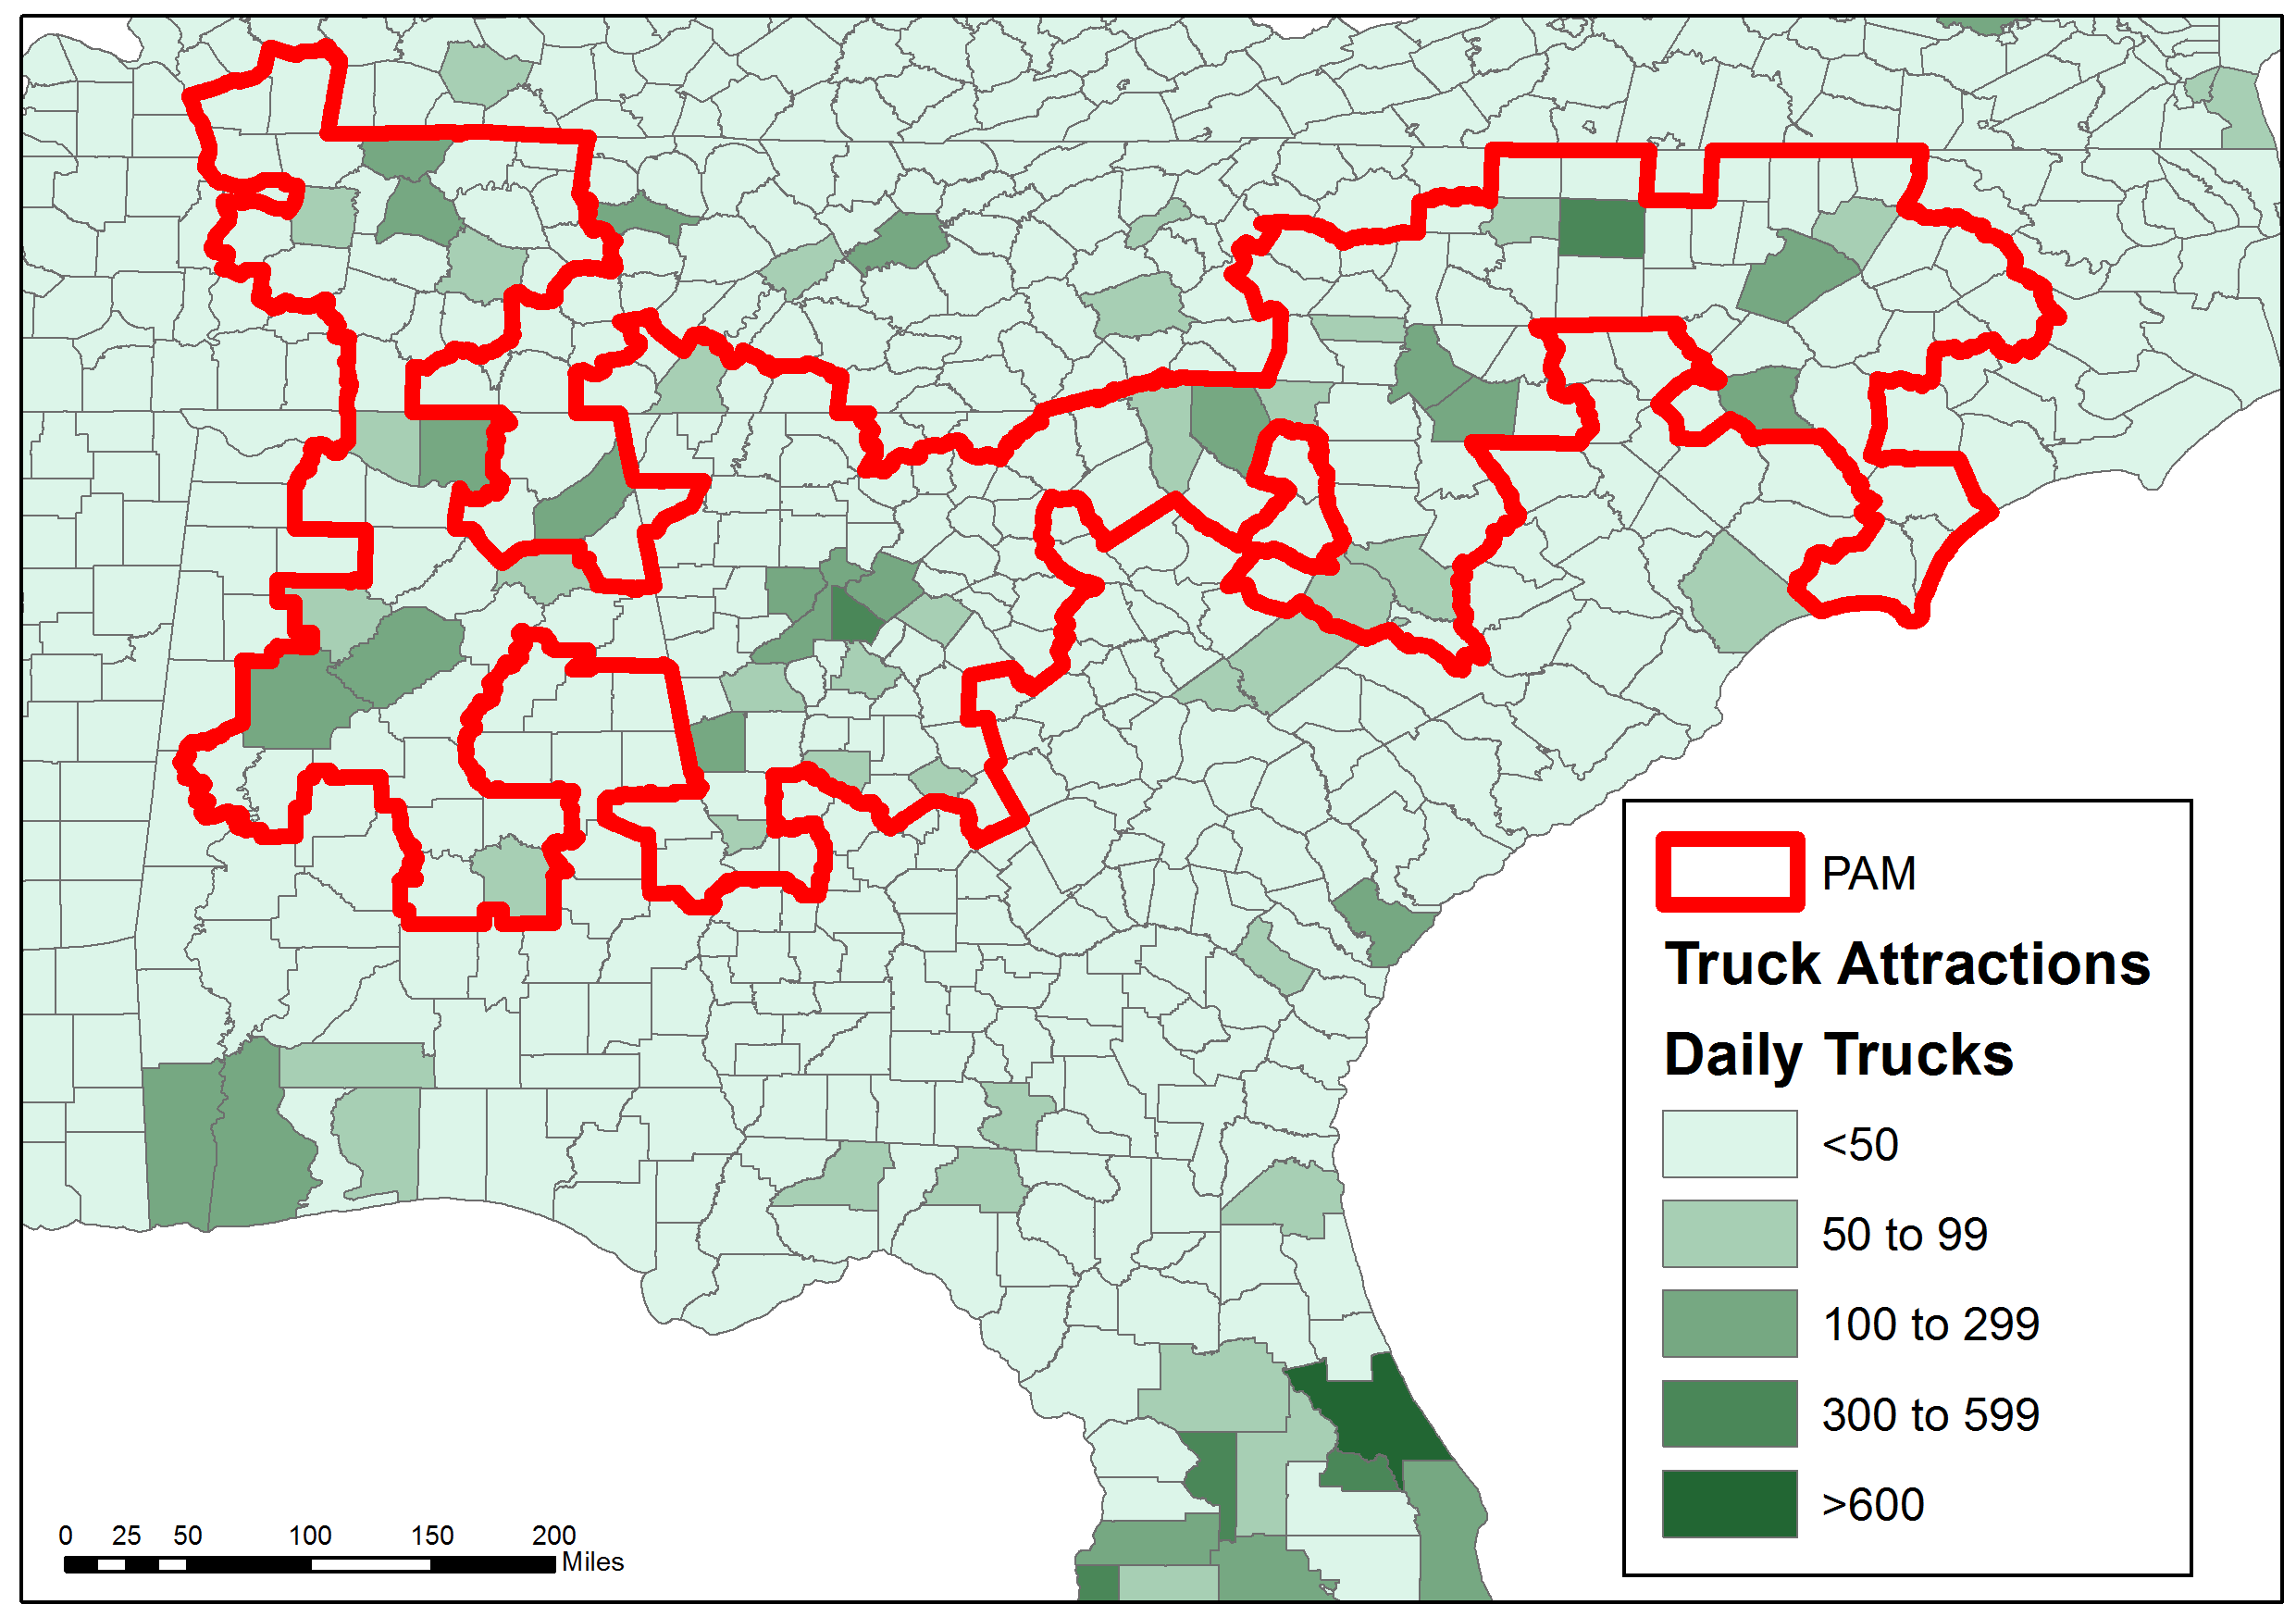
Piedmont Atlantic Megaregion: Key Points
Understanding Private Sector Needs on Goods Movement and the Impact on Transportation/Economic Development
Focus on Corridors of Interest
Implementing steps to Regional Coordination
Source: Georgia Tech CQGRD

Slide 15
Think Globally, Coordinate Regionally, and Act Locally
By the Numbers:
467 Counties Across 5 States
  3000 in the United States
3 Seaports
  Savannah, Charleston, Wilmington
2 Large, World Class Airports
  Atlanta + Charlotte
Major Class I Railroads and Inland Ports
18 Major Interstate Corridors
  I-10, I-16, I-20, I-22, I-24, I-26, I-40, I-55, I-59, I-65, I-69 I-73, I-74, I-75, I-77, I-81, I-85, I-95
Source: Georgia Tech CQGRD

Slide 16
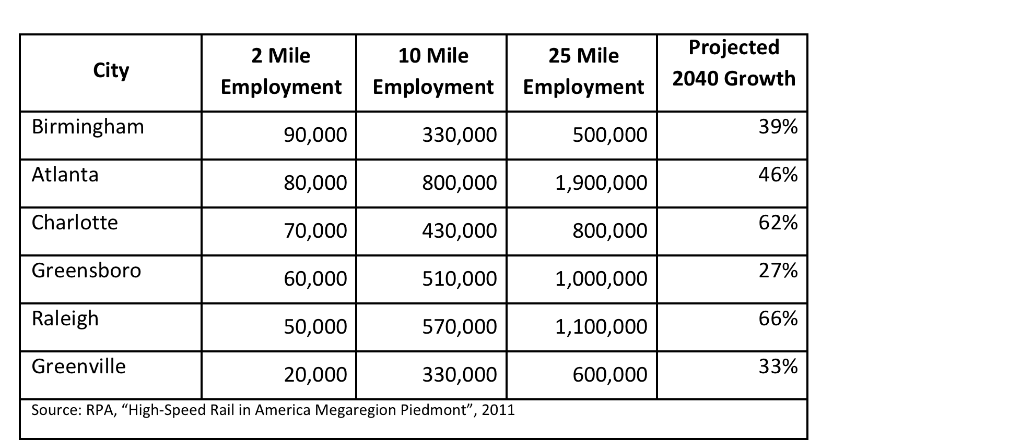
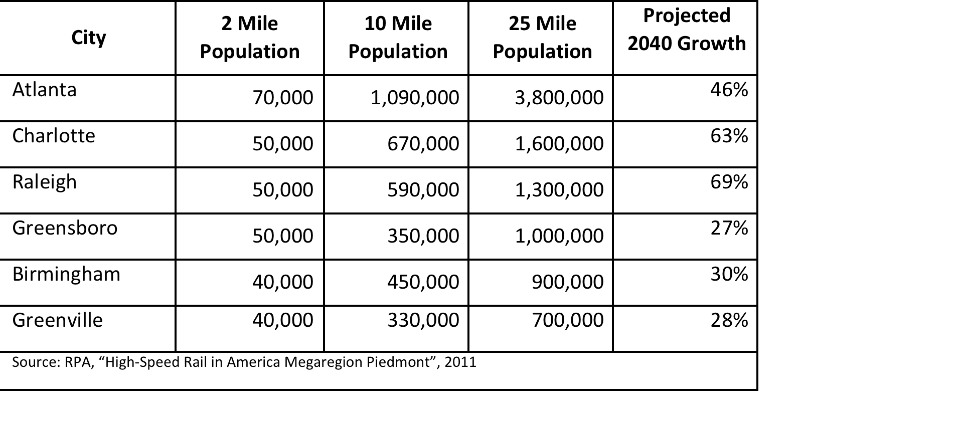
Think Globally, Coordinate Regionally, and Act Locally
PAM Summary Statistics
Population 2010: 17,611,162
Percent of U.S. Population: 6%
Population 2025: 21,687,449
Population 2050: 31,342,393
Projected Growth (2010 - 2050): 78.0% (13,731,231)
2005 GDP: $485,753,000,000
Percent of US GDP: 4%
Source: www.america2050.org

Slide 17
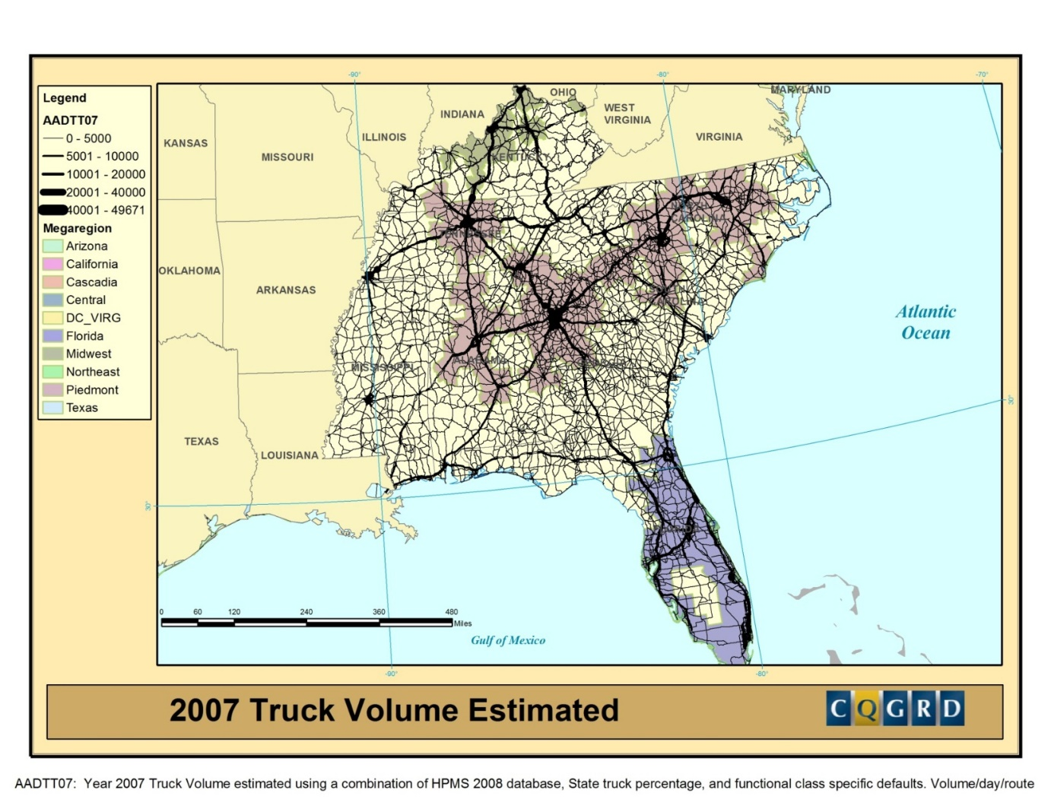

Slide 18
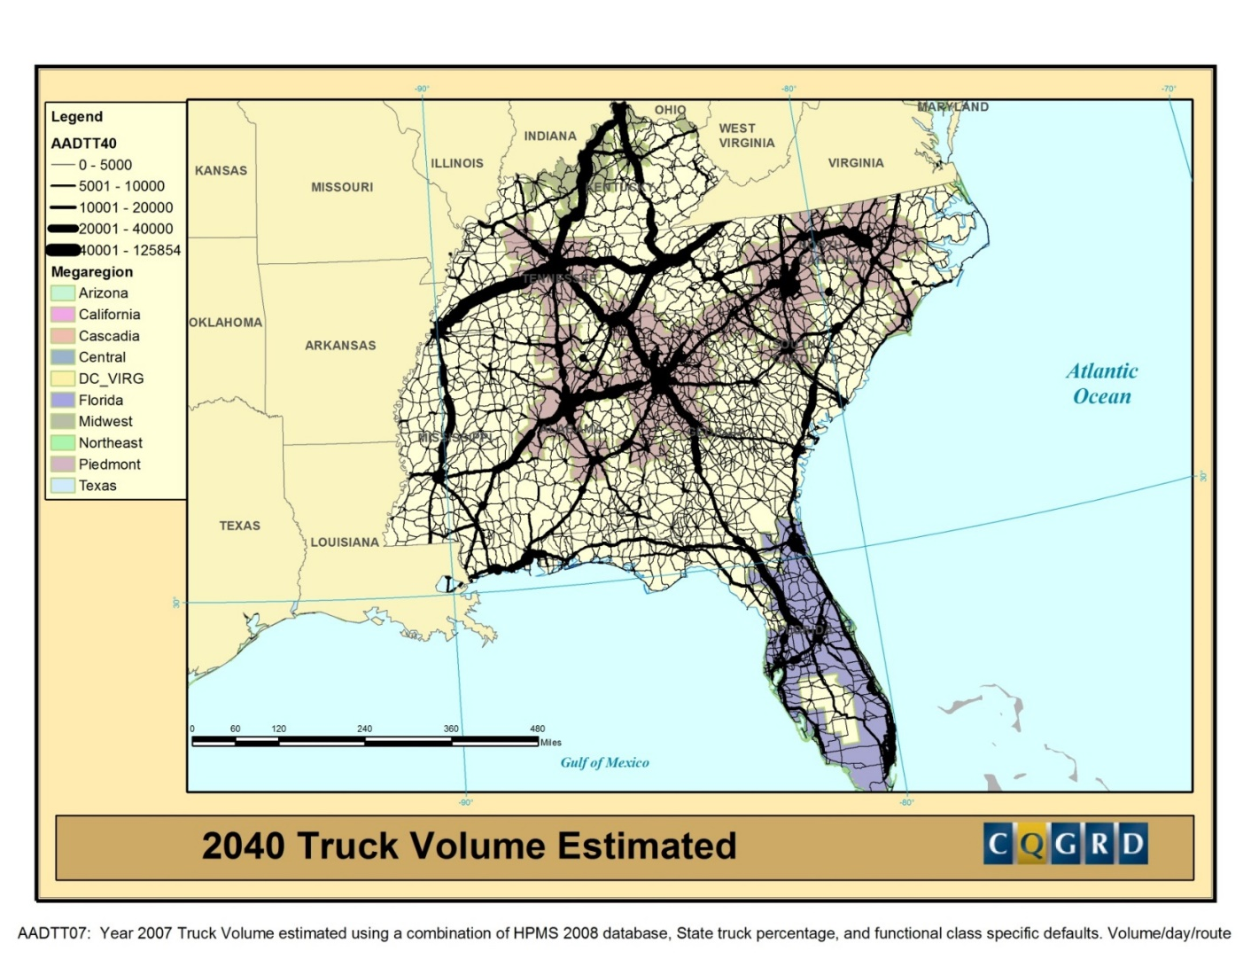

Slide 19
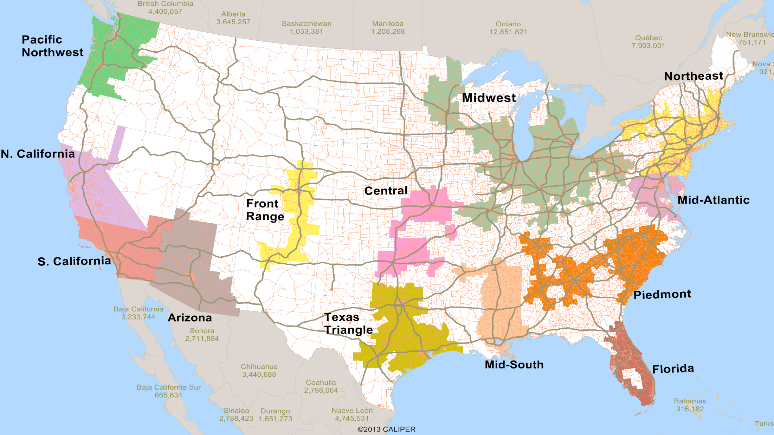
Opportunities for Counties

Slide 20
Counties at the forefront
Address the economic, cultural, demographic, and spatial relationships across borders
Strategies for Freight-Oriented Economic Development (NACo Report)
Urban, Suburban, and Rural representation

Slide 21
Counties at the forefront (continued)
Regional Rural Transportation Planning (NADO Report)
Megaregion v. Non Megaregion Economic Competitiveness (Ross and Wu Study- 2011)
Urban, Suburban, and Rural representation
Improve Regional Collaboration among stakeholders
  Northern California Case Study

Slide 22
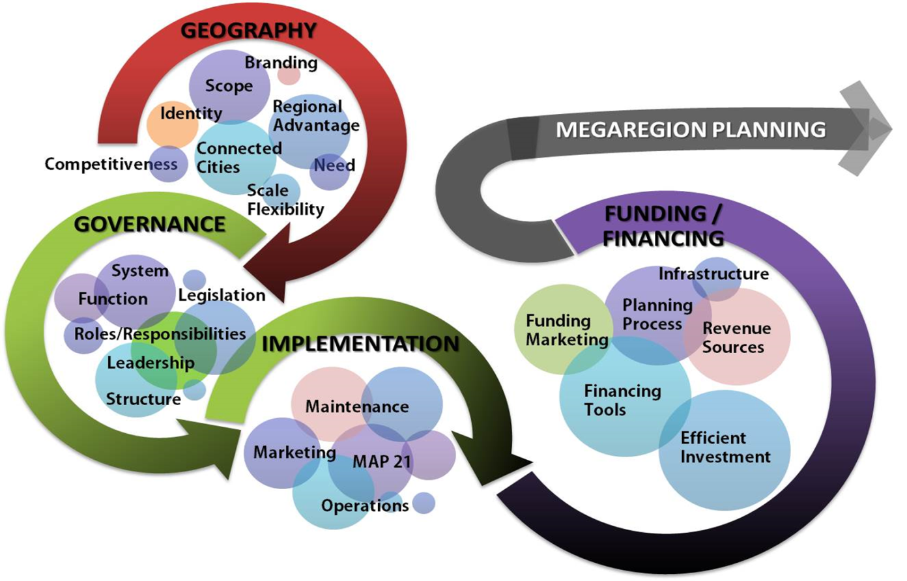
Implementing Megaregions
Work through the Political, Economic, and Technical Issues to Advance Megaregions
Identify Champions and Field Leaders
Fill Critical Research Gaps
  Document and Implement Best Practices
Source: Georgia Tech CQGRD

Slide 23
Getting Engaged- Planned Megaregions Workshops
Coming Soon
  Northeast (PA, NY, NJ, CT, RI, MA, VT, NH, ME)
    Early Summer 2017; Location TBD: Topic Freight/ED
  Central Plains/Midwest (IA, IL, KS, MO, NE)
    Early Summer 2017; Kansas City, MO: Topic TBD
  Great Lakes/Chicago (IA, IL, IN, MI, MN, MO, WI)
    August 28-29, 2017; Chicago: Topic: Freight/ED
  Texas
    Early Fall 2017; Location TBD: Topic TBD
Additional Partnership Opportunities
  Midwest (MI, OH, PA, WV)

Slide 24
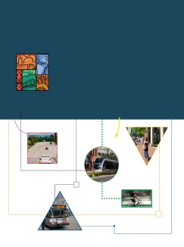
FHWA Resources Available
Megaregions Case Studies and Homepage
  www.fhwa.dot.gov/planning/megaregions
Regional Models of Cooperation Homepage
  www.fhwa.dot.gov/planning/regional_models/
  Regional Models of Cooperation Handbook- NEW
Planning Capacity Building website
  www.planning.dot.gov
PlanWorks https://fhwaapps.fhwa.dot.gov/planworks/
Briefing Book for Transportation Planning Officials
  http://www.fhwa.dot.gov/planning/publications/briefing_book/fhwahep15048.pdf

Slide 25
James Garland
FHWA Office of Planning
Planning Capacity Building Team
Washington, DC
202-366-6221 Office
James.Garland@dot.gov
www.planning.dot.gov
www.fhwa.dot.gov/planning/megaregions

