Slide 1
FASTLANE Grants, Freight, Megaregions, Innovation, and more….
National Association of Counties Transportation Peer Exchange
Savannah, GA
March 24, 2017
Notes:
Good afternoon and thanks for being here.

Slide 2
FASTLANE Grants Overview
$4.5 billion authorized through FY 2020
$850 million for FY 2017
25 percent for rural projects
90 percent for large projects
10 percent for small projects
Not more than $500 million in aggregate of the $4.5 billion for FY 2016 – 2020 can be used for freight rail, ports, or intermodal projects
Approximately $326 million is still available
Notes:
The FAST Act established the Nationally Significant Freight and Highway Projects (NSFHP) program to provide funding to projects of national or regional significance that address critical freight and highway issues
We’re calling these FASTLANE grants.
The NSFHP program provides an opportunity to address challenges across the nation’s transportation system including:
Improving highways and bridges on the National Highway System
Reducing highway congestion and bottlenecks;
Enabling more efficient intermodal connections; minimizing delays at international borders;
improving inadequate first and last mile segments;
modernizing port facilities to meet 21st Century demands, including connections between ports and their surface transportation systems;
improving grade crossings;
and addressing the impact of population growth on the movement of people and freight.
The program was authorized at $4.5 billion for fiscal years 2016 through 2020, including $800 million for this year.
Of these authorized funds, 25 percent – about $190 million this year – will be spent on projects located in rural areas
For the purposes of FASTLANE grants a rural project is one outside a Census designated urbanized area with 200,000 or more people. If you are a suburb of a large metro area, please review this carefully. If your project is located within the boundary of an urbanized area of 200,000 or more, you will be considered urban for the purpose of a FAST LANE grant – even if your town has fewer than 200,000 people. Cost share and minimum grant awards are the same for rural and urban projects.
Ten percent – about $76 million – is reserved for small projects and we’ll go over what constitutes a rural project in a few slides. .
Under statute, not more than $500 million in aggregate over the five years of the authorized program may be used for grants to freight rail, port, or intermodal projects and these projects must make significant improvements to freight movement on the National Highway Freight Network.
There are few notable exceptions to projects that count toward the cap. Grade crossing and grade separation either for highway-railway or rail/rail don’t count toward the $500 million maximum for freight rail, port, or intermodal projects.
Additionally, only the non-highway portion(s) of multimodal projects count toward the $500 million maximum – so if your project includes multiple components, some of which would count toward the $500 million maximum, we ask that you clearly identify those in your application.

Slide 3
Eligible Applicants
State(s)
Metropolitan Planning Organizations with 200,000 population
Local Government(s)
Political subdivision(s) or State or local government
Public authorities (including port authorities) with a transportation function
Federal land management agencies applying jointly with a State(s)
Tribal government/consortiums
Multi-State or multijurisdictional group of public entities
Notes:
Eligible applicants are:
a State or group of States
MPOs that serve an urbanized area with 200K plus
Local government or political division of state or local government
Special purpose public authority like a port authority
Federal land management agency that applies jointly with a State
Tribal government
Multi-state or Multijurisdictional group
If applying as part of a Multi-State or multijurisdictional group, your application should identify a lead applicant as a POC for the application.

Slide 4
Eligible Projects
Highway freight projects carried out on the National Highway Freight Network
Highway or bridge projects carried out on the National Highway System, including:
Projects that add Interstate System capacity to increase mobility
Projects located in a national scenic area
Railway-highway grade crossing or grade separation projects
Other freight projects that are:
Intermodal/rail freight project
Within the boundaries of a public or private freight rail, maritime (including ports) or intermodal facility
Notes:
Eligible projects for FASTLANE grants are:
Highway freight projects carried out on the National Highway Freight Network;
Highway or bridge projects carried out on the National Highway System (NHS
Railway-highway grade crossing or grade separation projects;
Intermodal, freight rail, or port project, or 2) within the boundaries of a public or private freight rail, water (including ports), or intermodal facility.
A freight rail, port, or intermodal facility must be a surface transportation infrastructure project necessary to facilitate direct intermodal interchange, transfer, or access into or out of the facility and must significantly improve freight movement on the National Highway Freight Network.
For a freight project within the boundaries of a freight rail, water (including ports), or intermodal facility, Federal funds can only support project elements that provide public benefits.

Slide 5
Grant Amounts and Cost Share
Minimum FASTLANE Grants
$25 million for large projects
$5 million for small projects
Cost Share
Up to 60 percent FASTLANE grants
Up to 80 percent total Federal
Previously incurred expenses cannot count toward cost share
Notes:
For large projects with a minimum project size of $100 million, the minimum award is $25 million.
For small projects, the minimum award is $5 million.
FASTLANE grants may be used for up to 60 percent of future project costs. And total Federal assistance may not exceed 80 percent of costs.
Non-Federal sources include State funds originating from programs funded by State revenue, local funds originating from State or local revenue funded programs, private funds or other funding sources of non-Federal origins.
If funds originate from a Federal source – even if the State or a local government is providing them – they are still considered Federal funds.
Unless otherwise authorized in statute, local cost-share may not be counted as non-Federal share for both the NSFHP and another Federal program.
For any project, the Department cannot consider previously incurred costs towards the matching requirement. This means we’re going to be looking carefully at an applicant’s budget to make sure they meet all statutory requirements.

Slide 6
Eligible Project Costs
Development phase activities, including planning, feasibility analysis , revenue forecasting, environmental review, preliminary engineering, design work, and other pre-construction activities
Construction activities including new construction, reconstruction, rehabilitation, property or equipment acquisition, environmental mitigation, construction contingencies, and operational improvements
Notes:
FASTLANE grants can support development phase activities and construction.
Development phase activities include planning, feasibility analysis , revenue forecasting, environmental review, preliminary engineering, design work, and other pre-construction activities
Construction activities including new construction, reconstruction, rehabilitation, property or equipment acquisition, environmental mitigation, construction contingencies, and operational improvements
Please note, however, that one statutory requirement for project selection is that the project be based on preliminary engineering. While development phase activities are eligible project costs, to be considered for selection, some level of environmental analysis and preliminary engineering must be undertaken prior to the application. The Department will evaluate the level of completion of development phase activities to assess project readiness and risk – which I’ll get into more in a bit.

Slide 7
FY17 FASTLANE Application Deadline
December 15, 2016 8:00 PM EST: Applications submitted to www.Grants.gov
Notes:
If you think you’ll apply, we ask that you email FASTLANEgrants@dot.gov by March 25 with your project name, cost, and a 2-3 sentence description. This is not a requirement for submission.
Applications must be submitted by 8:00 p.m. EDT on April 14, 2016. The Grants.gov “Apply” function will open by March 15, 2016.
Applications must comply with all requirements set forth in the Notice of Funding Opportunity and be submitted through www.Grants.gov to be eligible for award.
Applications received after the deadline will not be considered except in the case of unforeseen technical difficulties outlined in the Notice of Funding Opportunity.

Slide 8
More information
Visit: www.transportation.gov/buildamerica/FASTLANEgrants
Email: FASTLANEgrants@dot.gov
FHWA Point of Contact:
Crystal Jones, Office of Freight Management and Operations (Crystal.Jones@dot.gov)
Notes:
The Department will regularly post answers to frequently asked questions on the program’s website. Guidance, webinar registration, and other importation information is also available.at www.transportation.gov/FASTLANEgrants
If your question is not addressed or you would like to contact the Department, please email FASTLANEgrants@dot.gov

Slide 9
Advancing Innovation
What are some critical freight projects and initiatives in your area?
Can these projects support larger (regional, megaregional) goals and activities?
Who in your region is best suited to lead a Megaregions effort?
What partnerships work best?

Slide 10
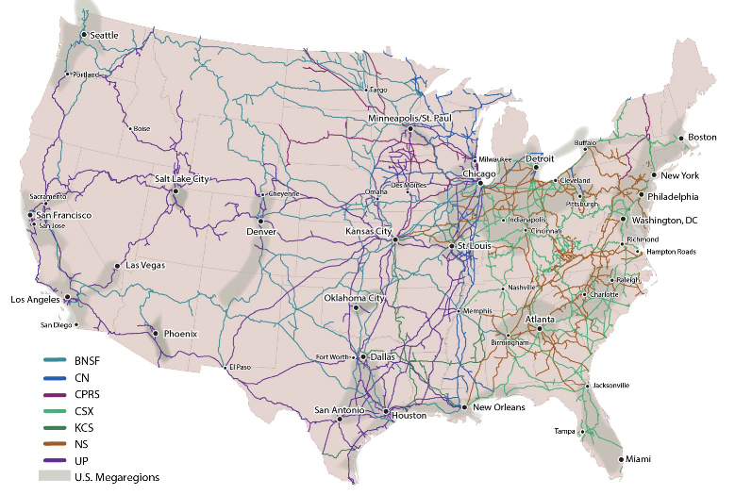
Challenges Facing PAM: Railway Infrastructure
Facts on U.S. railroads:
139,000 miles of track
$68.9 billion of revenue annually
Railroads offer capacity to accommodate future freight increases.
88% of railroads under capacity (2007)
By 2035, 45% projected to be under capacity.
Investment required to accommodate projected freight increases.
Source: Federal Railroad Administration

Slide 11
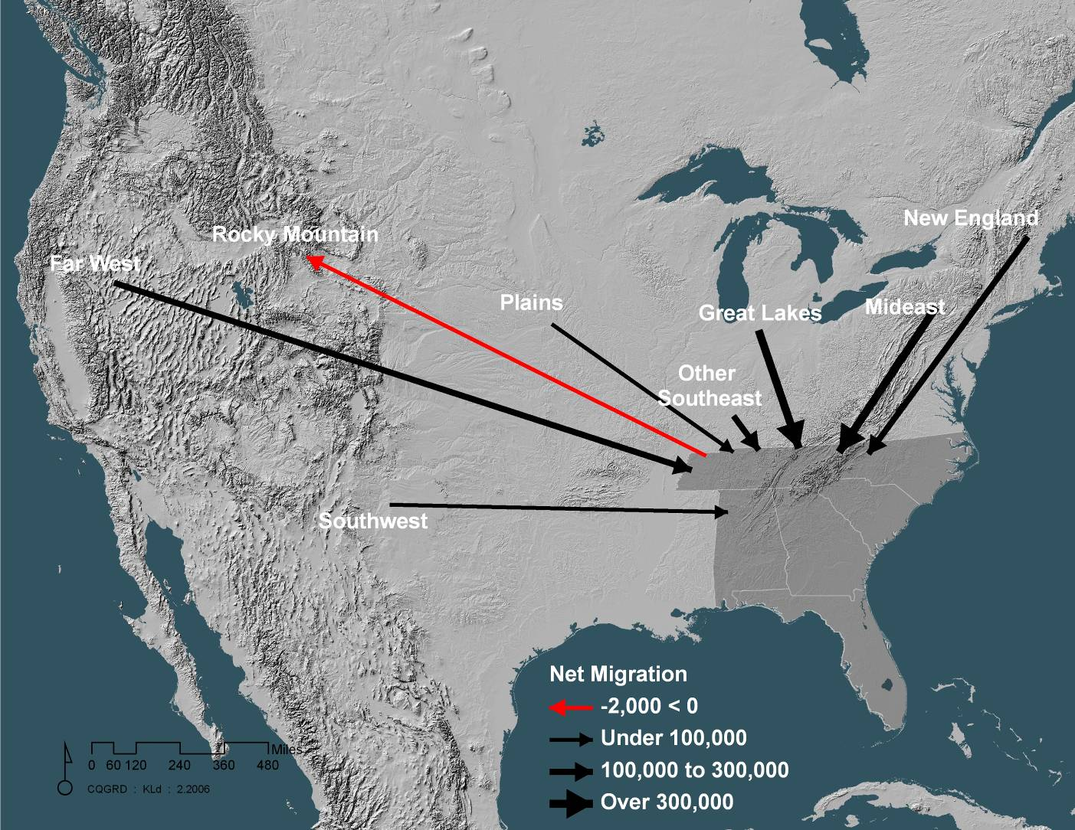
Piedmont-Atlantic Megaregion: Migration Trends 1995 to 2000
1.6 million people moved to PAM from the rest of the country.
1.3 million people migrated to PAM internationally.
Source: US Census Bureau
Source: U.S. Census Bureau
Notes:
In just 5 years, 2.9 million people moved to PAM, with just over half from other parts of the US and the rest coming from other countries.

Slide 12
Memphis Spotlight- Freight Committee Membership
Just a few listed here………….

Slide 16
Mid-South Megaregion Workshop Feedback **Important ideas gained from workshop**

Slide 17
Mid-South Megaregion Workshop Feedback **Additional FHWA efforts to support megaregions**

Slide 18
Mid-South Megaregion Workshop Feedback **Suggestions for megaregions in development of planning and projects**

Slide 19
Mid-Atlantic Megaregion Workshop Feedback **Important ideas gained from workshop**

Slide 20
Mid-Atlantic Megaregion Workshop Feedback **Additional FHWA efforts to support megaregions**

Slide 21
Mid-Atlantic Megaregion Workshop Feedback *Suggestions for megaregions in development of planning and projects*

Slide 22
Advancing Innovation
What are some critical freight projects and initiatives in your area?
Can these projects support larger (regional, megaregional) goals and activities?
Who in your region is best suited to lead a Megaregions effort?
What partnerships work best?

Slide 23
Thank You
James Garland
Planning Capacity Building Team
FHWA Office of Planning
202-366-6221 Office
James.Garland@dot.gov
www.planning.dot.gov
www.fhwa.dot.gov/planning/megaregions

