Slide 1
ATF and ESF #13

Slide 2
FOUR PRIORITIES GUIDE DOJ
Protecting Americans from Terrorism
Protecting Americans from Violent Crime
Protecting Americans from Financial Fraud
Protecting the Most Vulnerable Members of Our Society
ATF IS WORKING WITH DOJ TO SERVE AS THE
PLATFORM TO IMPACT and REDUCE VIOLENT CRIME

Slide 3
SMART ON CRIME - FRONTLINE

Slide 4
FRONTLINE
Bureau of Alcohol, Tobacco, Firearms and Explosives
Primary Mission: PROTECT AMERICANS from violent gun crime, acts of arson, and the criminal misuse of explosives; and to regulate the firearms and explosives industries

Slide 5
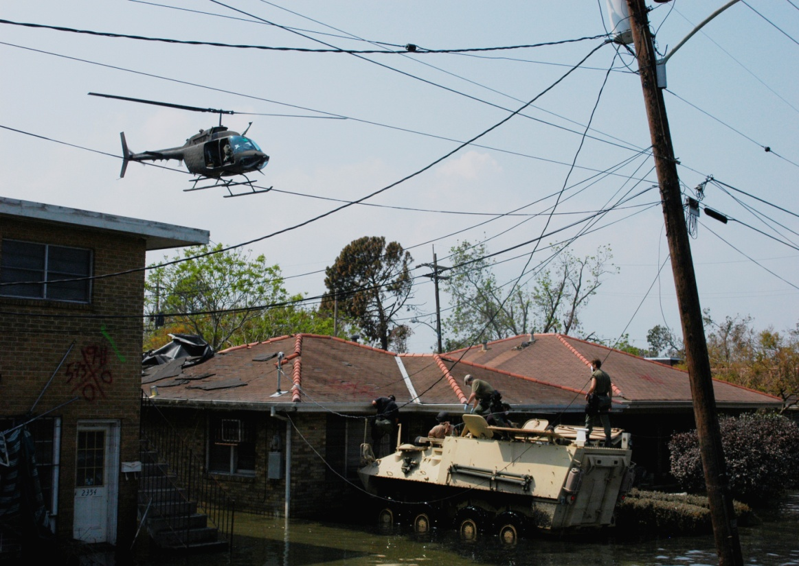
EMERGENCY SUPPORT FUNCTION #13

Slide 6
FEMA ESF Structure
#1 – Transportation
#2 – Communications
#3 – Public Works and Engineering
#4 – Fire Fighting
#5 – Emergency Management
#6 – Mass Care, Em Assistance, Housing and Human service
#7 – Logistics and Resource Support
#8 – Public Health and Medical Services
#9 – Search and Rescue
#10 – Oil and Hazardous Materials Response
#11 – Agriculture and Natural Resources
#12 – Energy
#13 – Public Safety and Security
#14 – Long Term Community Recovery
#15 – External Affairs

Slide 7
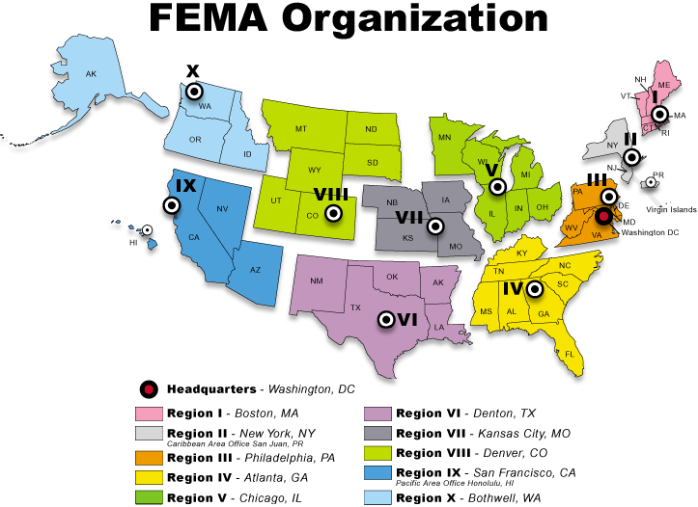
FEMA Organization

Slide 8
ESF#13 Operations
National Coordination Center (NCC)
ATF National Commander
National Response Coordination Center (NRCC)
ESF#13 representative
Regional Response Coordination Centers (RRCC)
Regional Law Enforcement Coordinators (SAs)
Field Coordinators (Civilian Contractors)
Joint Field Offices (JFO)
Law Enforcement Staging Areas (LESA)

