Slide 1
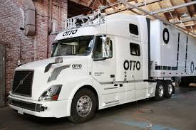
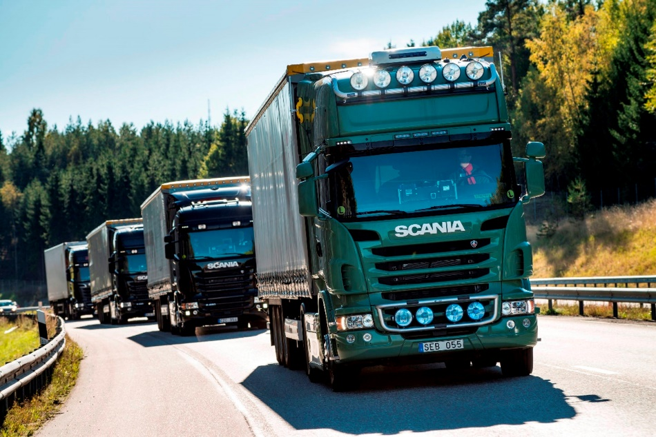
Transportation Peer Exchanges on Freight and Connected and Automated Vehicles
National Association of Counties
Savannah, Georgia
March 23 and 24, 2017
Steve Brown, Commissioner
Fayette County, Georgia

Slide 2
Points to consider …
Who has jurisdiction over vehicles?
- National Highway Traffic Safety Administration (NHTSA) – Vehicle
- State Governments - Drivers
How will autonomous vehicles affect mass transit decisions?
How will autonomous vehicles affect local revenue streams? Traffic fines? Less vehicles to collect tax on? Infrastructure (road quality) cost?

Slide 3
Points to consider …
Could states and counties lose authority over traffic law?
- No traffic signals scenario?
Can civil liberties be protected?
What will be the impact on employment?
Does autonomous freight mean less traffic congestion, safer travel?

Slide 4
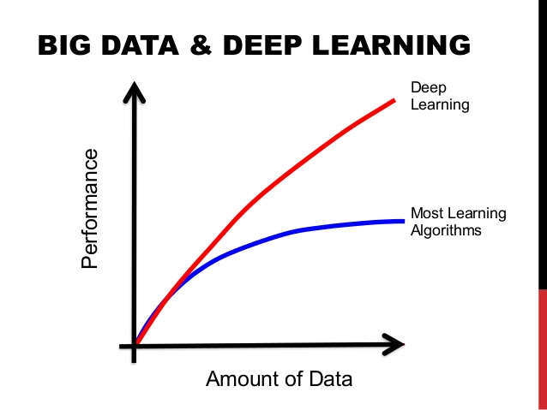
Vehicles learning to drive …
Artificial intelligence
“Deep learning”

Slide 5
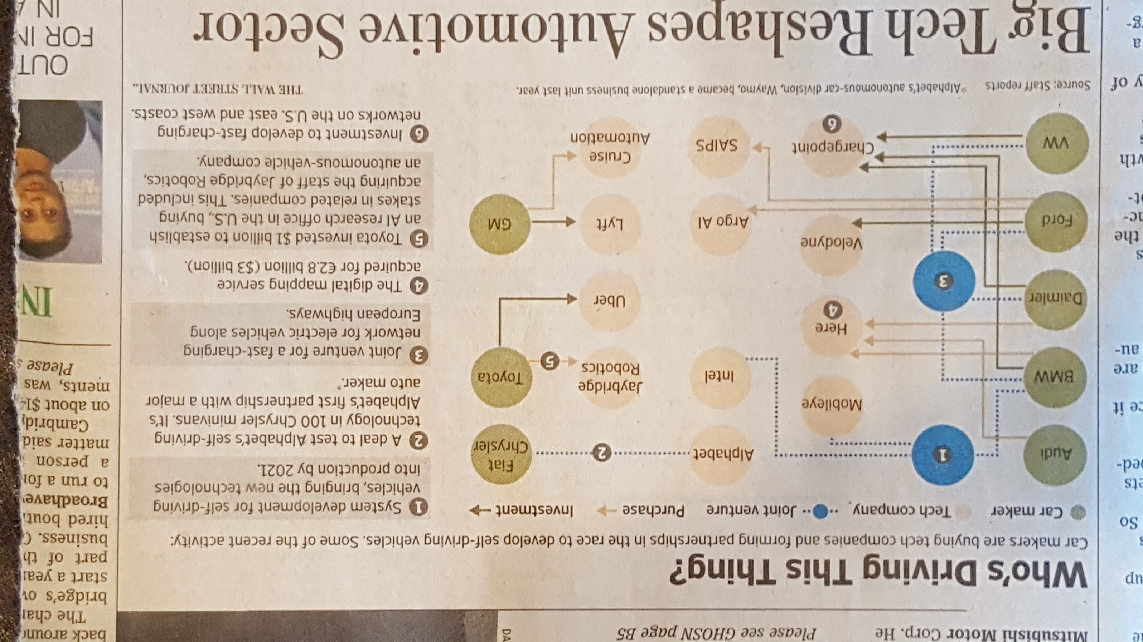

Slide 6
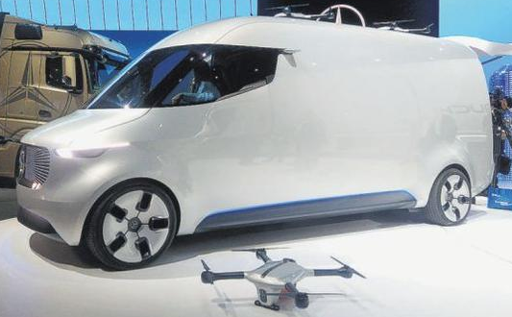
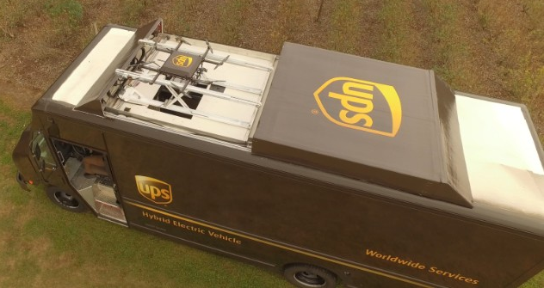
End User Delivery
Self-driving delivery robots (Virginia)
Drone deployment
Van Drones (Daimler)
Starship Technologies
Daimler

Slide 7
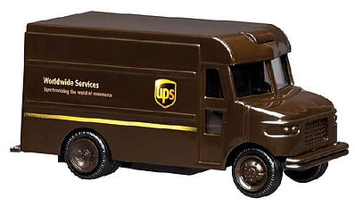
3
4
2
1
5
Five packages delivered from one location…

Slide 8
End User Delivery
Amazon Airship Warehouses/Drones

Slide 9
Autonomous Freight
The low-hanging fruit of the industry with the greatest gain.
In the United States, 68.9% of all freight tonnage is moved on the nation’s highways.

Slide 10
Autonomous Freight
The industry was short an estimated 48,000 drivers in 2015
If the trend holds, with the average age of truck drivers climbing, the shortage may balloon to almost 175,000 by 2024

Slide 11
Autonomous Freight
According to the American Transportation Research Institute (ATRI), 34% of trucking’s operational costs per mile is driver pay, which, with the recent drop in fuel prices, is quickly putting driver pay as the largest operational cost.
Physical limitations of long-haul drivers (fatigue) slows freight movement and can compromise safety on highways

Slide 12
Autonomous Freight
Utilize unused night-time highway capacity
Improved traffic flow during the day
Fuel saving cost from platooning vehicles
Can accommodate extended haul routes
Significant boost to the economy

Slide 13
Cost Savings
- Fuel
- Personnel
Improved Safety
Less Traffic Congestion
Better Use of Infrastructure
More Freight Delivered Faster
Benefits

Slide 14
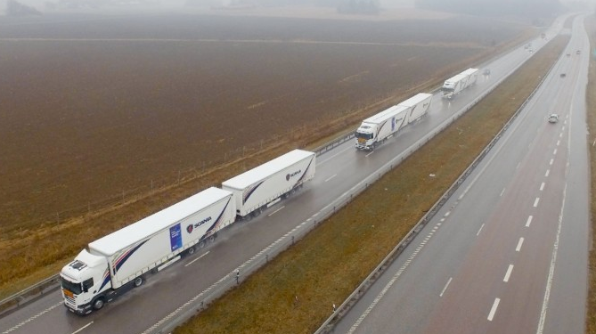
2016 - EU Truck Platooning Challenge
Six semi-autonomous vehicles drove in a convoy
1,300 miles
Crossed four national borders
“Slipstreaming” = improved fuel efficiency

Slide 15
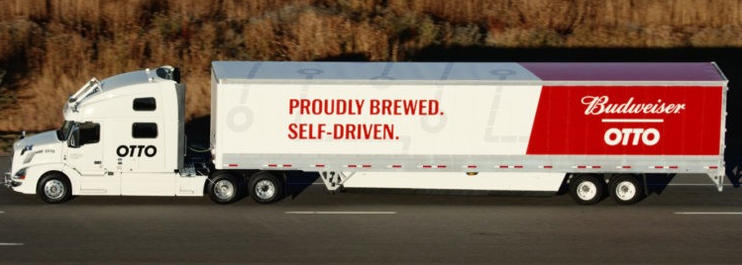
2016 – First Otto Delivery
World’s first delivery via autonomous vehicle
Delivery was 120 miles on Colorado roads
Driver was in the sleeper compartment during operation

Slide 16
Hub and Spoke – we have the capability now…
Autonomous on the highway
Human driver in the urban setting

Slide 17
Future Issues
Can Vehicle-to-Infrastructure be sustained?
How to protect Vehicle-to-Vehicle and Vehicle-to-Infrastructure from being hacked?
Reaction from labor unions
State acceptance of allowing the technology on the roads

Slide 18
Steve Brown, Commissioner
Fayette County Board of Commissioners
CommissionerBrown@fayettecountyga.gov
(404) 798-0587

