Slide 1
Crisp County Regional Projects
Mr. Tom Patton, County Manager
Mr. Grant Buckley, Esq., Executive Director, Cordele-Crisp IDC
National Association of Counties Transportation Peer Exchange Meeting
Savannah, Georgia
March 23, 2017

Slide 2
3 Topics
Regional T-Splost
South Georgia Railroad Coalition
Cordele Inland Port®

Slide 3
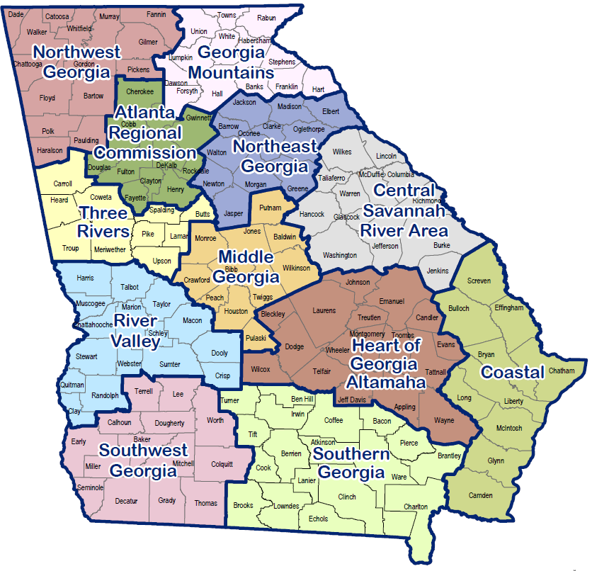
Regional T-Splost 2013-2023

Slide 4
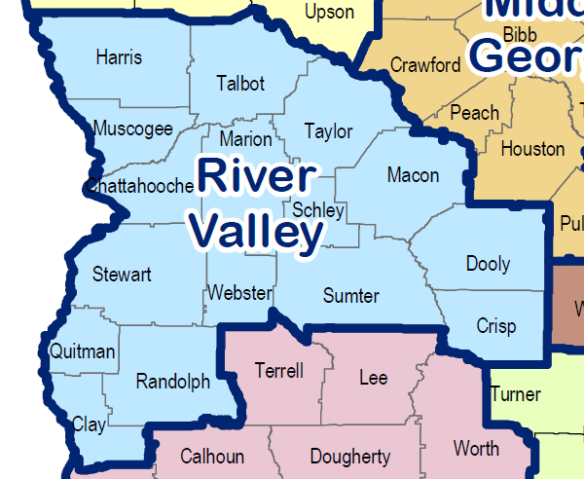
2 Parts
75% Constrained Projects: $200,000,000
25% Unconstrained: $60,000 per month county projects

Slide 5
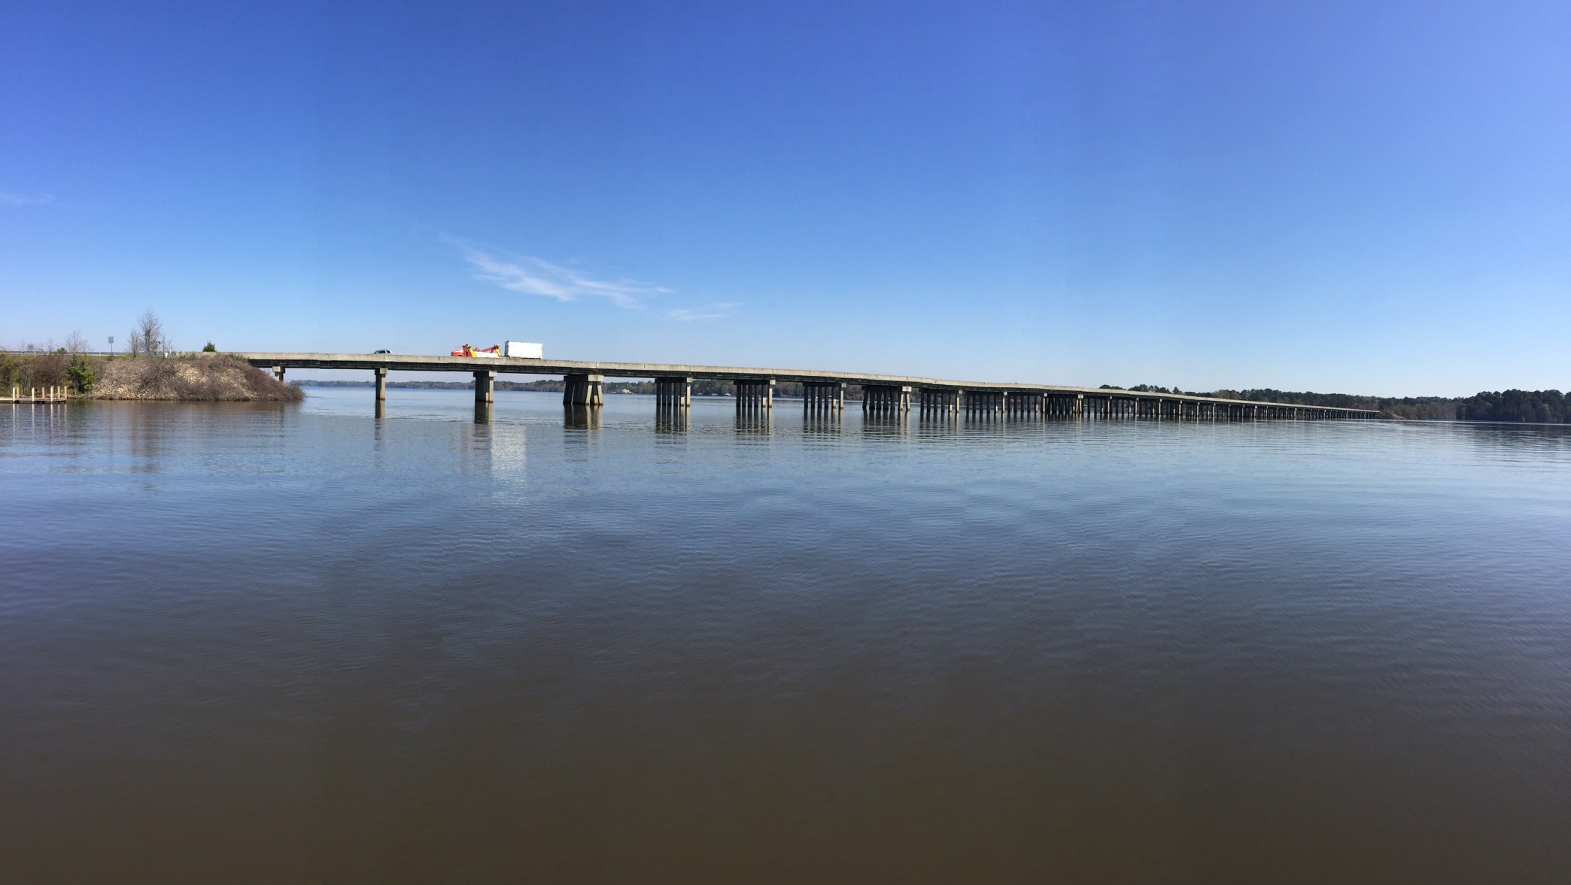

Slide 6
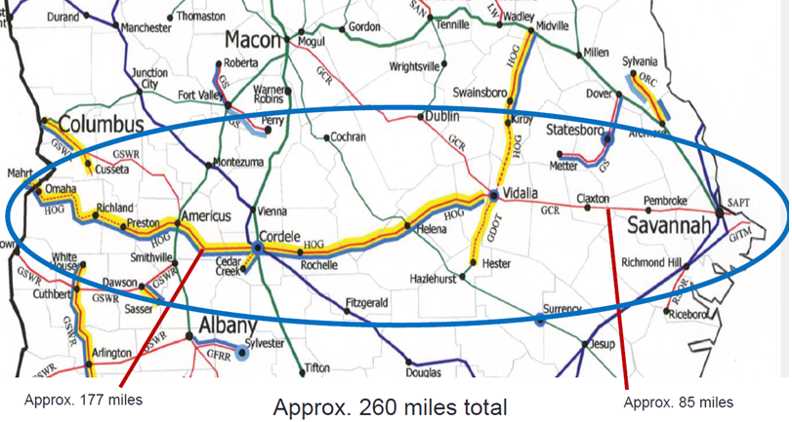
South Georgia Railroad Coalition

Slide 7
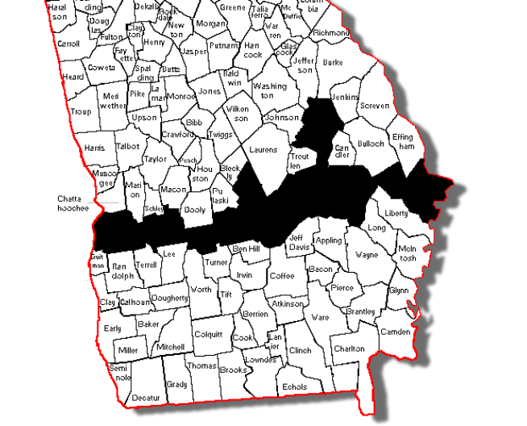
15 Counties West to East:
Stewart, Webster, Sumter, Crisp, Wilcox, Dodge, Telfair, Wheeler, Montgomery, Toombs, Emanuel, Tattnall, Evans, Bryan, and Chatham

Slide 8
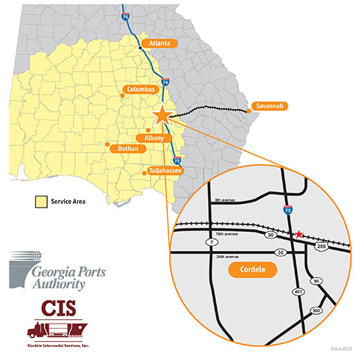
Cordele Inland Port®

Slide 9
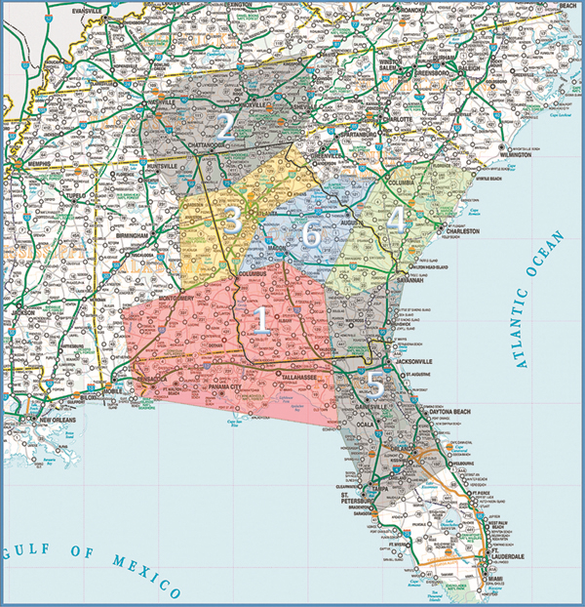
Network Georgia

Slide 10
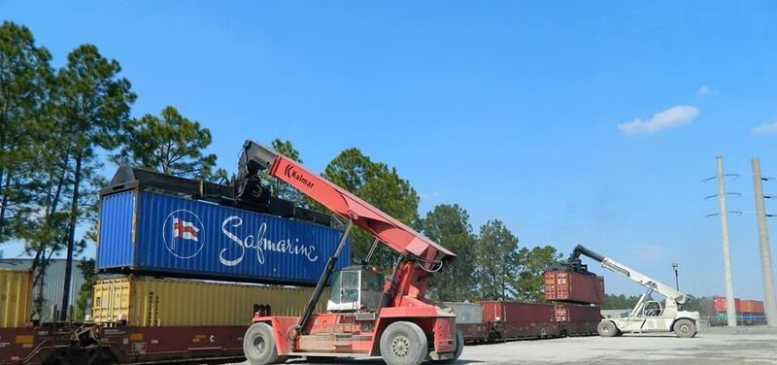

Slide 11
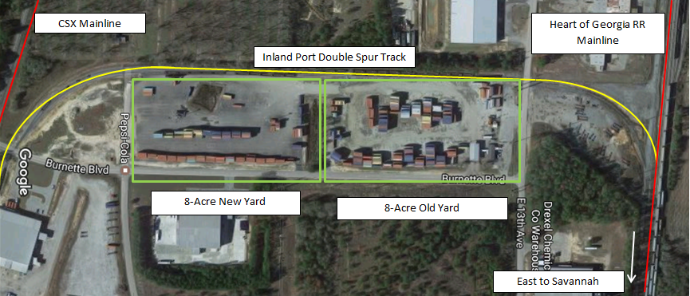
Owned by Crisp-Cordele IDA; leased to and operated by Cordele Intermodal Services, Inc. (“CIS”).
Daily rail service between Cordele and Savannah Port.
60 employees.
Cordele Inland Port traffic has grown over 200% (from 300 to 1000 TEUs per month) in last 2 years.
KIA is largest import customer; exports are primarily agriculture commodities.
Public-Private Investment 2016: $3 million ($500k State, $500k City, $500k County, $1.5 MM CIS).
First spin-off announced this week: Chinese peanut oil producer.

Slide 12
Thank You

