Slide 1
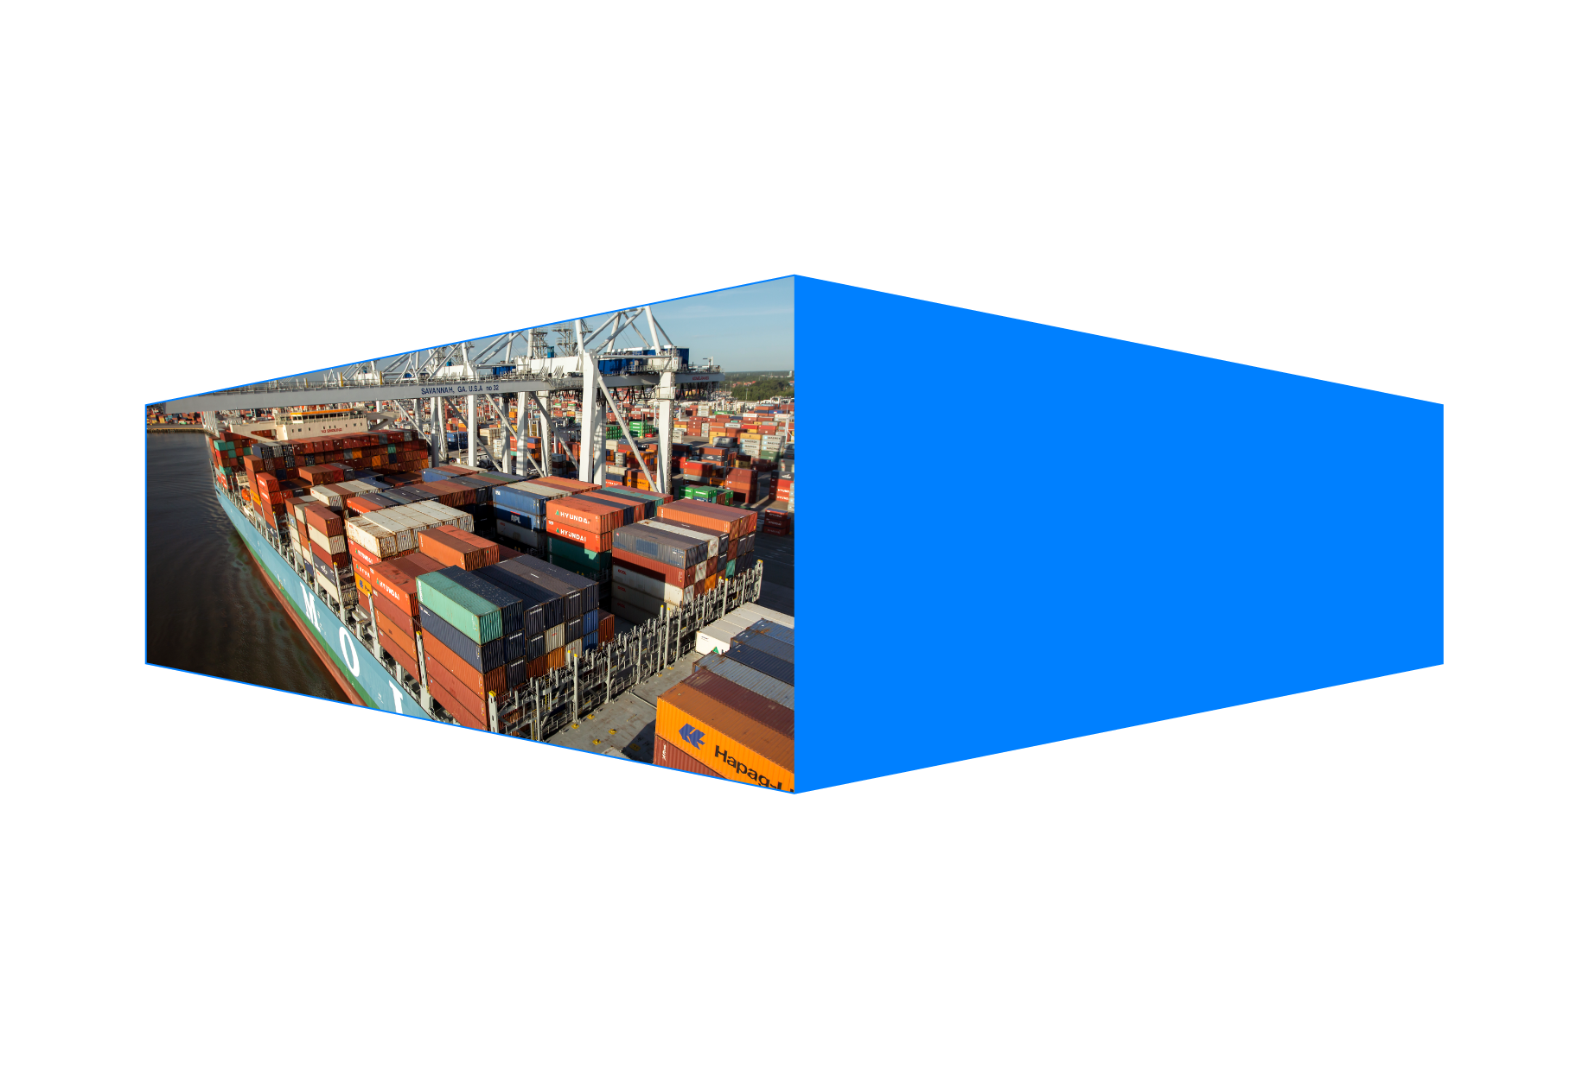
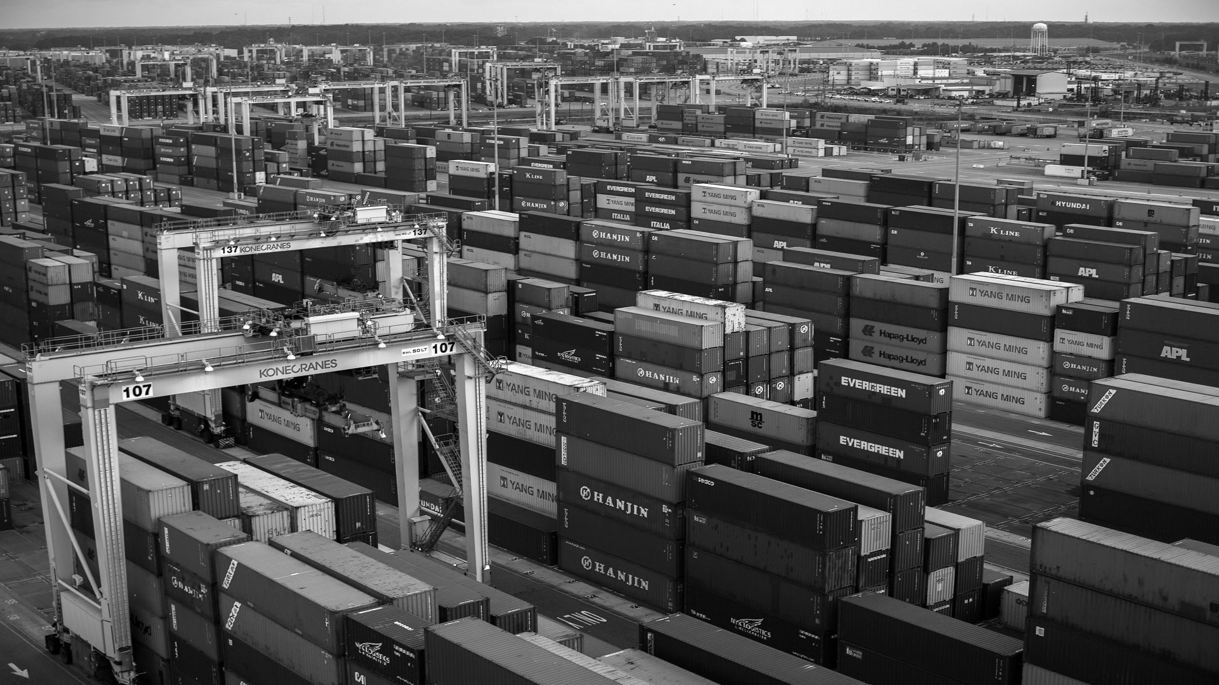
Georgia Ports Authority
Year in Review
March 22, 2017

Slide 2
STATEWIDE IMPACT
$84 BILLION
IN SALES
LOCAL IMPACT:
$20 BILLION
40,000
IN INCOME
PORT OF SAVANNAH
$33 BILLION
JOBS
IN STATE GDP
370,000 JOBS
Source: Terry College of Business, University of Georgia (FY2014)
Notes:
GPA IS INSTUMENTALITY OF THE STATE OF GEORGIA AND ONE OF OUR KEY MISSIONS IS TO ASSIST THE SUPPORTING THE CREATION OF NEW JOBS.
UNDER THE LEADERSHIP OF GOV DEAL AND HIS TEAM, GEORGIA ECONOMIC DEVELOPMENT AND OTHER ECONOMIC DEVELOPMENT AUTHORITIES THORUGHOUT THE STATE NO ONE DOES IT BETTER.
IVE GOT NEWS FOR YOU, NO ONE DOES IT BETTER THAN GEORGIA, AND WE ARE A WINNING TEAM.
THE GPA IS 1100 STRONG BUT THROUGH AN INDEPENDENT STUDY BY THE UNIVERSITY OF GEORGIA, WE TOUCH 370,000 JOBS THROUGHOUT THE STATE
AND HERE LOCALLY THE IMPACT IS 40,000 JOBS IN JUST THE 4 IMMEDIATE COUNTIES IN CLOSE PROXIMITY TO THE PORT

Slide 3
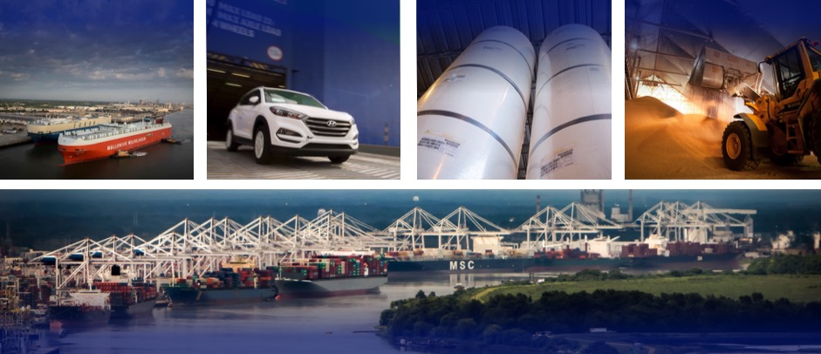
5 DEEPWATER TERMINALS
Helping to Generate 370,000 Jobs in Georgia
Ocean Terminal
Colonel’s Island
Mayor’s Point
East River
Garden City
Notes:
COMPRISED OF 5 DEEP WATER FACILITIES. STARTING DOWN IN BRUNSWICK WE HAVE 3 DEEPWATER TERMINALS. COLONELS ISLAND IS THE SECOND LARGEST AUTO TERMINAL IN THE US AND THE LARGEST FOR IMPORTS.
WE ALSO HAVE MAYOR’S POINT BREAK BULK TERMINAL WHERE WE HANDLE FOREST PRODUCTS
EAST RIVER TERMINAL IS LEASED TO OUR PARTNERS AT LOGISTEC A MONTREAL BASED STEVEDORE WHO HANDLE VARIOUS BULK PRODUCTS BUT THE LIONSHARE OF THEIR FREIGHT IS WOODPELLETS BOUND FOR EUROPE.
MOVING UP TO SAVANNAH WE’VE GOT TWO GREAT TERMINALS IN GARDEN CITY TERMINAL AND OCEAN TERM INAL. GARDEN CITY IS THE SINGLE LARGEST CONTAINER TERMINAL IN NORTH AMERICA WHICH I WILL SPEAK A GREAT DEAL ABOUT TODAY AND OCEANT TERMINAL IS A REAL DIAMOND IN THE ROUGH SERVING THE STATE AS A KEY BREAK BULK TERMINAL HANDLING AUTOS, HEAVY MACHINERY, CRUDE RUBBER, IRON&STEEL, AND SEVERAL OTHER PRODUCTS.

Slide 4
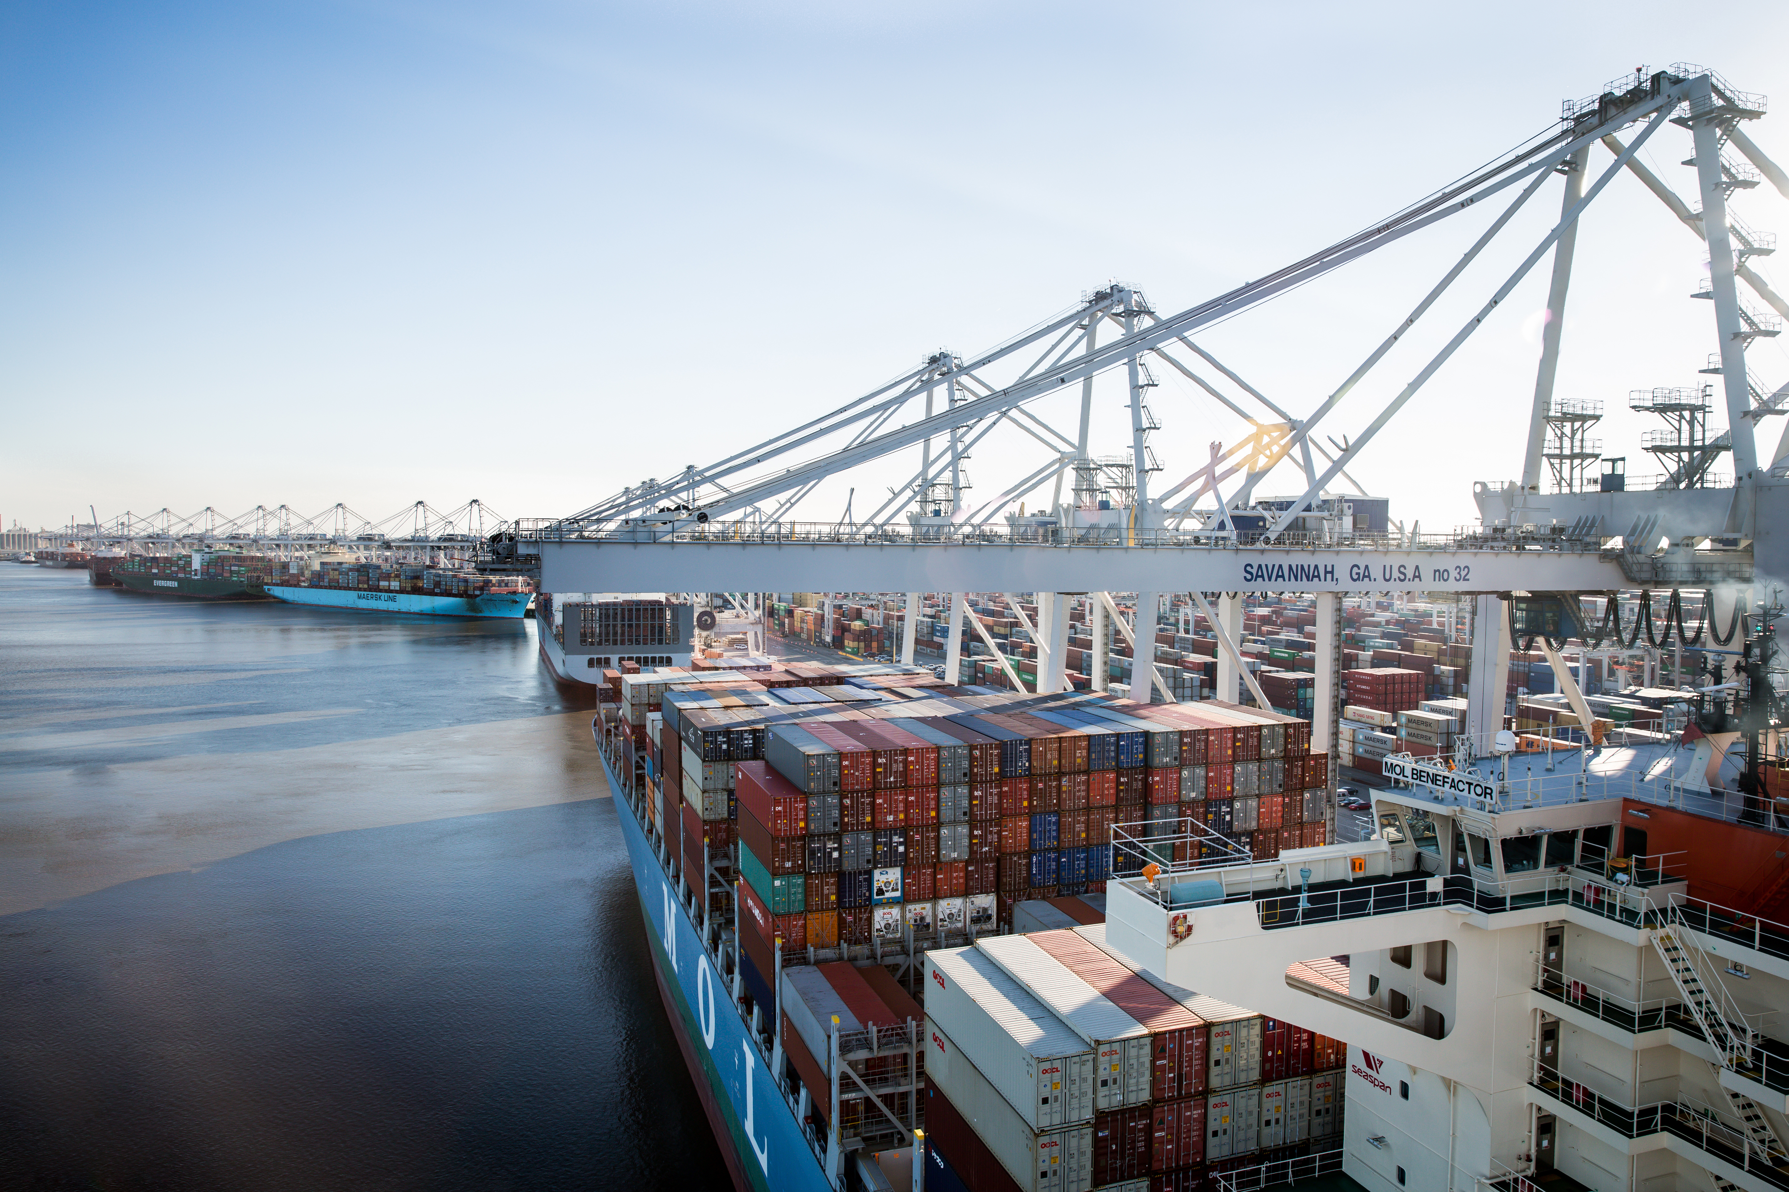
JANUARY: HIGHEST MONTH EVER
BY THE NUMBERS
Jan 2017: 3.0M tons*; +26%
Record month for total tonnage
Jan 2017: 149K; +18% total container loads
Record month for total container loads
FYTD (July 2016- Jan 2017) total tonnage: +6%
*Total tonnage all terminals

Slide 5
GARDEN CITY TERMINAL
5-YEAR TEU ANNUAL GROWTH RATE
16.9%
24%
-1.6%
DIVERTED CARGO RETAINED
1.9%
-1.1%
6.3%
3.6M TEUs
2 YEARS RUNNING
FY2012
FY2013
FY2014
FY2015
FY2016
2.98M
2.95M
3.14M
3.67M
3.61M
Source: AAPA; throughput excluding domestic
Notes:
YOU MAY RECALL THAT 2015 WAS A EXCEPTIONAL YEAR IN EVERY CATEGORY AND THIS WAS PRIMARILY DRIVEN BY DIVERSIONS TO THE USEC AS A RESULT OF USWC LABOR ISSUES. SO GIVEN THE FACT THAT THE GEORGIA PORTS RECEIVED MORE DIVERSION THAN ANY OTHER PORT, WE FULLY EXPECTED TO SEE MOST OF THAT GO BACK AND WE HAD FORECAST A CONTRACTION OF OUR BUSINESS IN 2016. THE FACT OF THE MATTER IS THAT WE WERE PLEASANTLY SURPRISED TO RETAIN APPROXIMATELY 24-25% OF THE DIVERSION CARGO. THE KEY TAKE AWAY IS THAT WE ARE UP BY OVER 14% FROM 2014 AND THAT IS A GREAT SIGNAL TO US.

Slide 6
GARDEN CITY TERMINAL
5-YEAR INTERMODAL
ANNUAL GROWTH RATE
387K
369K
333K
310K
315K
FY2012
FY2013
FY2014
FY2015
FY2016
6 CONSECUTIVE YEARS OF RECORD
INTERMODAL CONTAINER VOLUME
Notes:
YOU CANT TALK ABOUT INTERMODAL UNLESS YOU TALK ABOUT OUR RAIL PARTNERS IN NORFOLK SOUTHERN, CSX AND THE GENESSE & WYOMING. WITHOUT THEIR COMMITMENT TO THE GPA WE COULD NOT HAVE ACHIEVED 7 STRAIAGHT YEARS OF RECORD INTERMODAL GROWTH.
TODAY ABOUT 19 % OF ALL OF OUR CONTAINERS ARE HANDLE BY RAIL AND WE THINK THAT’S THE TIP OF THE ICEBERG, LATER I WILL SHARE A KEY STRATEGY THAT WE ARE DEVELOPING WHICH IS A GAMECHANGER FOR THE SOUTHEAST.
THAT’S CONTAINERS, REMEMBER, WE ALSO HAVE RAIL TOUCHING ALL OF OUR 5 DEEPWATER TERMINALS, WHETHER IS SOYBEAN MEAL THROUGH COL’S ISLAND, TOYOTAS THROUGH OCEANT TERMINAL OR WOODPELLETS AT EAST RIVER,
RAIL IS A CRITICAL COMPONENT OF OUR BUSINESS AND ON OF MY KEY GOALS IS TO RAISE OUR RELATIONSHIP WITH OUR FRIENDS AT THE RAILROADS TO A WHOLE NEW LEVEL.

Slide 7
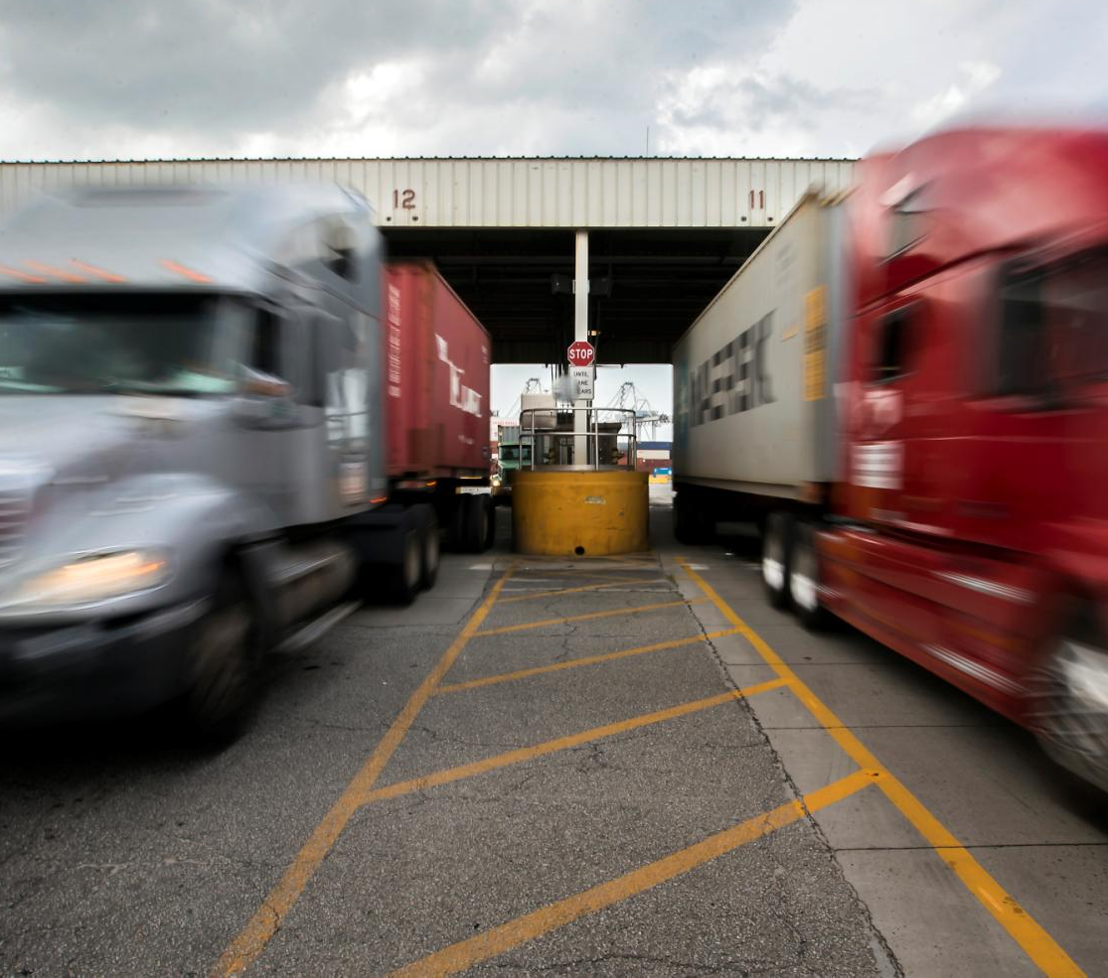
BY THE NUMBERS
GATE FLUIDITY
Averaging 10,000 gate moves per day
Single 33 minutes
Double 54 minutes
4 gates
48 lanes
12 portal approach lanes
INDUSTRY DYNAMICS
EXPANSION CAPABILITY
NEXT STEPS

Slide 8
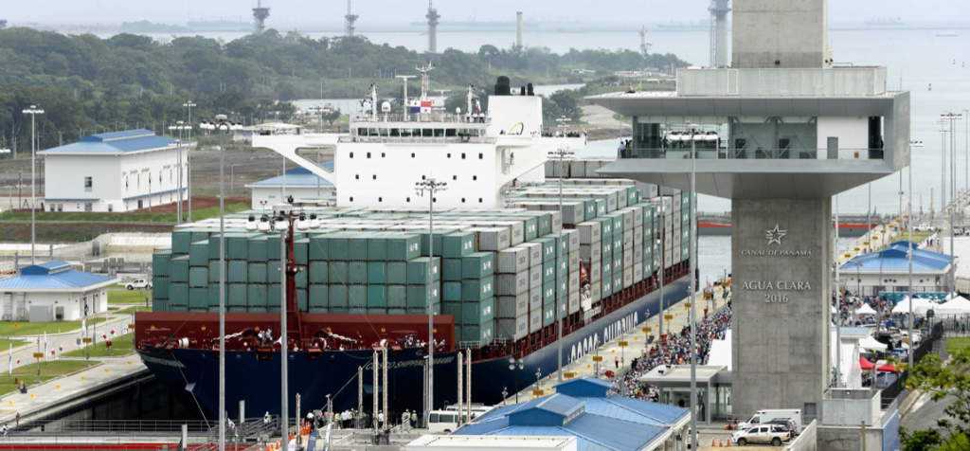
PANAMA CANAL EXPANSION COMPLETE!
GAME CHANGER!
OCEAN CARRIER INDUSTRY:
IN TRANSITION
Photo courtesy of Panama Canal Authority

Slide 9
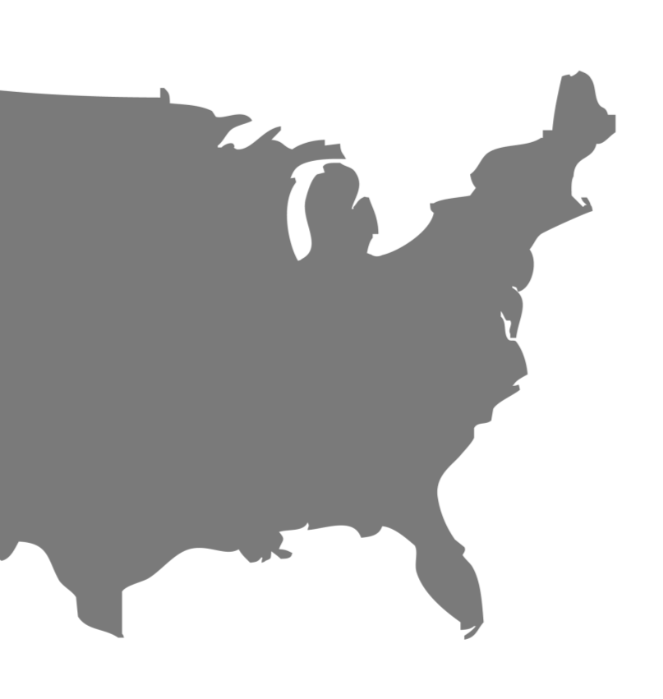
PANAMA CANAL EXPANSION:
MARKET EXPANDS WEST
THE NEW
BATTLE
GROUND
NY/NJ
CHICAGO
COLUMBUS
NFK
ST. LOUIS
MEMPHIS
CHARLESTON
ATLANTA
SAVANNAH
MOBILE
JACKSONVILLE
MIAMI
EAST COAST
PORT MARKETS
Source: U.S. Department of Commerce Bureau of Economic Analysis; BCG Analysis
MARKET
OPPORTUNITIES

Slide 10
What are the gateway ports?
10K+ TEU VESSEL CALLS FROM JULY 1, 2016 - DECEMBER 31, 2016
Source: American Shipper BlueWater Reporting & Carrier Websites January 2017

Slide 11
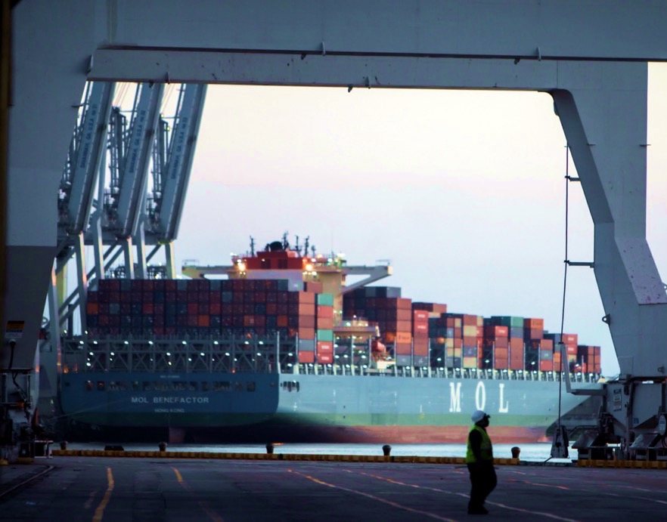
NEOPANAMAX VESSELS: CALLING
GPA IN GROWING NUMBERS
IN 6 MONTHS SINCE PANAMA CANAL EXPANSION, SHEP MORE CRITICAL
THAN EVER
56%
OF ALL VESSELS CALLING ON
SAVANNAH ARE NEOPANAMAX
10,100 TEU MOL Benefactor

Slide 12
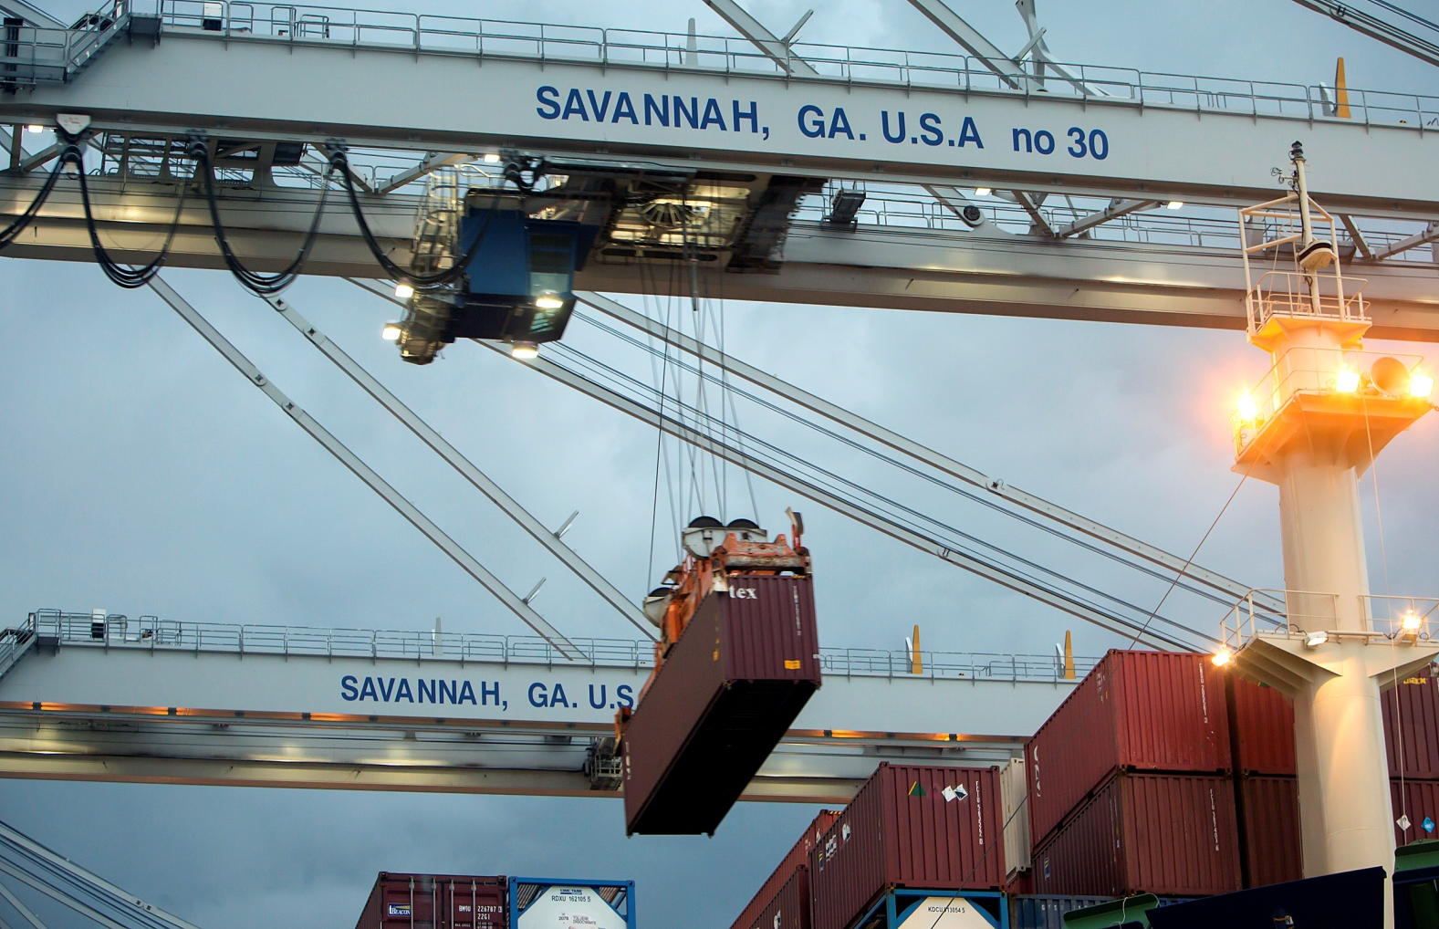
AVERAGE CONTAINER MOVES PER VESSEL UP SHARPLY
BY THE NUMBERS
Since
Panama Canal expansion
ECONOMIC ENGINE
INDUSTRY DYNAMICS
+16%
EXPANSION CAPABILITY
Average container moves/vessel*
NEXT STEPS
*June vs. December 2016; GPA Marketing

Slide 13
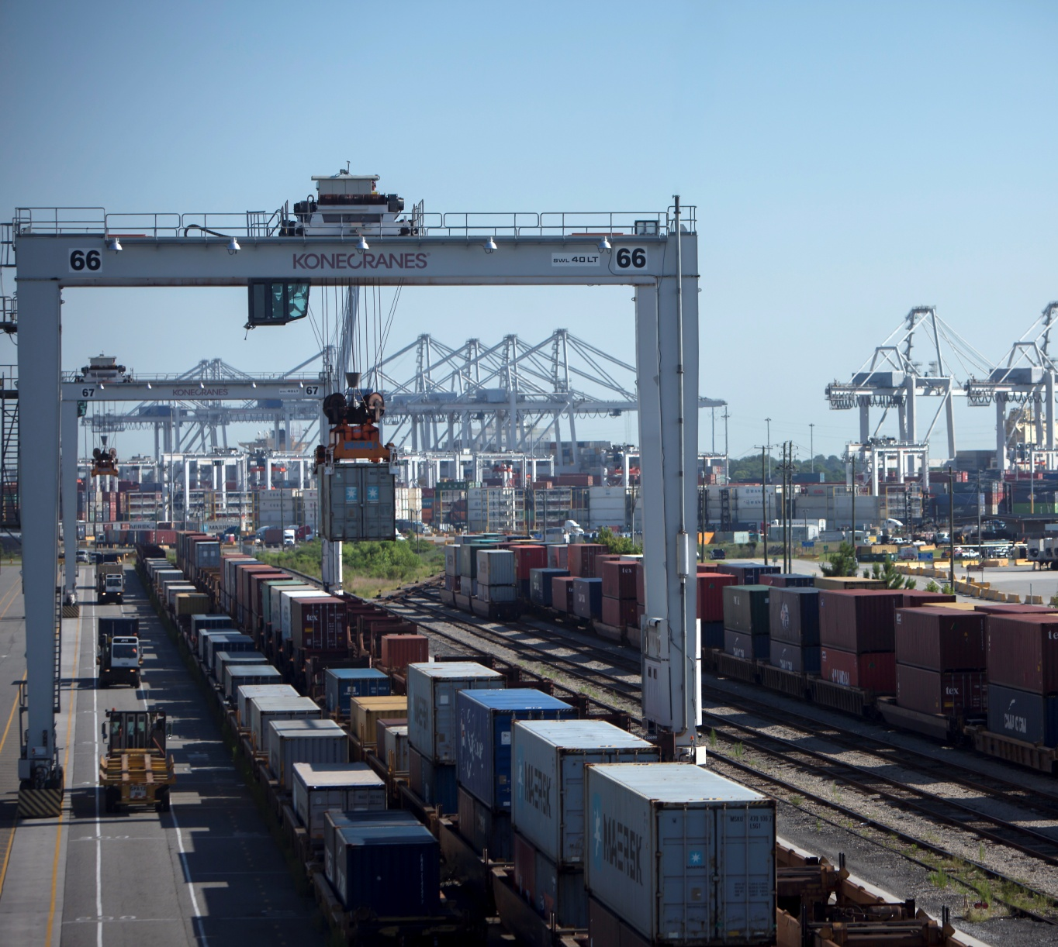
CONSOLIDATED ALLIANCES, LARGER VESSELS REQUIRE INFRASTRUCTURE INVESTMENT
GPA INVESTMENT FOR NEXT 10 YEARS: $1.9B
Water
On Terminal
Road
Rail

Slide 14
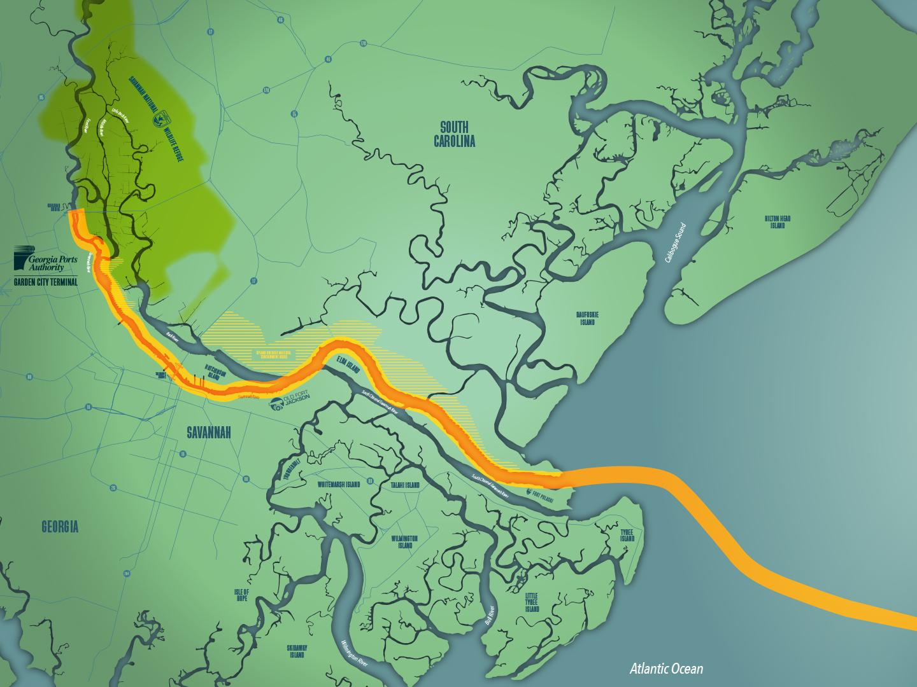
SAVANNAH HARBOR EXPANSION PROJECT (SHEP) UPDATE
Water supply improvement
60% complete
Oxygen
Injection 25% complete
Overall project: 20% complete
Dike raising 59% complete
CSS Georgia 80% complete
Channel deepening
Entrance channel 46% complete

Slide 15
In Thousands of TEUs
Demand
GPA will spend $1.9B in investment over the next
10 years
Current Demand
Capacity
Source: GPA Marketing

Slide 16
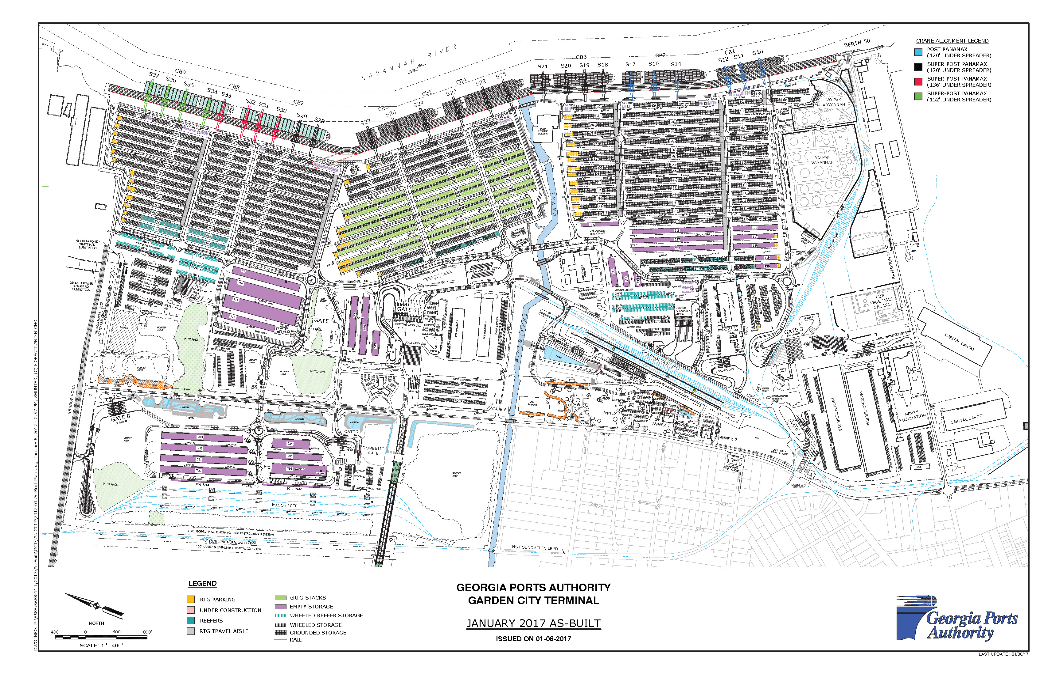
Garden City Terminal

Slide 17
Cross Terminal Road Study
2 New Gates
Notes:
4.5 M TEU 2026
6.5 M TEU 2026

Slide 18
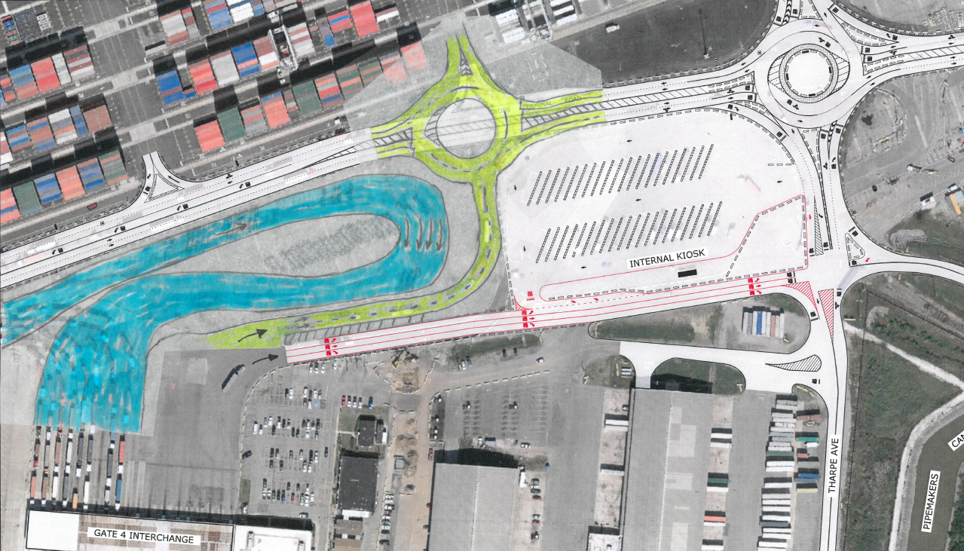
Transportation Planning

Slide 19
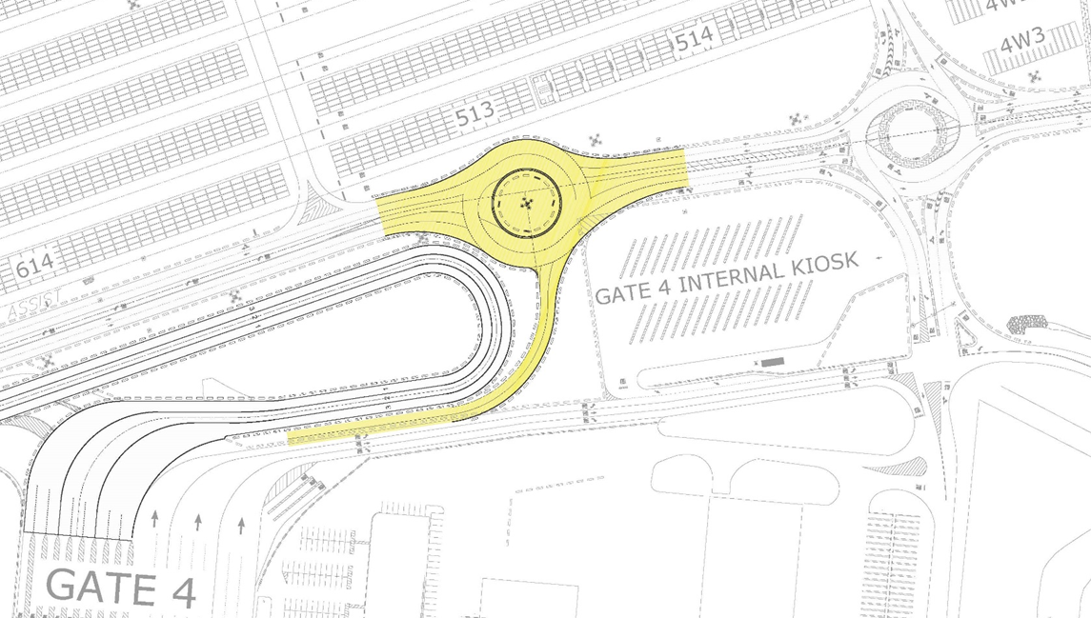
Transportation Design

Slide 20
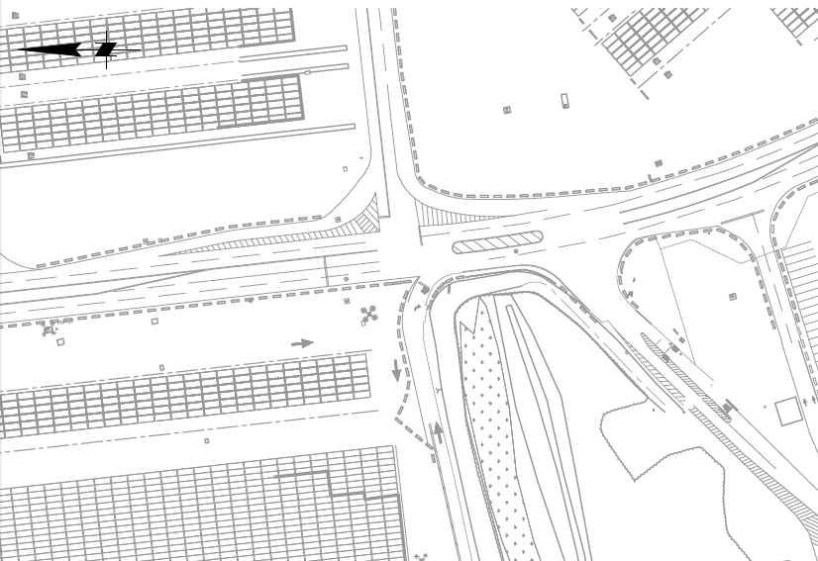
CB7 Intersection – Existing

Slide 21
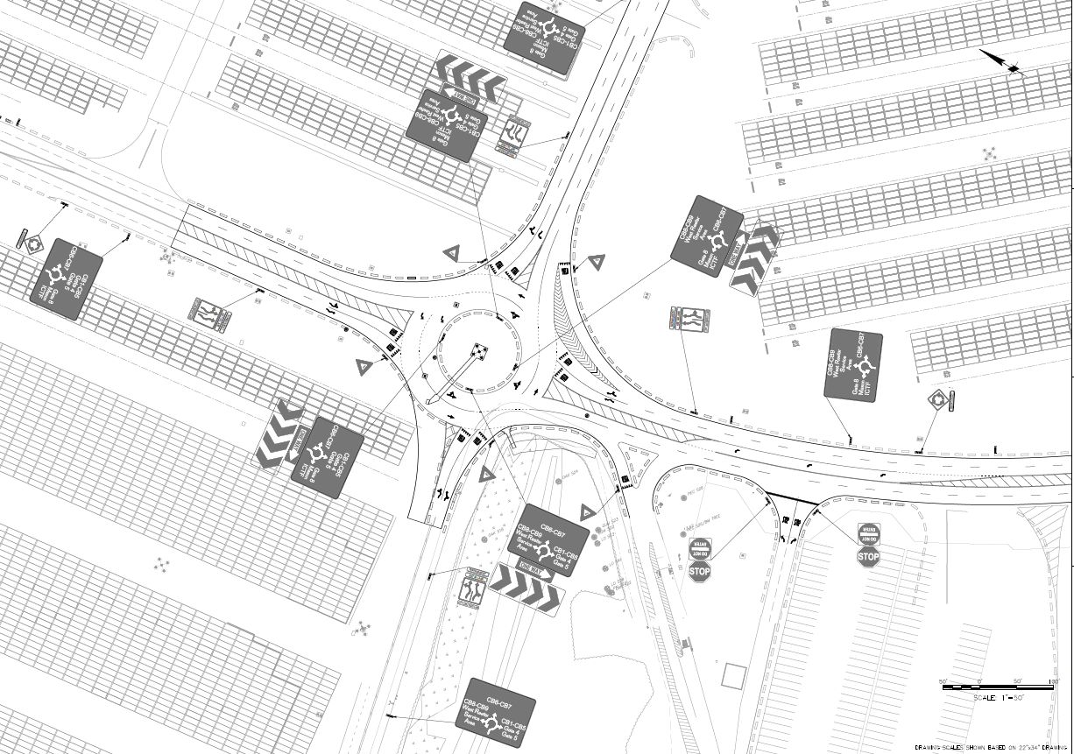
CB7 Roundabout

Slide 22
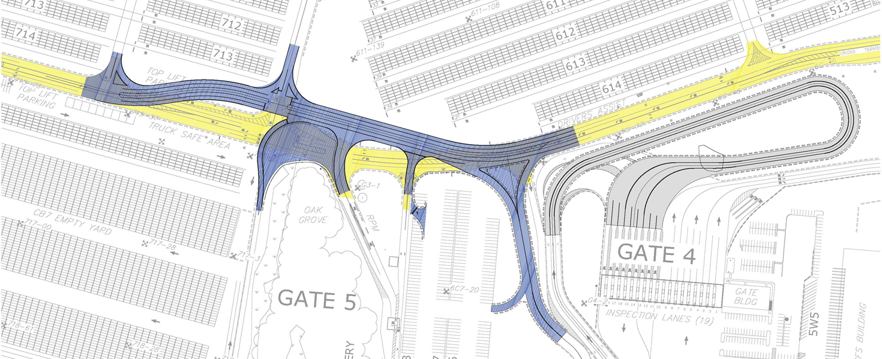
CB7 Roundabout – Staging
Stage 1:
Construct CTR Detour to the east
Construct temporary intersections

Slide 23
CB7 Roundabout – Staging
Stage 2:
Shift traffic to CTR Detour
Construct roundabout limits shown

Slide 24
Georgia Ports Authority, Cross Terminal Road at CB7 Access Road/Mason Connector Road, Garden City, GA
Photo courtesy of Stephen B. Morton

Slide 25
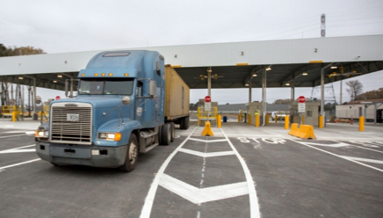
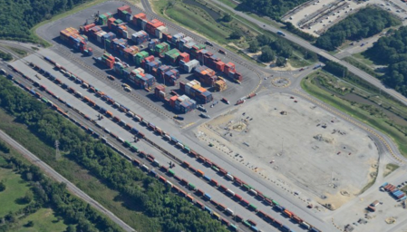
ON TERMINAL EXPANSION
+20%
NEW GATE 8
INCREASE IN GATE CAPACITY
+15%
NEW CONTAINER YARD
INCREASE IN YARD CAPACITY
Phase II

Slide 26
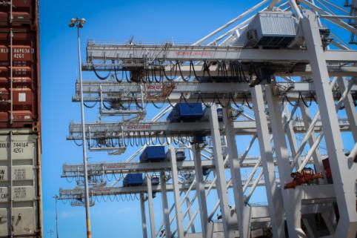
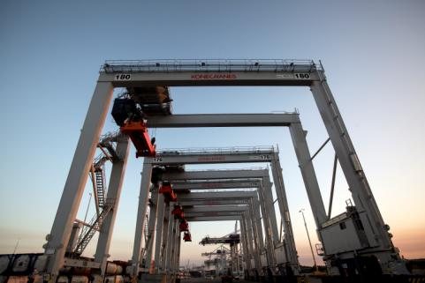
MORE CRANES THAN ANY OTHER US TERMINAL
+36%
8 NEW
SHIP-TO-SHORE CRANES
30 TOTAL
INCREASE IN CRANE CAPACITY
+26%
30 NEW
RTG CRANES
146 TOTAL
INCREASE IN RTG CRANE FLEET

Slide 27
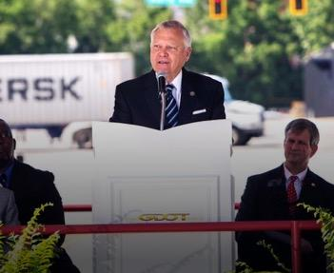
LAST-MILE PROJECTS
GRANGE ROAD
Complete end of 2017
BRAMPTON ROAD CONNECTOR
Complete FY2020
JIMMY DELOACH CONNECTOR
900 hours/day reduction in truck traffic
5,000+ trucks/day removed from Highway 21

Slide 28
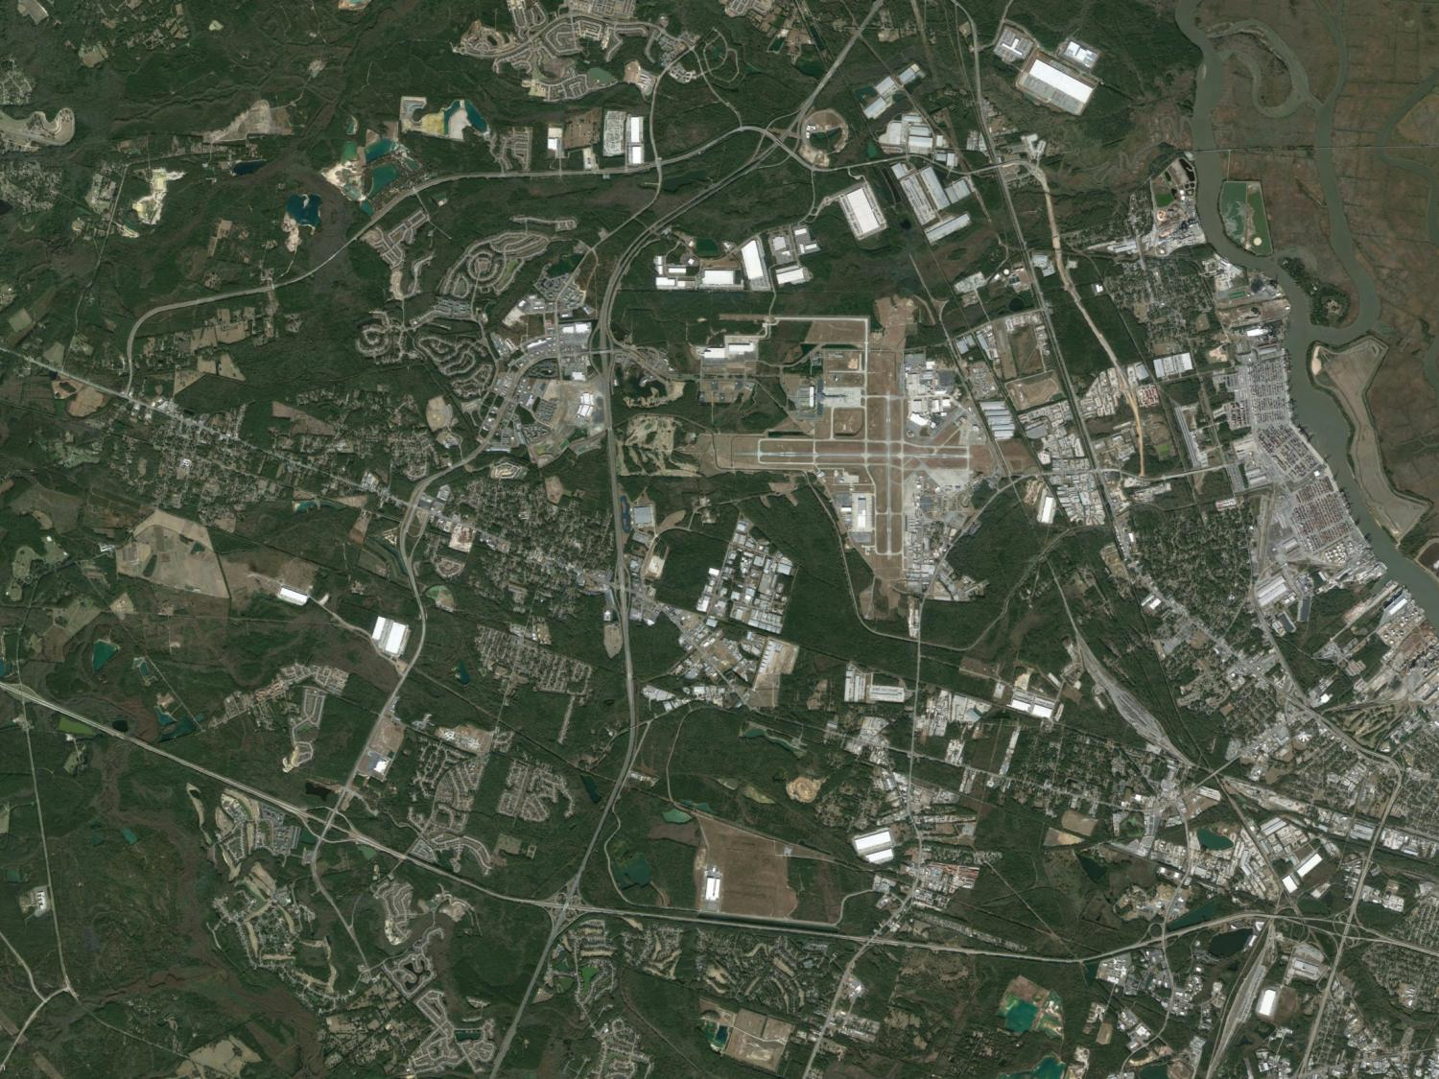
LAST MILE PROJECTS
Savannah River
International Trade Park
Jimmy Deloach
Parkway Connector
(completed)
Crossroads
Business
Center
Gate 8
Grange Road Upgrade
Exp. completion: 2018
Savannah International
Airport
Garden City Terminal
Mason ICTF / HWY 307 Overpass (completed)
Jimmy Deloach
Parkway Extension to I-16
Brampton Road Connector
Exp. Completion: TBD
Reduces traffic
Cuts turn times
Reduces emissions

Slide 29
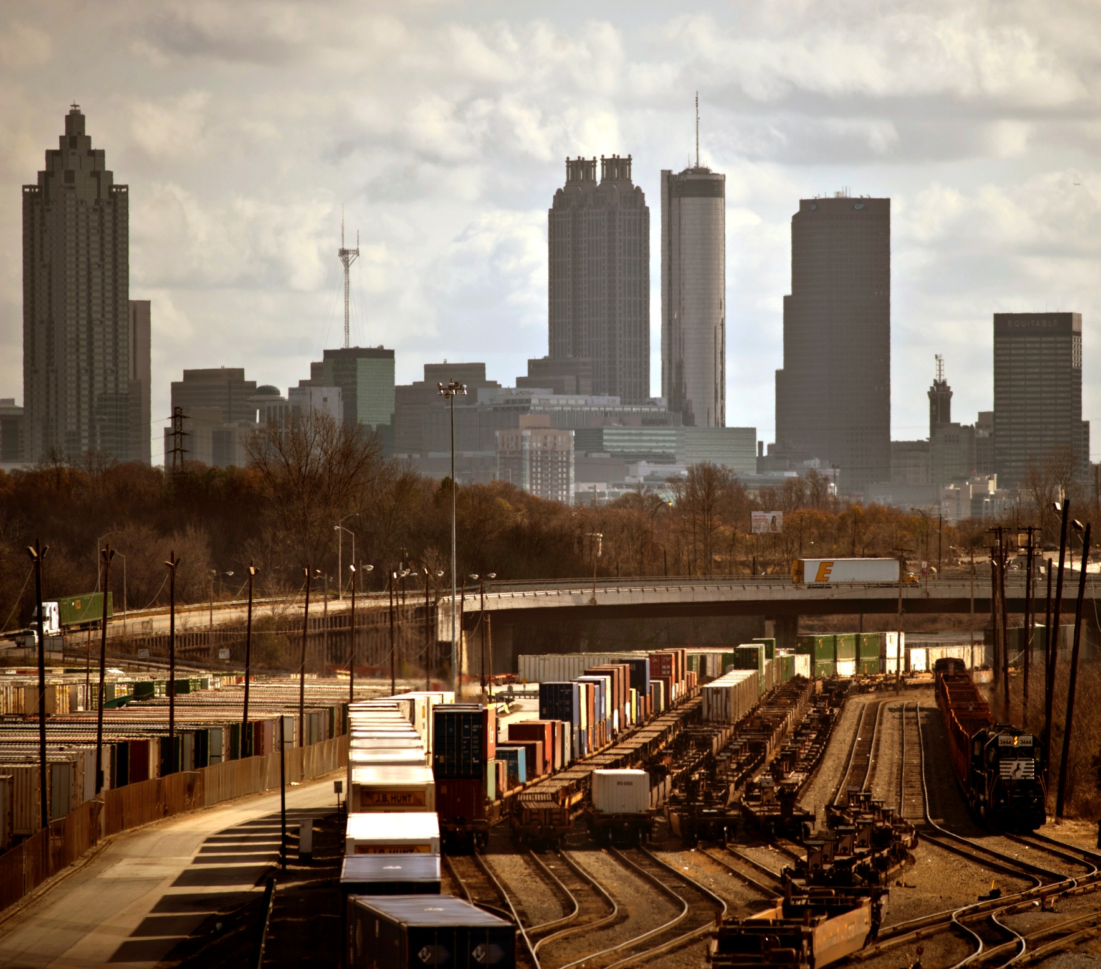
ATLANTA:
RAIL HUB OF THE SOUTHEAST
100 miles
CLOSER TO ATLANTA THAN ANY
OTHER PORT
10,100 TEU MOL Benefactor

Slide 30
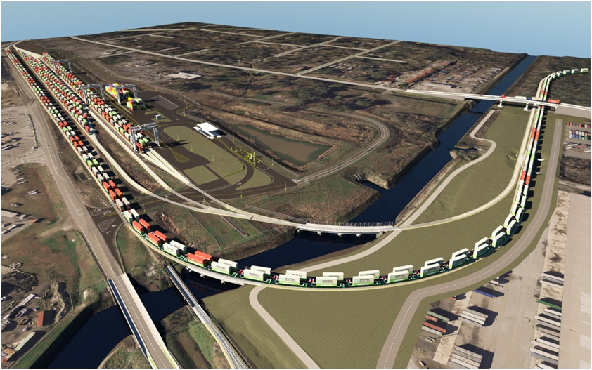
MEGA RAIL TERMINAL:
MULTIMODAL CONNECTOR WILL INCREASE LIFT CAPACITY BY NEARLY 100%
$44M FEDERAL GRANT AS PART OF $140M PROJECT
GPA VIEWED AS A “PORT OF NATIONAL SIGNIFICANCE”
GPA WILL HAVE LARGEST RAIL FACILITY ON EAST COAST

Slide 31
SR 25 Grade Separation
Notes:
$5 million each
6 in Mason
2 in Chatham

Slide 32
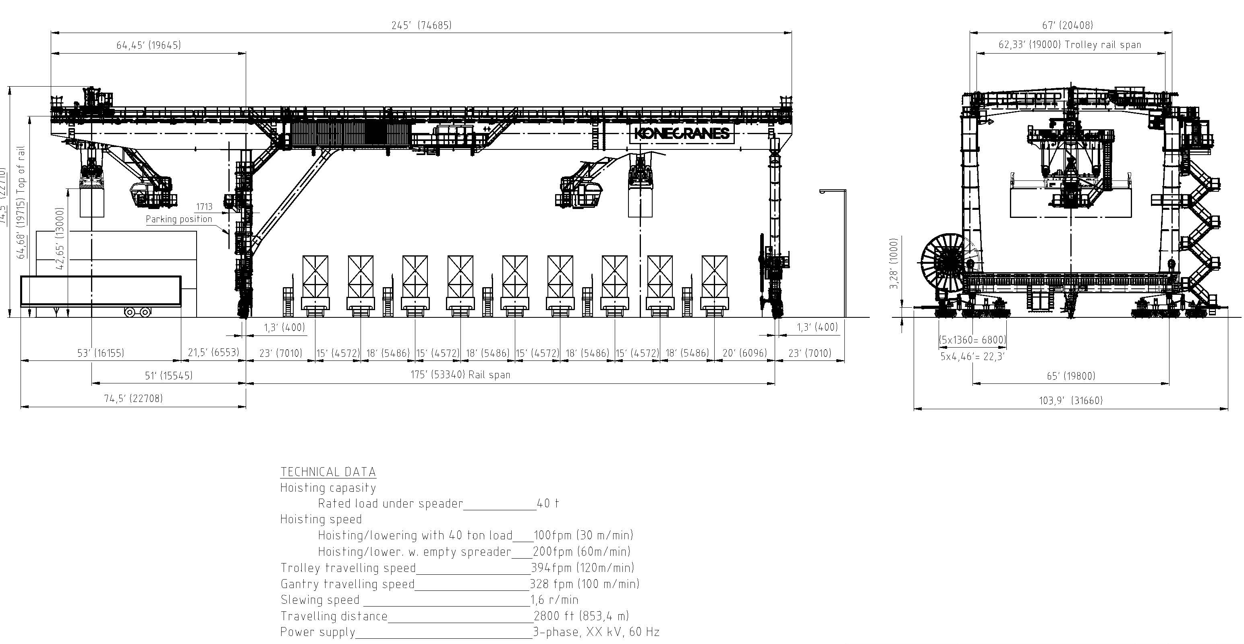
Rail Mounted Gantry Crane (RMG)
Notes:
$5 million each
6 in Mason
2 in Chatham

Slide 33
THANK YOU!

