Slide 1
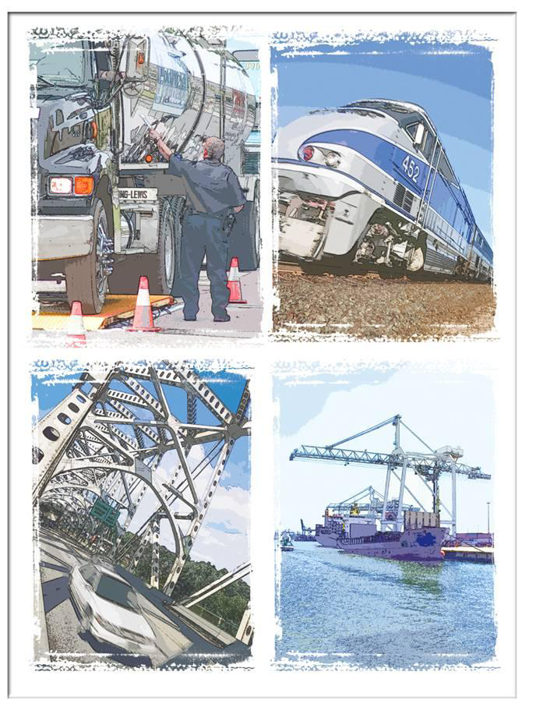
Considerations in Megaregional Freight – I-95 Corridor Coalition Perspective
CHATHAM COUNTY TRANSPORTATION PEER EXCHANGE – MARCH 24, 2017 Marygrace Parker
Intermodal Freight Program Coordinator
I-95 Corridor Coalition

Slide 2
Today’s Comments
I-95 Corridor Coalition Overview
Mega-Regions and Freight Transportation
Supply Chains and Relationship to Mega-Regions
Key Industry Freight Considerations
Key Freight Considerations - Relating Locally
Corridor Coalition Perspectives and Activities to Advance Mega-regional freight

Slide 3
The I-95 Corridor Coalition is….
A “mega-regional” partnership of multi-state, multi-modal public agencies working together to create a seamless and efficient transportation system
State DOTs, MPOs, Port and Transportation Authorities, some County agencies
Key collaborators:
Federal partners (USDOT agencies – FHWA, MARAD, FRA, BTS…)
Industry (i.e., American Trucking Association)
…
Notes:
16 States, the District of Columbia
$4.7 trillion economy (40% of US GDP)
21% of nation’s road miles; 35% of nation’s VMT
5.3 billion tons of freight shipments annually
2 Canadian Provinces (Quebec, New Brunswick)

Slide 4
I-95 Corridor – “A Corridor of Mega-Regions”
A “Mega-Region+” Freight Corridor
5.3 billion tons of freight shipments annually into/through corridor
Multi-Modal Freight Mega-Region
Truck, rail, water, aviation
“Mega-Region+”:
Northeast*
DC-Virginia*
Piedmont
Florida
Notes:
*Portions of these form Mid-Atlantic Mega-Region

Slide 5
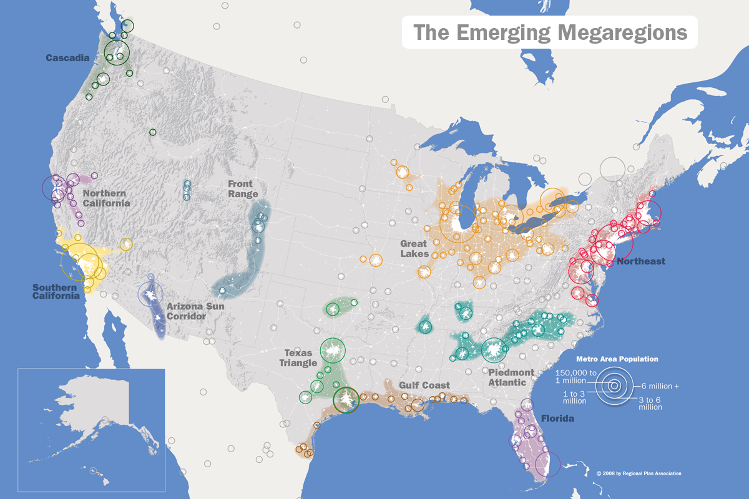
Megaregions and Distribution Hubs

Slide 6
Megaregions/Freight Corridors and Freight – Basic Principles
Freight is multi-modal
(but trucking dominates)
Mega-regions and freight transcend “traditional” jurisdictional boundaries
(avg. truck trip is 100+miles per trip)
Benefits of freight and solutions to address freight issues, often occur/accrue beyond or other than at point of investment
(i.e. bottlenecks)
Critical to understand supply chains and role you play

Slide 7
Why Supply Chains
It’s how our freight users do business
Supply chain performance feeds economic competitiveness
Performance is end-to-end: sum of stages
Travel time, travel time reliability, cost (and resiliency)
Stages put local dynamics in larger perspective: user view, market view

Slide 8
Why It is Critical for to Understand Public Role in Supply Chain Performance
Supply chain performance is public-private
Public contributes networks and policies to total outcome
Contribution is at many stages from many jurisdictions (counties included!)
Pain is shared, so are solutions
Fundamentally a cooperative venture: between sectors, between agencies (at all levels)
What’s our role…?

Slide 9
Key considerations for Manufacturing, Distribution, Warehouse Supply Chain segments
Proximity to Major Markets
Transportation infrastructure
Inventory of available commercial properties
Reliable utility infrastructure
Favorable tax structure for businesses
Financial incentives/assistance
Skilled workforce
Performance measures – cost, travel time, travel time reliability
Measured end to end (origin to destination)

Slide 10
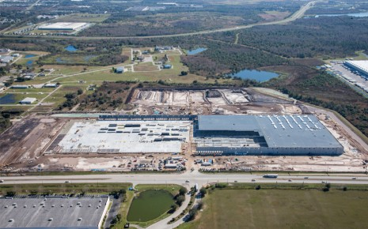
Many Freight Considerations Begin Locally
Land use and siting
Consider and provide opportunities for development and/or redevelopment
i.e. brownfield or underutilized sectors
In planning process, address issues that may cause local concern
Congestion – work to avoid creating or to mitigate impacts/ bottlenecks
Safety and related issues
Increased activity for rail at grade crossings
Truck parking /staging

Slide 11
Many Freight Considerations Begin Locally
Connectivity issues
Encourage locations strategic or in proximity to transportation networks
First mile/last mile
Don’t overlook local connectors and mix modes as practical
Rail linkage (i.e. short line rail to connect to Class I rail?)
Utilize Inland waterways (i.e. barge services)
Workforce Development
Training critical - but also:
Transportation
Can they get to work economically and reliably?
Housing, access to resources
Level of Engagement
Freight “success” at local level can be enhanced by engaging beyond boundaries/regionally

Slide 12
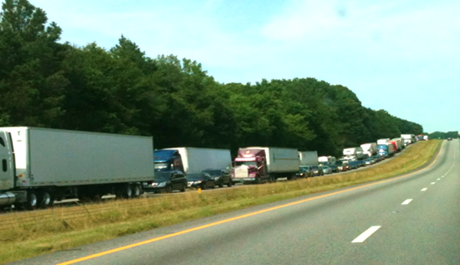
Coalition Perspectives on Advancing Megaregional Freight Mobility
Engage and Build relationships and capabilities of staff at all levels and disciplines across jurisdictions
Information exchanges; best practice sharing; collaborative endeavors; educating decision-makers
Be on the leading edge of new topics (or ones that others won’t touch)
Advance operational, institutional and capital projects across freight corridors/mega-region
Use TSM&O strategies to enhance Freight Mobility
Integrated Corridor Management,
ITS Technologies
Incident Management
Significant Event Planning

Slide 13
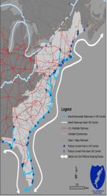
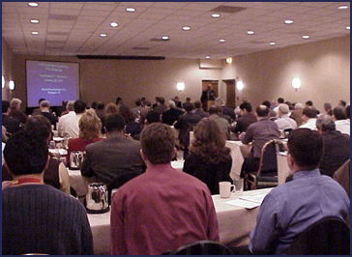
Corridor Level Activities to Enhance Megaregional Freight Mobility
Support efforts to identify and insure connected freight
Designation programs
i.e., Priority Freight Network, Marine Highways (“M-95 Corridor”), Alternative Fuel Corridors…
Advance activities to address freight mobility and performance:
Ability for agencies to utilize data economically and efficiently
Share best practices, identify/enhance tools for data analysis,
Support best practices/information exchange on regional basis for agencies advancing freight plans and addressing key issue
Reliability, Redundancy, Safety (i.e. Truck Parking)
Enhance agency access to and use of data for freight planning and performance measures
Support and advance use of real time/archived probe data and other analytics/tools
Identify/Develop application of consistent freight performance measures
Freight Fluidity/Multi-State Freight Performance Measures for Supply Chains
Support continued freight professional capacity building in public sector staff
Freight Academy

Slide 14
Planning for the Future (or not so distant future) is important for mega-regions
Emerging connected and automated vehicle technologies
Automated Trucks & Truck Platooning
Can provide benefits:
Safety
Environmental
Driver shortages
Mega-Region considerations:
Where is this technology applicable/ effective
Policy issues
Legislation
Standard application of requirements
Notes:
About 9% trailing truck and 4% on lead yielding 6.5% combined average.*

Slide 15
In Closing…
We need to understand and address freight on a corridor/megaregion basis - that is how supply chains function
Investment decisions that do not look at the compendium of improvement projects across the megaregion may weaken performance of a freight corridor
There is a need to develop institutional models that can move beyond planning to take projects with multi-state significance/benefit from local level to “across the finish line”
Multiple agencies have a key role to play

Slide 16
Questions? Thank You!
Marygrace Parker
Program Coordinator, Freight
I-95 Corridor Coalition
518-852-4083
mgparker@i95coalition.org

