Slide 1
Freight Analysis of the Chesapeake Megaregion
The National Center for Smart Growth Research and Education
at the University of Maryland
Frederick W. Ducca
Funding – FHWA Exploratory Advanced Research Program

Slide 2
AGENDA
Chesapeake Megaregion
Statistics
Linkages
Freight Movements
Supply chain
Economic Flows
Conclusions

Slide 3
Chesapeake Megaregion

Slide 4
Data Source
Freight Analysis Framework 3.3
American Community Survey 2006-2008 three-year estimate
2009 IMPLAN data
440 economic sectors
Input and output to and from each county by sector by dollar value
For each county pair 440x440 interactions

Slide 5
Chesapeake Megaregion - Statistics
Population (2010) | 15 million
Employment (2010) | 9 million
Counties | 124
Gross Domestic Product (2010) | $880 billion, 6% of U.S. GDP
Interstate Highways | 13,000 lane miles
Major Airports (Passengers 2011) | Baltimore (U.S. Rank 22) Washington Dulles (U.S. Rank 23) Washington National (U.S. Rank 26)
Major Ports (Cargo Volume 2010) | Norfolk, VA (U.S. Rank 8) Baltimore, MD (U.S. Rank 16) Wilmington, NE (U.S. Rank 72)
Source: Population and employment: Census 2010; GDP: BEA 2010; Airport: American Aviation Administration, 2011;
Port: American Association of Port Authorities, 2010.

Slide 6
Infrastructure

Slide 7
INTRA-MEGAREGION LINKAGES
The Chesapeake Megaregion

Slide 8
Commuter Flows
Source: ACS 2006/2008

Slide 9
Dollar Value of Freight Flows by Truck
Source: 2009 IMPLAN data, EcoNorthwest Haul-Choice Model of truck-dependent industries

Slide 10
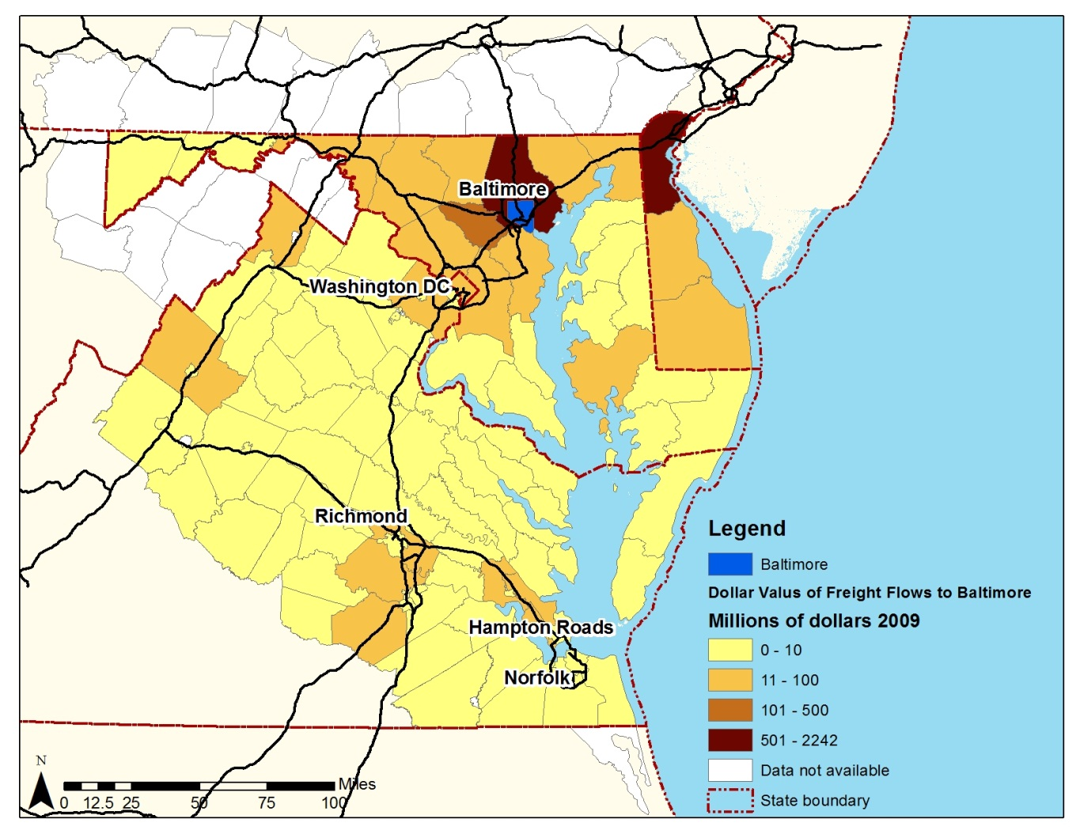
Highway Freight Flows in Dollars to Baltimore
Source: 2009 IMPLAN data

Slide 11
Highway Freight Flows in Dollars from Baltimore
Source: 2009 IMPLAN data

Slide 12
Highway Freight Flows in Dollars to Washington
Source: 2009 IMPLAN data

Slide 13
Highway Freight Flows in Dollars from Washington
Source: 2009 IMPLAN data

Slide 14
Highway Freight Flows in Dollars to Richmond
Source: 2009 IMPLAN data

Slide 15
Highway Freight Flows in Dollars from Richmond
Source: 2009 IMPLAN data

Slide 16
Supply chain Analysis
The Chesapeake Megaregion

Slide 17
Highway Shipments into Richmond

Slide 18
Richmond to Baltimore Highway Shipments

Slide 19
Highway Shipments into Baltimore

Slide 20
Baltimore to Richmond Highway Shipments

Slide 21
Impact of 1% Change in Richmond Production on Selected Counties – Magnitude (in dollars)
Source: 2009 IMPLAN data

Slide 22
Impact of 1% Change in Richmond Production on Selected Counties – Industry Share (in dollars)
Source: 2009 IMPLAN data

Slide 23
The Trend to 2030
The Chesapeake Megaregion

Slide 24
Growth of Auto Traffic on I 95 & I 64 2007-2030
Source: CM model

Slide 25
Volume/Capacity Ratio 2030
Source: CM model

Slide 26
Conclusions

Slide 27
Conclusions
Megaregions are tied together by
Economic interactions
Commodity flows
Traffic flows, particularly commute trips
Identity
Environment
Megaregions are not defined by
State boundaries
Administrative regions

Slide 28
Contact Information
Frederick W. Ducca, Ph.D.
National Center for Smart Growth
University of Maryland
fducca@umd.edu
301-405-1945

