Slide 1


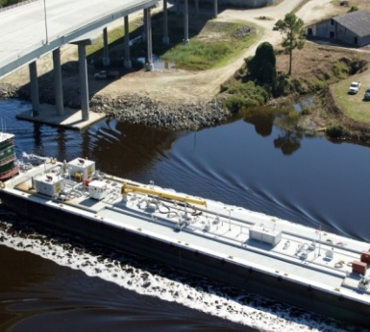
Freight Transportation Plan
Savannah, GA
NACo Transportation Peer Exchange March 23, 2017

Slide 2
Presentation Outline
Why MPO Freight Planning
CORE MPO Freight Plan
  Overview
  Study Area
  Data Considerations
  Freight Advisory Committee
  Land Use Component
  Lessons Learned

Slide 3
Why MPO Freight Planning
MAP-21
  Federal
    National freight strategic plan
  State
    Freight advisory committee
    Comprehensive plan for immediate and long-range freight-related planning and investment.
  MPO
    Freight shippers and freight transportation services providers participate in MPO process
    MPO planning processes consider projects and strategies to
      Increase accessibility and mobility of people and for freight
      Enhance integration and connectivity of the transportation system, across and between modes, for people and freight.

Slide 4
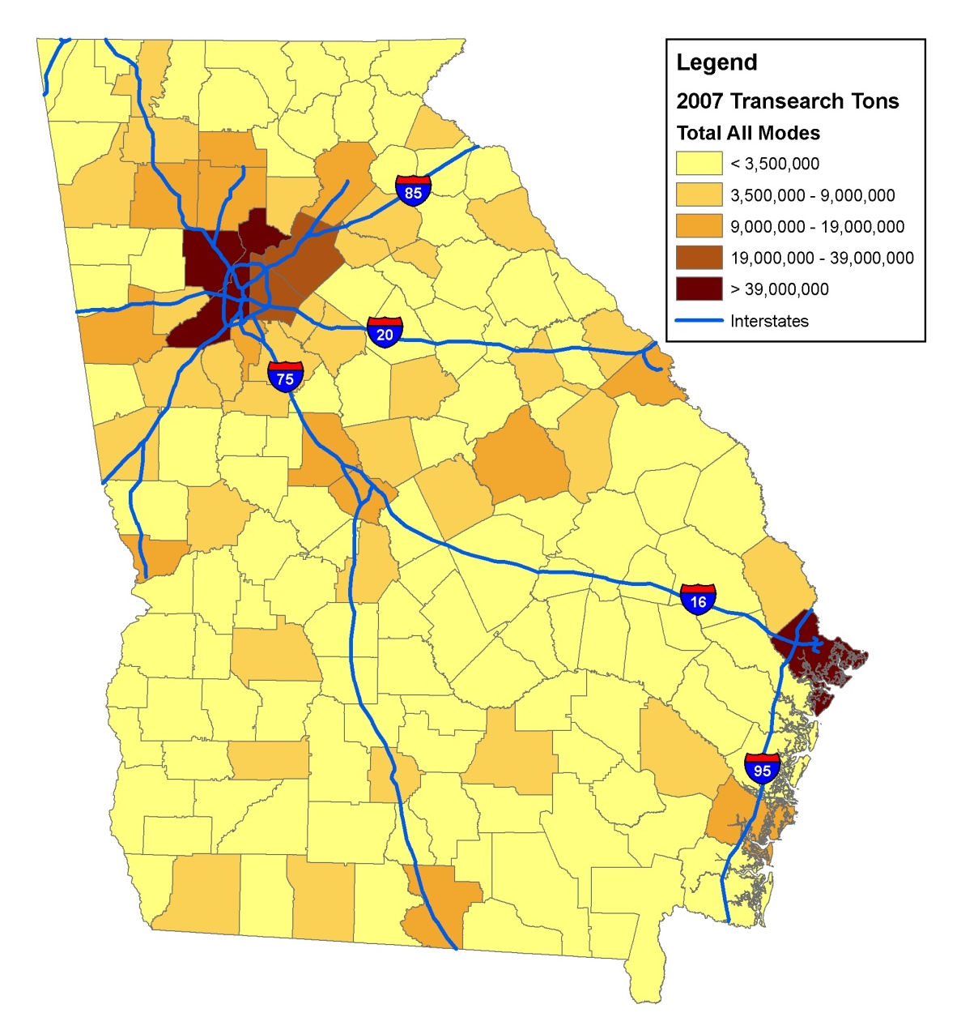
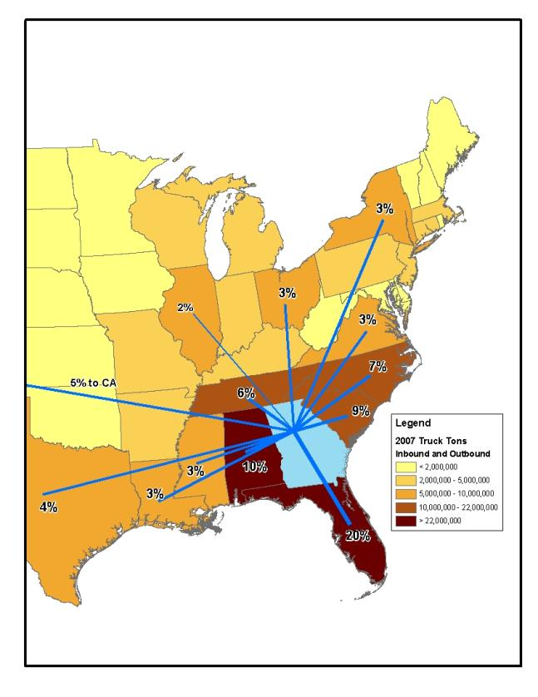
Why MPO Freight Planning
GDOT Freight & Logistics Plan: Macro-scale
  Emphasis on connectivity, efficiency and safety
    All modes analyzed: road, rail, air, and marine ports
    Goods movement within, to/from, and through Georgia
  Focus on key corridors and major “last mile” routes
Freight Tonnage in/out of Ga. counties
Truck Flows in/out metro Atlanta
Truck destinations from Port of Savannah
www.dot.state.ga.us/freight

Slide 5
Why MPO Freight Planning
MPO Freight Plan: Regional/Local Scale
  Emphasis on regional/local freight impacts and needs
  Integration with statewide freight planning efforts
  Help performance-based planning

Slide 6
CORE MPO Freight Plan Objectives
Provide a blueprint for the Savannah region regarding
  Freight-related infrastructure improvements
  Freight-related land use planning
  Freight linkage to economic development

Slide 7
CORE MPO Freight Plan Overview
Task 1
  Project Management and Freight Advisory Committee Establishment
Task 2 – Task 7
  Assessment of freight needs, land use, and economic development
Task 8
  Final Report and Documentation – Freight, Goods and Services Plan

Slide 8
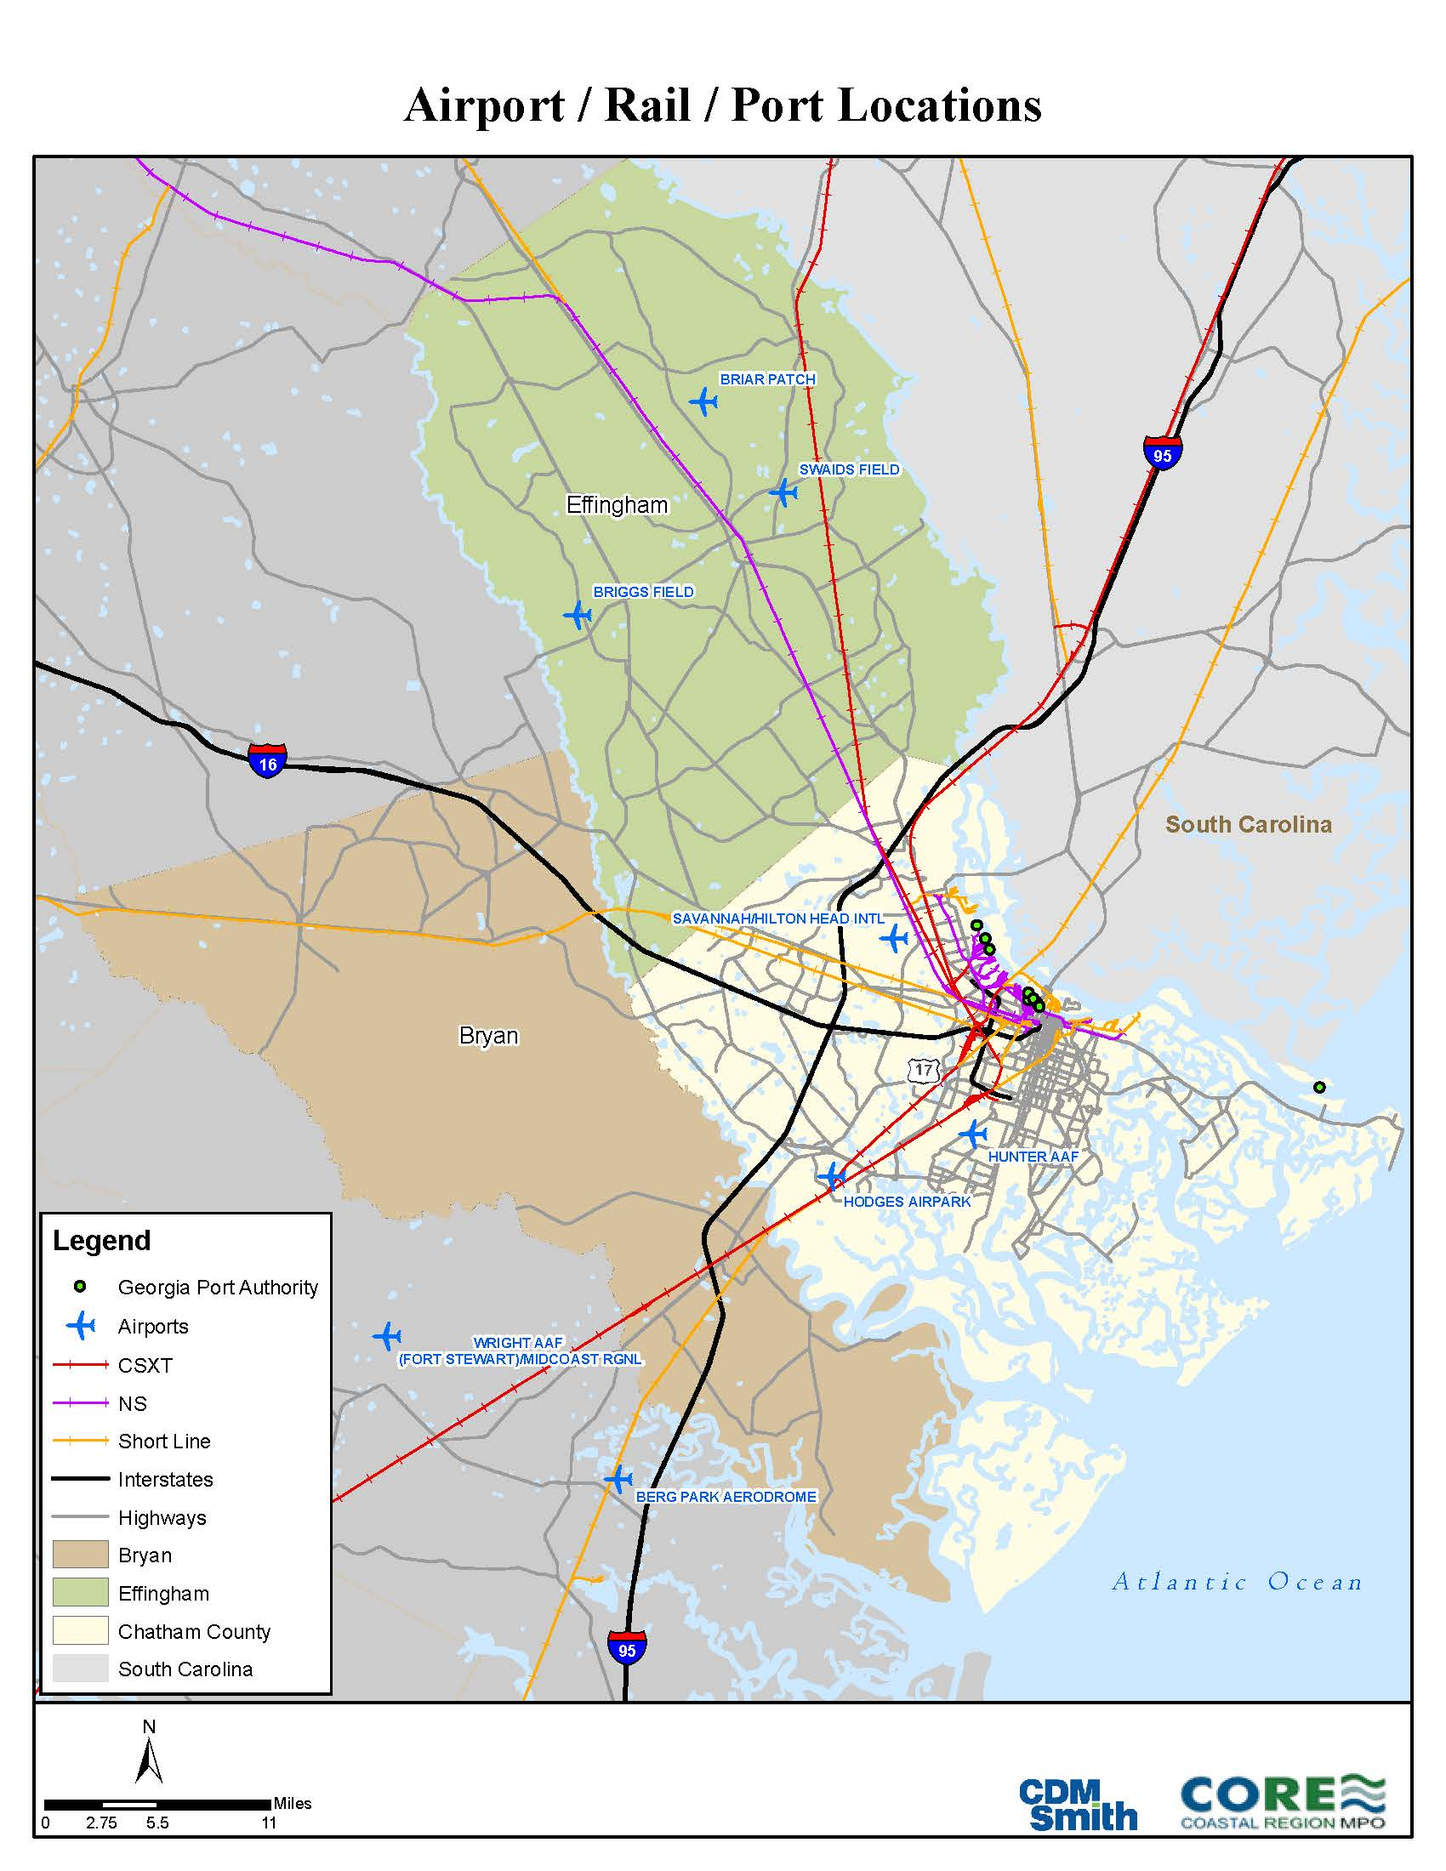
CORE MPO Freight Plan Study Area
Savannah Metropolitan Statistical Area (MSA)
  Chatham County
  Bryan County
  Effingham County

Slide 9
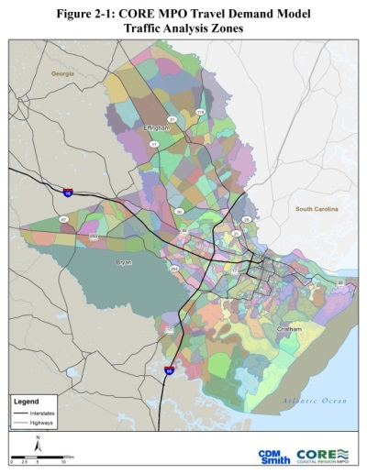
CORE MPO Freight Plan Study Area
Savannah MSA
  Consistent with MPO Travel Demand Model area
  Census data available
  A part of the FHWA FAF metro region
  Employment and economy integration

Slide 10
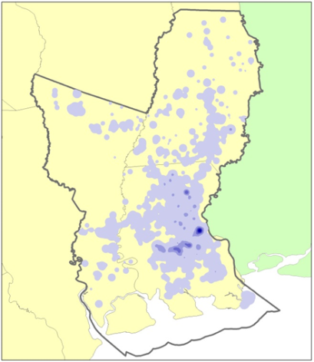
CORE MPO Freight Plan Data
FAF Disaggregation
  Freight Analysis Framework (FAF)
  County Business Patterns
  BEA Input-Output Accounts Data
  Longitudinal Employment Household Dynamics (LEHD)
  USDA Agriculture Data
  Coal Generated MWh from EIA

Slide 11
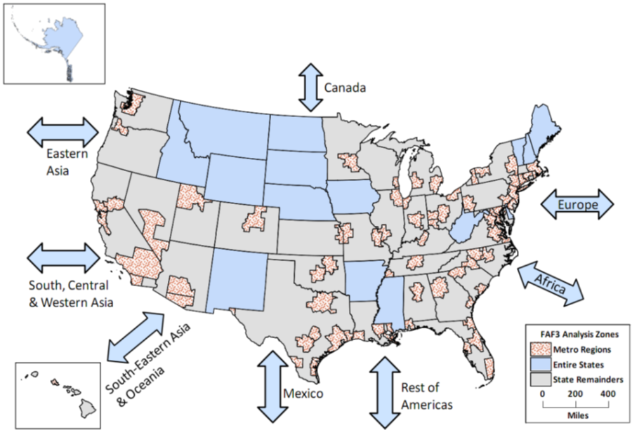
CORE MPO Freight Plan Data
FAF Disaggregation

Slide 12
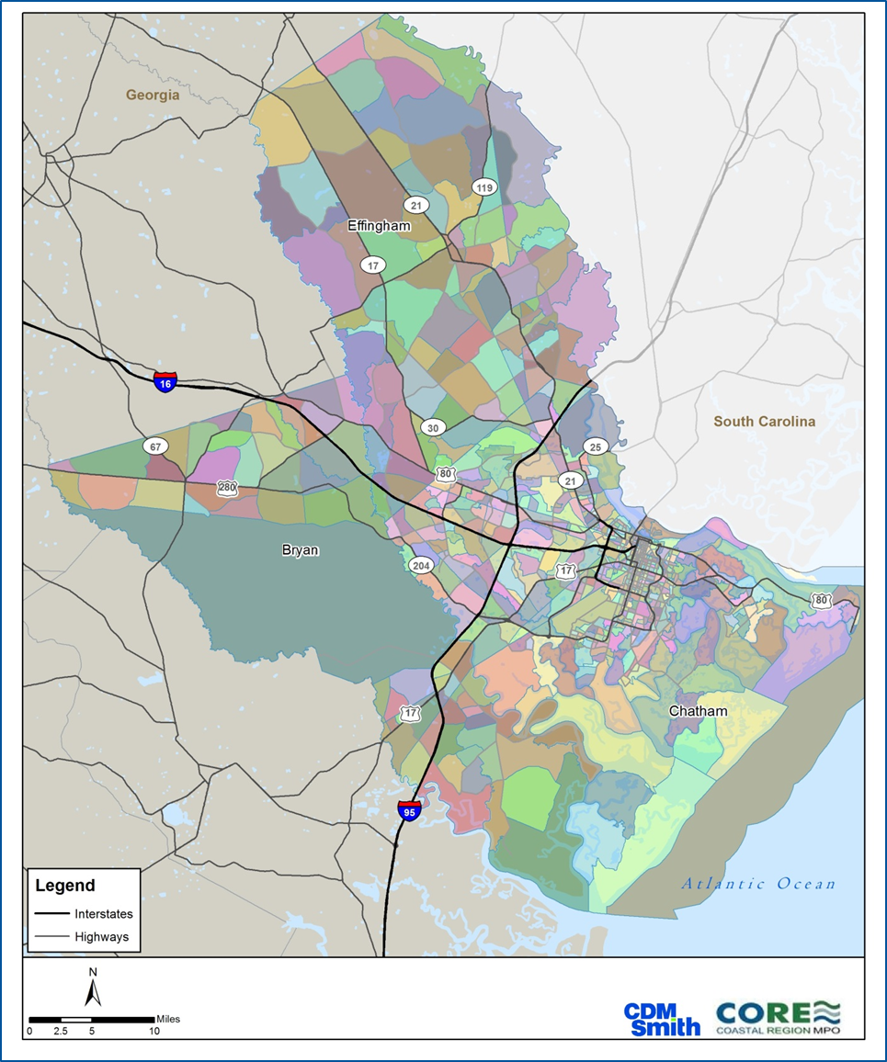
CORE MPO Freight Plan Data
FAF Disaggregation
  Methodology - Build a relationship between commodity production and consumption and industry and population by freight district

Slide 13
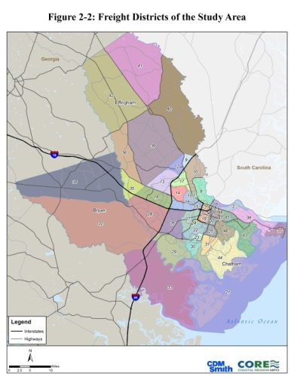
CORE MPO Freight Plan Data
FAF Disaggregation
  Methodology - Build a relationship between commodity production and consumption and industry and population by freight district

Slide 14
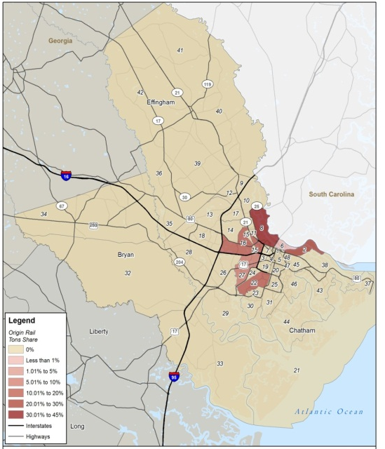
CORE MPO Freight Plan Data
FAF Disaggregation
  Results – Information on key modes, freight corridors, commodities, tonnage, value, as well as freight origins and destinations
Origin | Destination | KTons
Freight District 08 | Atlanta, GA | 211.1
Freight District 22 | Atlanta, GA | 183.1
Freight District 16 | Atlanta, GA | 124.7
Freight District 08 | Houston, TX | 81.3
Freight District 22 | Houston, TX | 80.3
Freight District 08 | Minneapolis, MN | 80.1
Freight District 22 | Minneapolis, MN | 74.2
Freight District 08 | State of Georgia | 54.7
Freight District 16 | Houston, TX | 54.1
Freight District 27 | Atlanta, GA | 51.3

Slide 15
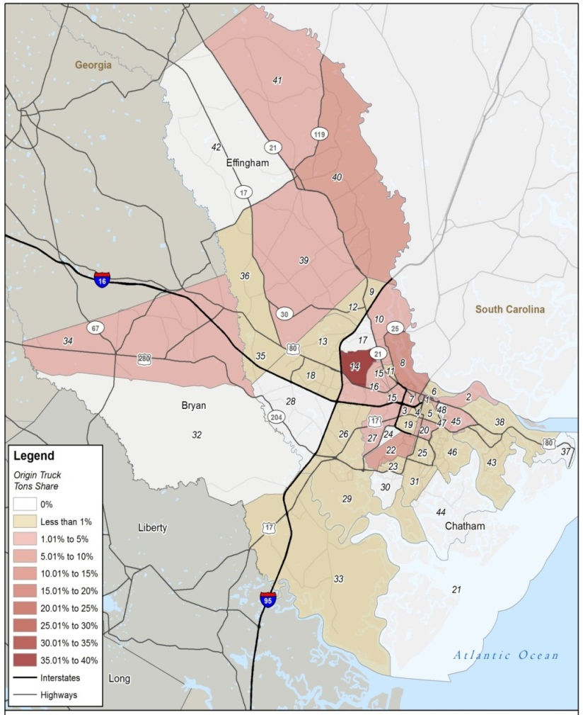
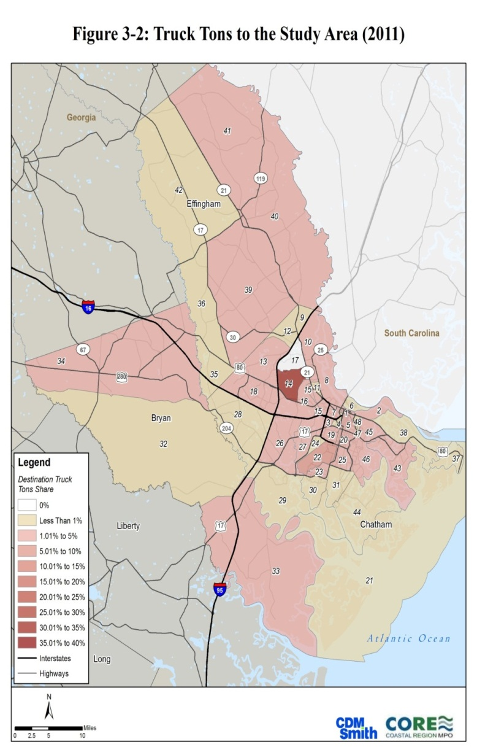
CORE MPO Freight Plan Data
FAF Disaggregation
Notes:
More FAF data disaggregated. The map on the left shows origin truck tonnage, the map on the left, destinations

Slide 16
CORE MPO Freight Plan Data
FAF Disaggregation
Origin | Destination | KTons
Freight District 08 | Atlanta, GA | 2,413.2
Freight District 16 | Houston, TX | 942.6
Freight District 16 | Atlanta, GA | 801.8
Freight District 14 | Houston, TX | 746.2
Freight District 08 | State of Georgia | 695.0
Freight District 10 | Atlanta, GA | 687.7
Origin | Destination | KTons
Newark, NJ (New York) | Freight District 14 | 1,557.2
Newark, NJ (New York) | Freight District 16 | 1,467.3
Newark, NJ (New York) | Freight District 10 | 1,169.7
Atlanta, GA | Liberty County | 937.5
Newark, NJ (New York) | Freight District 22 | 866.8
Newark, NJ (New York) | Freight District 08 | 864.8

Slide 17
CORE MPO Freight Plan Data
FAF Disaggregation
2040 Mode Values
2040 Top Ten Commodity by Tonnage by Truck
Notes:
And forecast mode share and commodities.

Slide 18
CORE MPO Freight Plan Data
Other Data sources
  State DOT
    Rail
    Statewide Freight and Logistics Plan
    Crash Data
    Traffic Data
    Bottlenecks
  Regional/Local Level
    MPO Travel Demand Model
    Local Reports (airport, port, SEDA, other)
    Comprehensive Plans (DCA website)

Slide 19
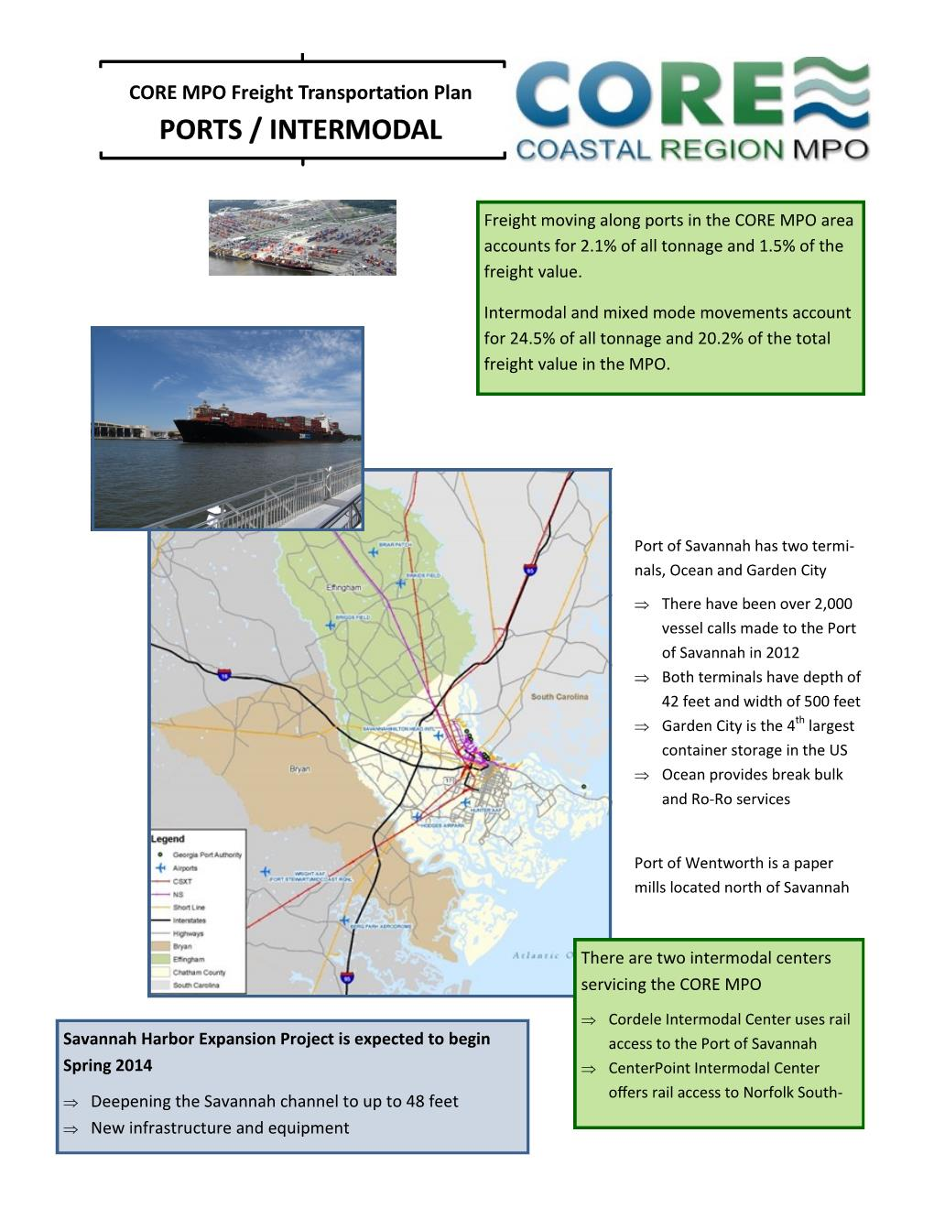
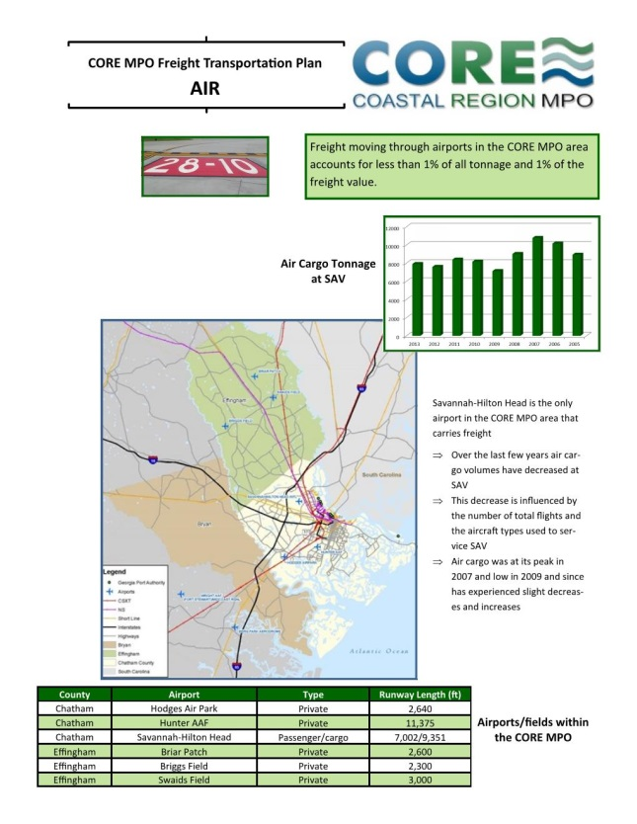
CORE MPO Freight Plan Data
Regional/Local Data sources

Slide 20
CORE MPO Freight Plan
Freight Advisory Committee
Who
  Airport, rail, and seaport representatives
  Carriers, shippers, and freight industry workforce
  Economic development agencies
  Local governments

Slide 21
CORE MPO Freight Plan
Freight Advisory Committee
Critical Roles
  Review MPO’s freight-centric goals and objectives
  Provide freight data and input
  Help validate study output
  Provide liaison between MPO and freight community
  Help more people understand MPO process
  Provide regional perspective and collaboration
  Possible opportunity for private investment in select projects
  Establish an advisory committee to MPO Board

Slide 22
Freight Related Land Use Analysis
Existing Zoning – Where are the current Freight-Related Zoning areas in the study area?
Existing Land Use – Where are the current Freight-Related Land Use areas in the study area?
Freight Possibilities – Where could Freight-Related Land Use occur in the study area?
Existing & Possibilities – How do the existing Freight-Related areas and Freight Possibilities match up with one another in the study area?

Slide 23
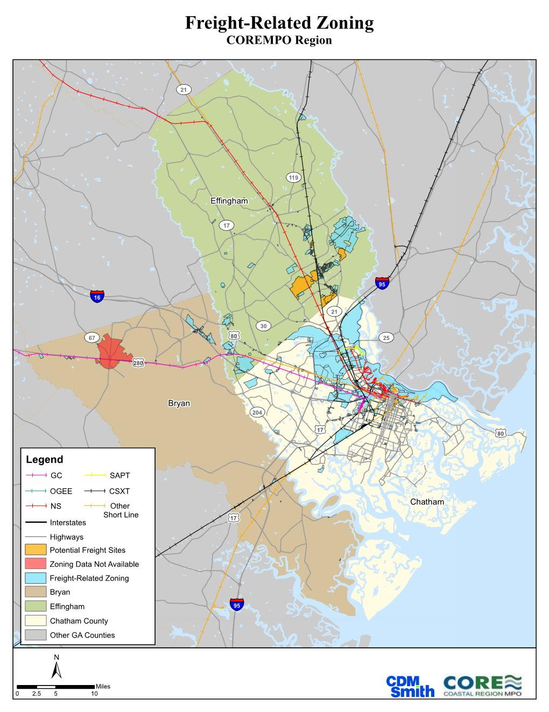
Existing Zoning – Study Area

Slide 24
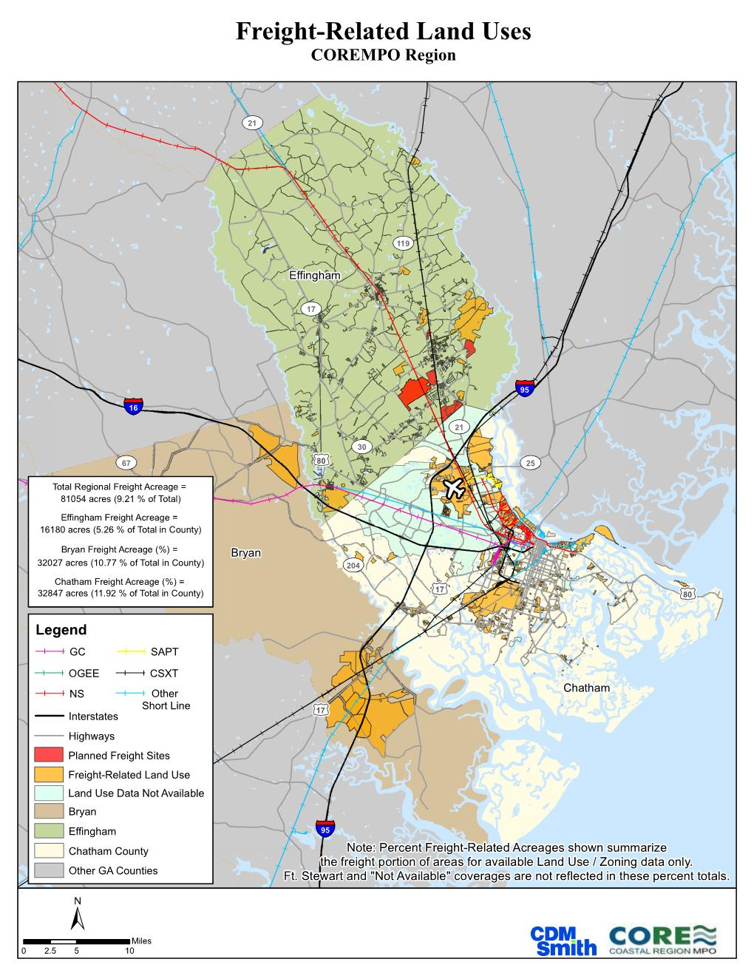
Existing Land Use – Study Area

Slide 25
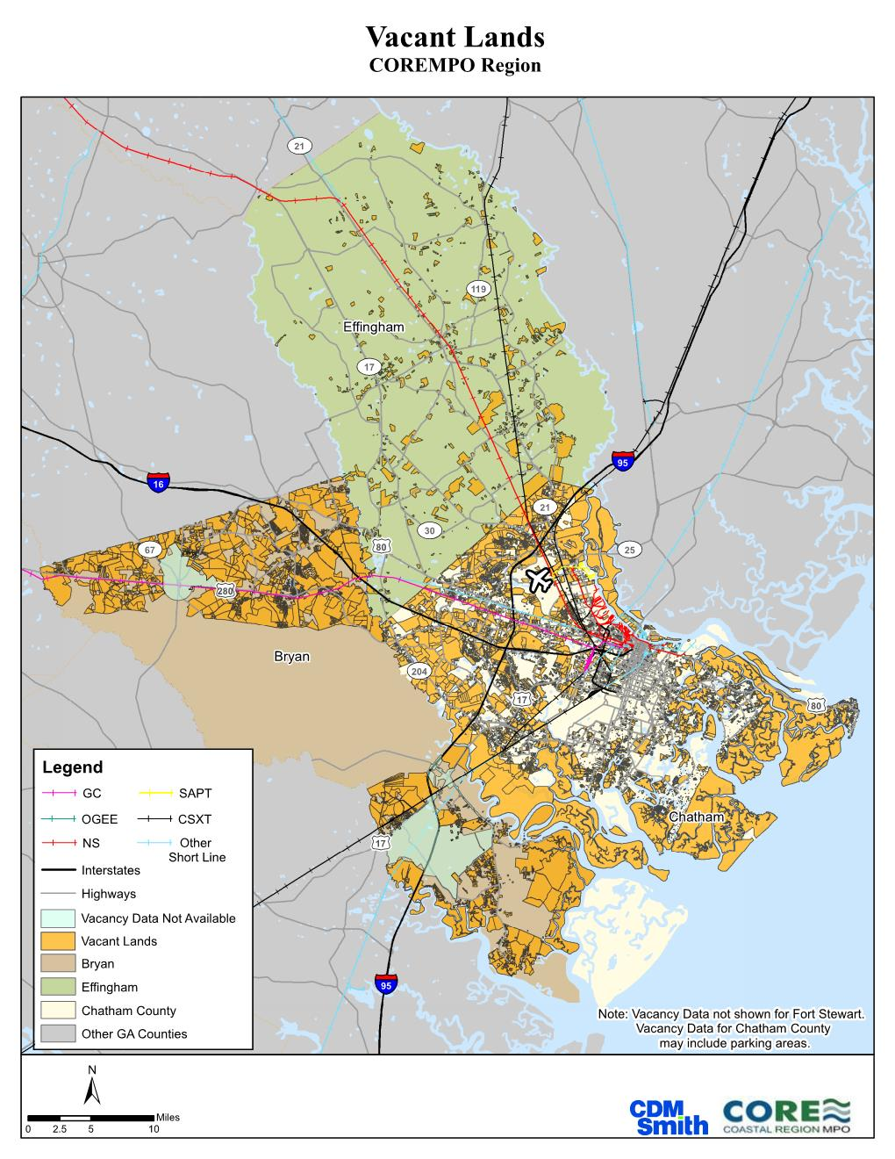
Freight Possibilities – Study Area
Notes:
Ask for plans and interaction at this point.

Slide 26
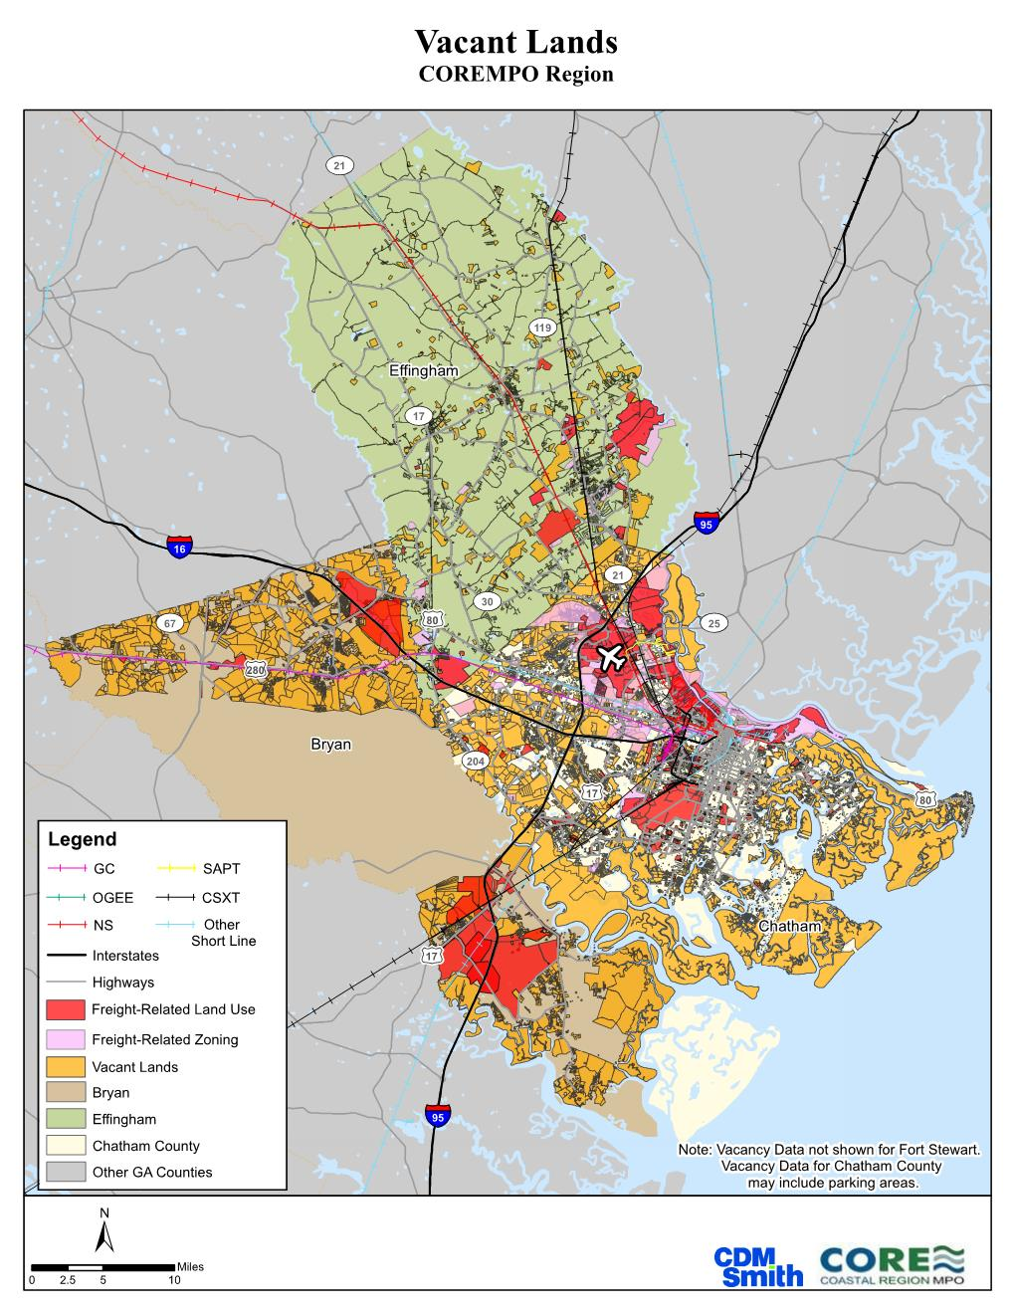
Existing & Possibilities – Study Area
Notes:
Ask for plans and interaction at this point.

Slide 27
CORE MPO Freight Plan
Lessons
  Make the most of existing and free data sources
  Supplement information by local reports/plans and industry survey results
  Validate output by freight advisory committee process
  Have the right stakeholders at the table and structure the process to keep them engaged

Slide 28
CORE MPO Freight Plan
Project Website
http://www.thempc.org/Dept/Freight
MPO Website
http://www.corempo.org

Slide 29
Contact Information
Mark Wilkes, P.E., AICP
Interim Executive Director
wilkesm@thempc.org
Zhongze (Wykoda) Wang
Project Manager
wangw@thempc.org

