Slide 1
Greater Charlotte Regional Freight Mobility Plan
NC SC USA

Slide 2
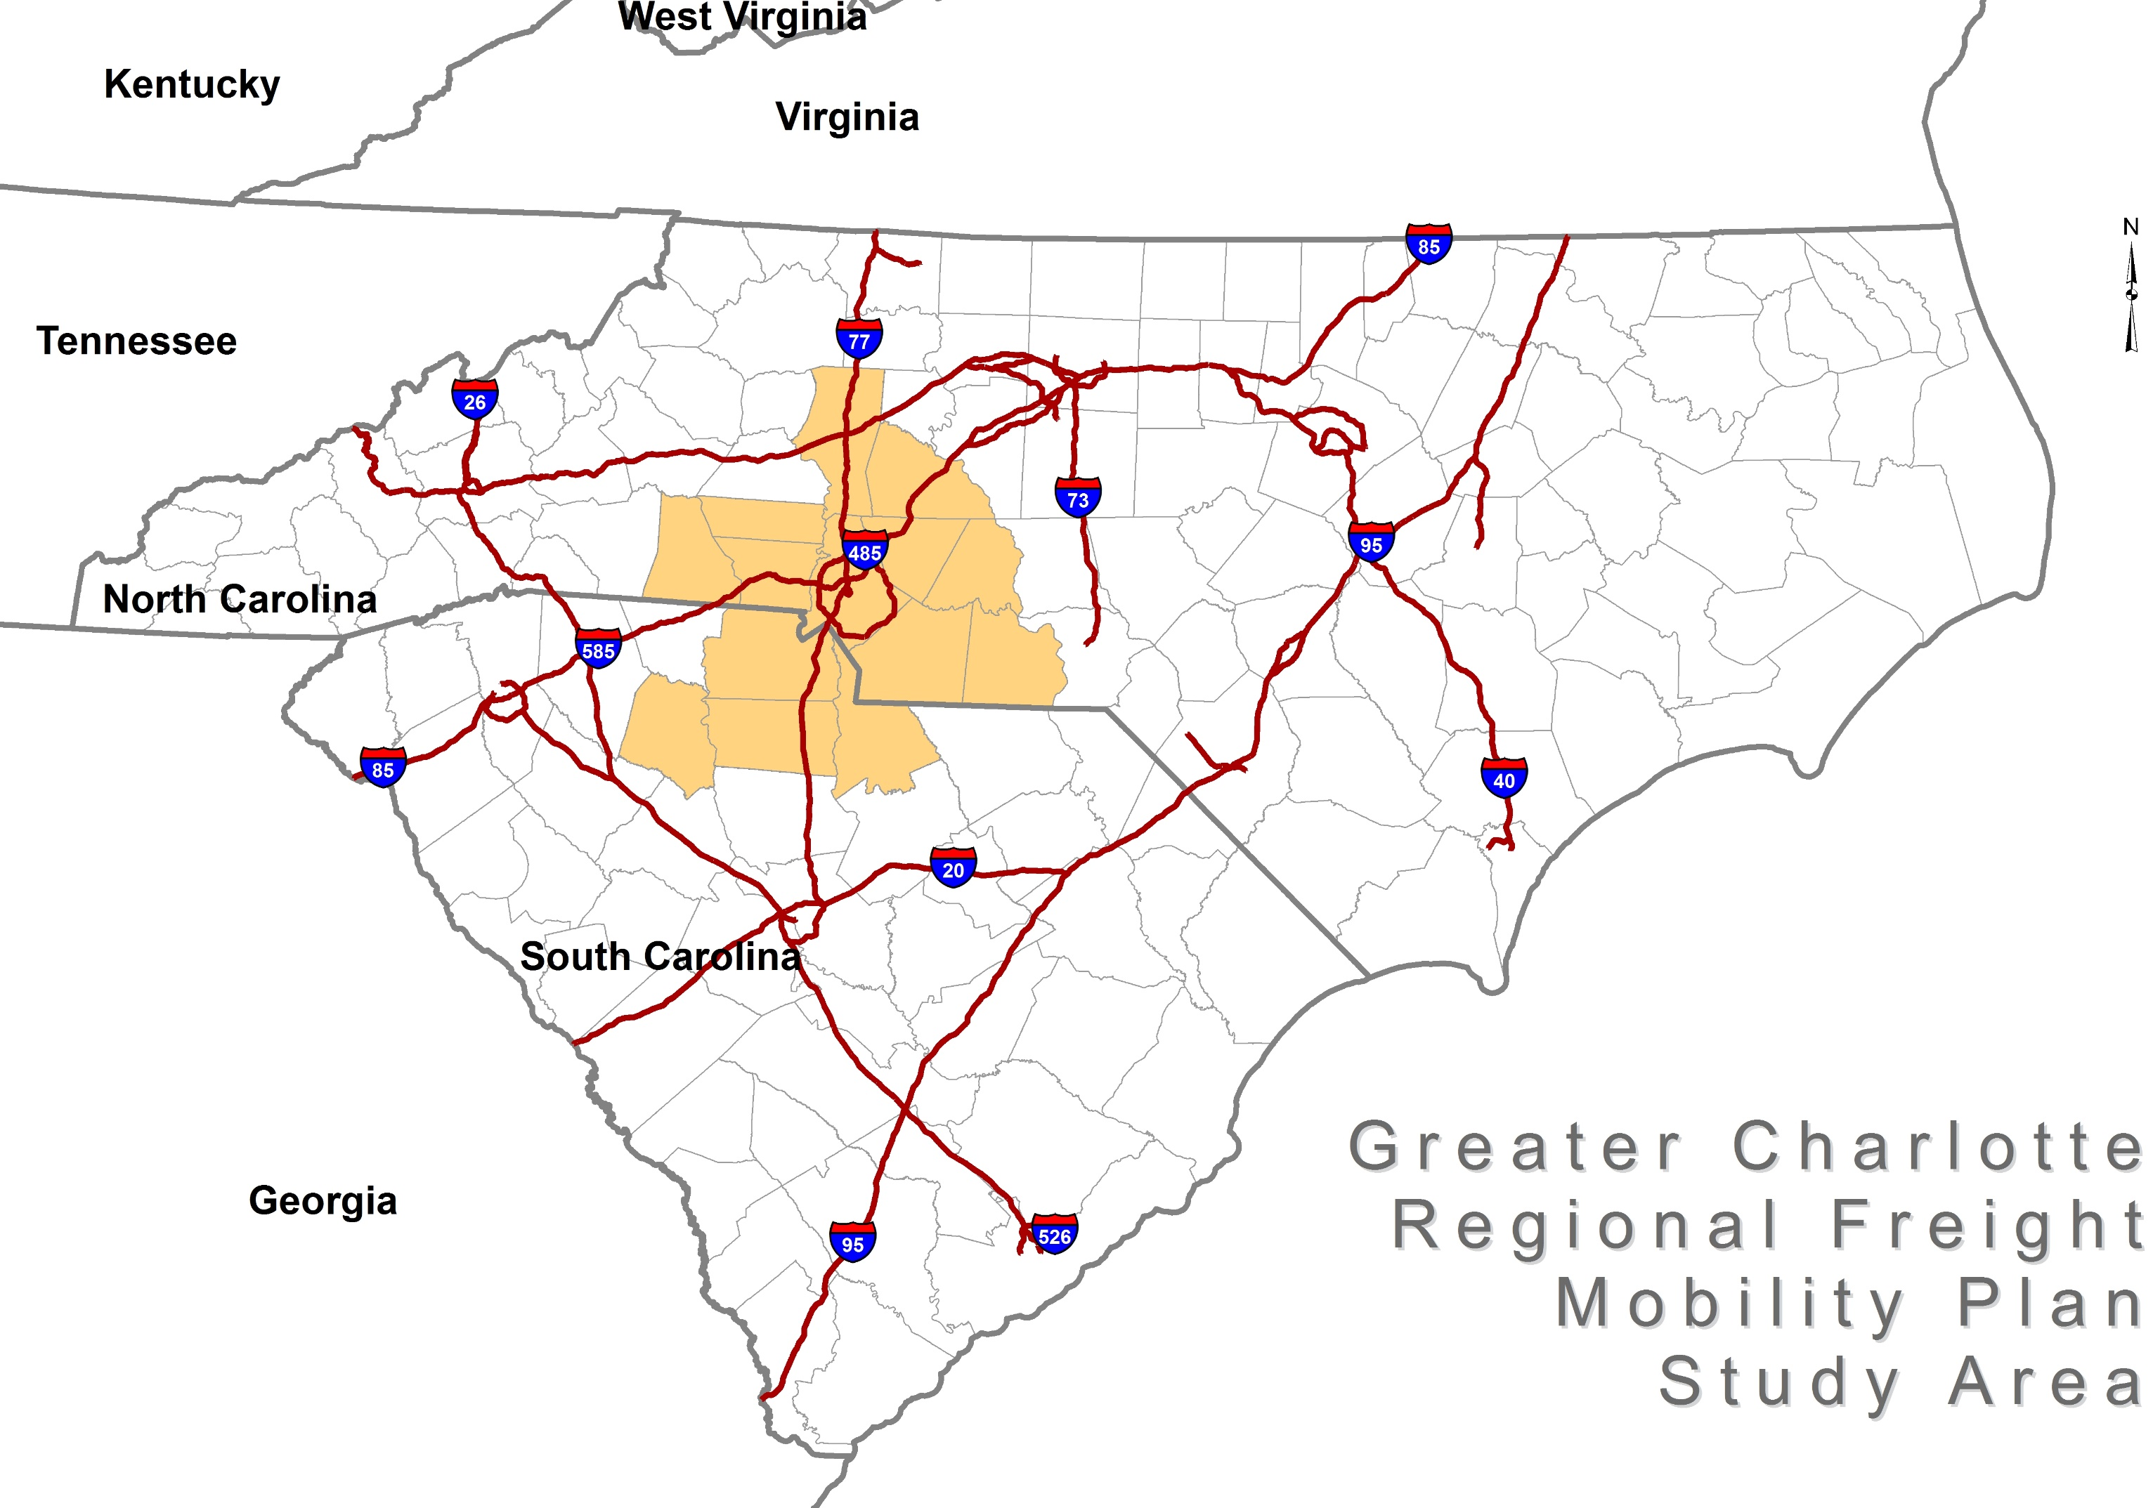

Slide 3
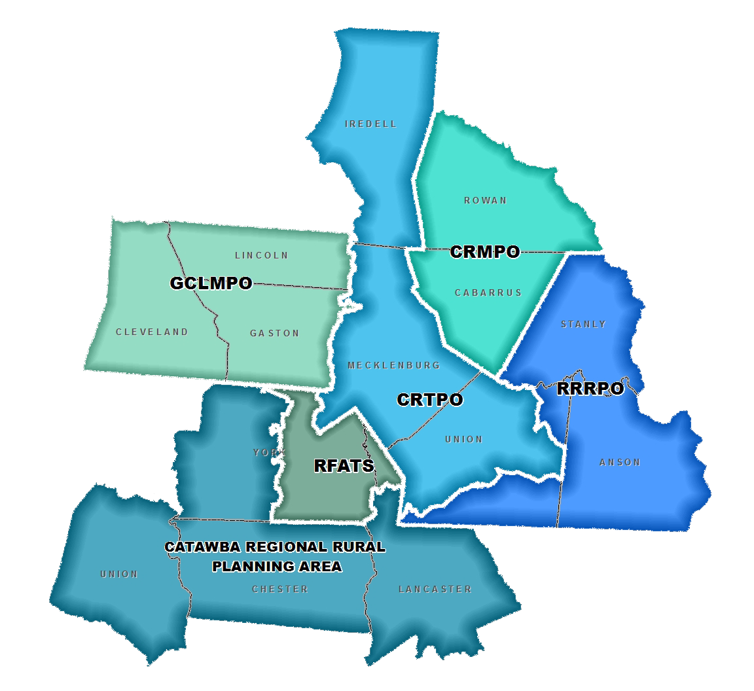
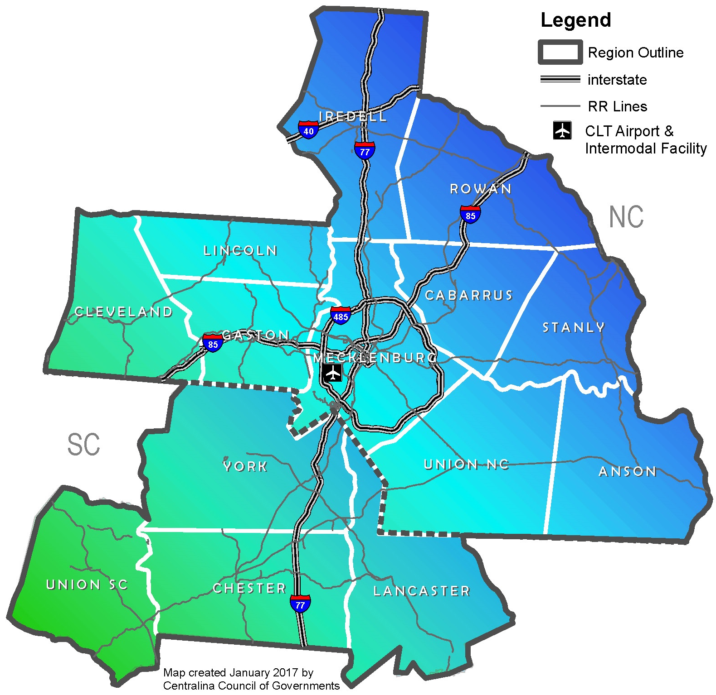
Greater charlotte region
14 Counties
2 States
4 MPOs
1 RPO
3 COGs (Full & Partial areas)

Slide 4
Population & Economic Context
Anticipated population growth
5 Counties – 50% increase in population by 2040
Anticipated employment growth
9 Counties - double jobs by 2040
Key employment sectors that are freight dependent:
Manufacturing, automotive, logistics, energy, aerospace, and biomedical
Freight and supply chains as economic tools
Notes:
To set the context of the local demographic profile that both generates and attracts freight traffic – we took a look a estimated growth in population, employment and the key sectors of employment that traditionally generate freight traffic.
Our region’s rapid growth over the last decade made it the fastest growing of all U.S. regions with more than 1 million people.
Our population is expected to continue to grow by 50% in the next two decades and double within four decades.
Clear focus needed on REGIONAL systems to support job and economic growth and LOCAL systems to create vibrant communities
Economics – Key Industries – competing on supply chains – supporting business get their goods to market more efficiently

Slide 5
Three Perspectives For Freight Planning
Land Use
Planning
Economic Development
Transportation Planning

Slide 6
Regional Freight Mobility
Freight Mobility
Quality of Life
Economy Growth
Business Attraction
Business Retention
Demand for Goods
Jobs
Freight mobility is moving goods efficiently, safely, reliably and affordably over the greater Charlotte region’s transportation system.
Notes:
Regional freight mobility is important to the Greater Charlotte Region for many reasons. It supports the quality of life of the citizens as population grows and demand for delivery of goods increases. It supports growth in the economy by attracting and retaining businesses providing additional jobs. Moving goods efficiently and affordably across the transportation system is the main driver of the Greater Charlotte Regional Freight Mobility Plan.

Slide 7
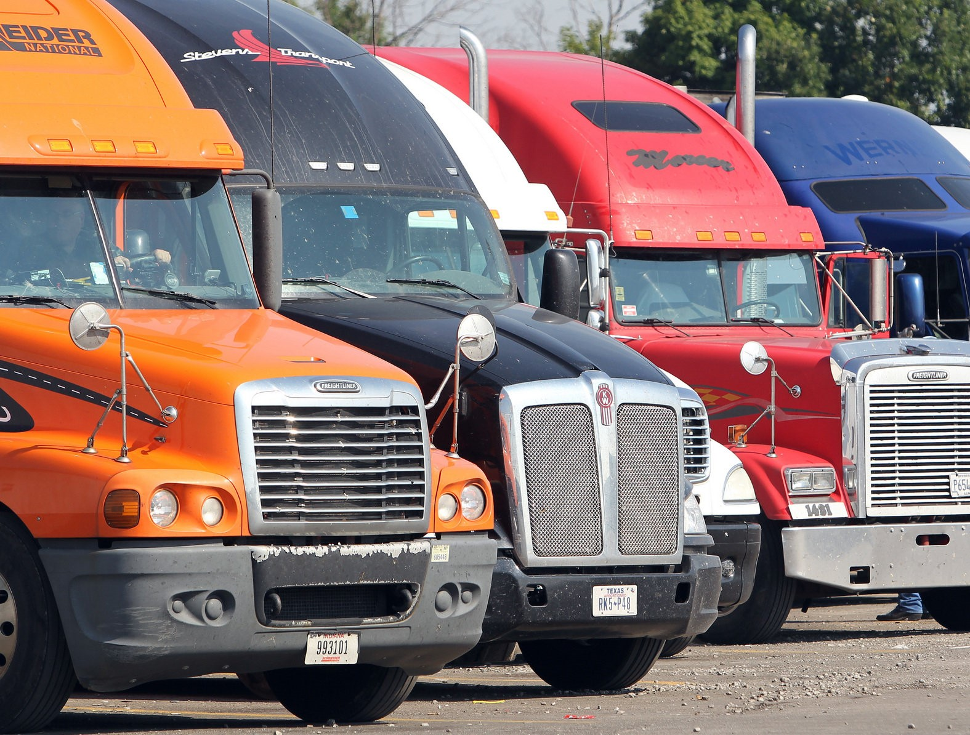
Charlotte Regional Freight Mobility Plan
Identifies key regional issues and transportation system constraints;
Recommends projects, programs, and policies; and
Establishes a regional collaborative approach for freight planning

Slide 8
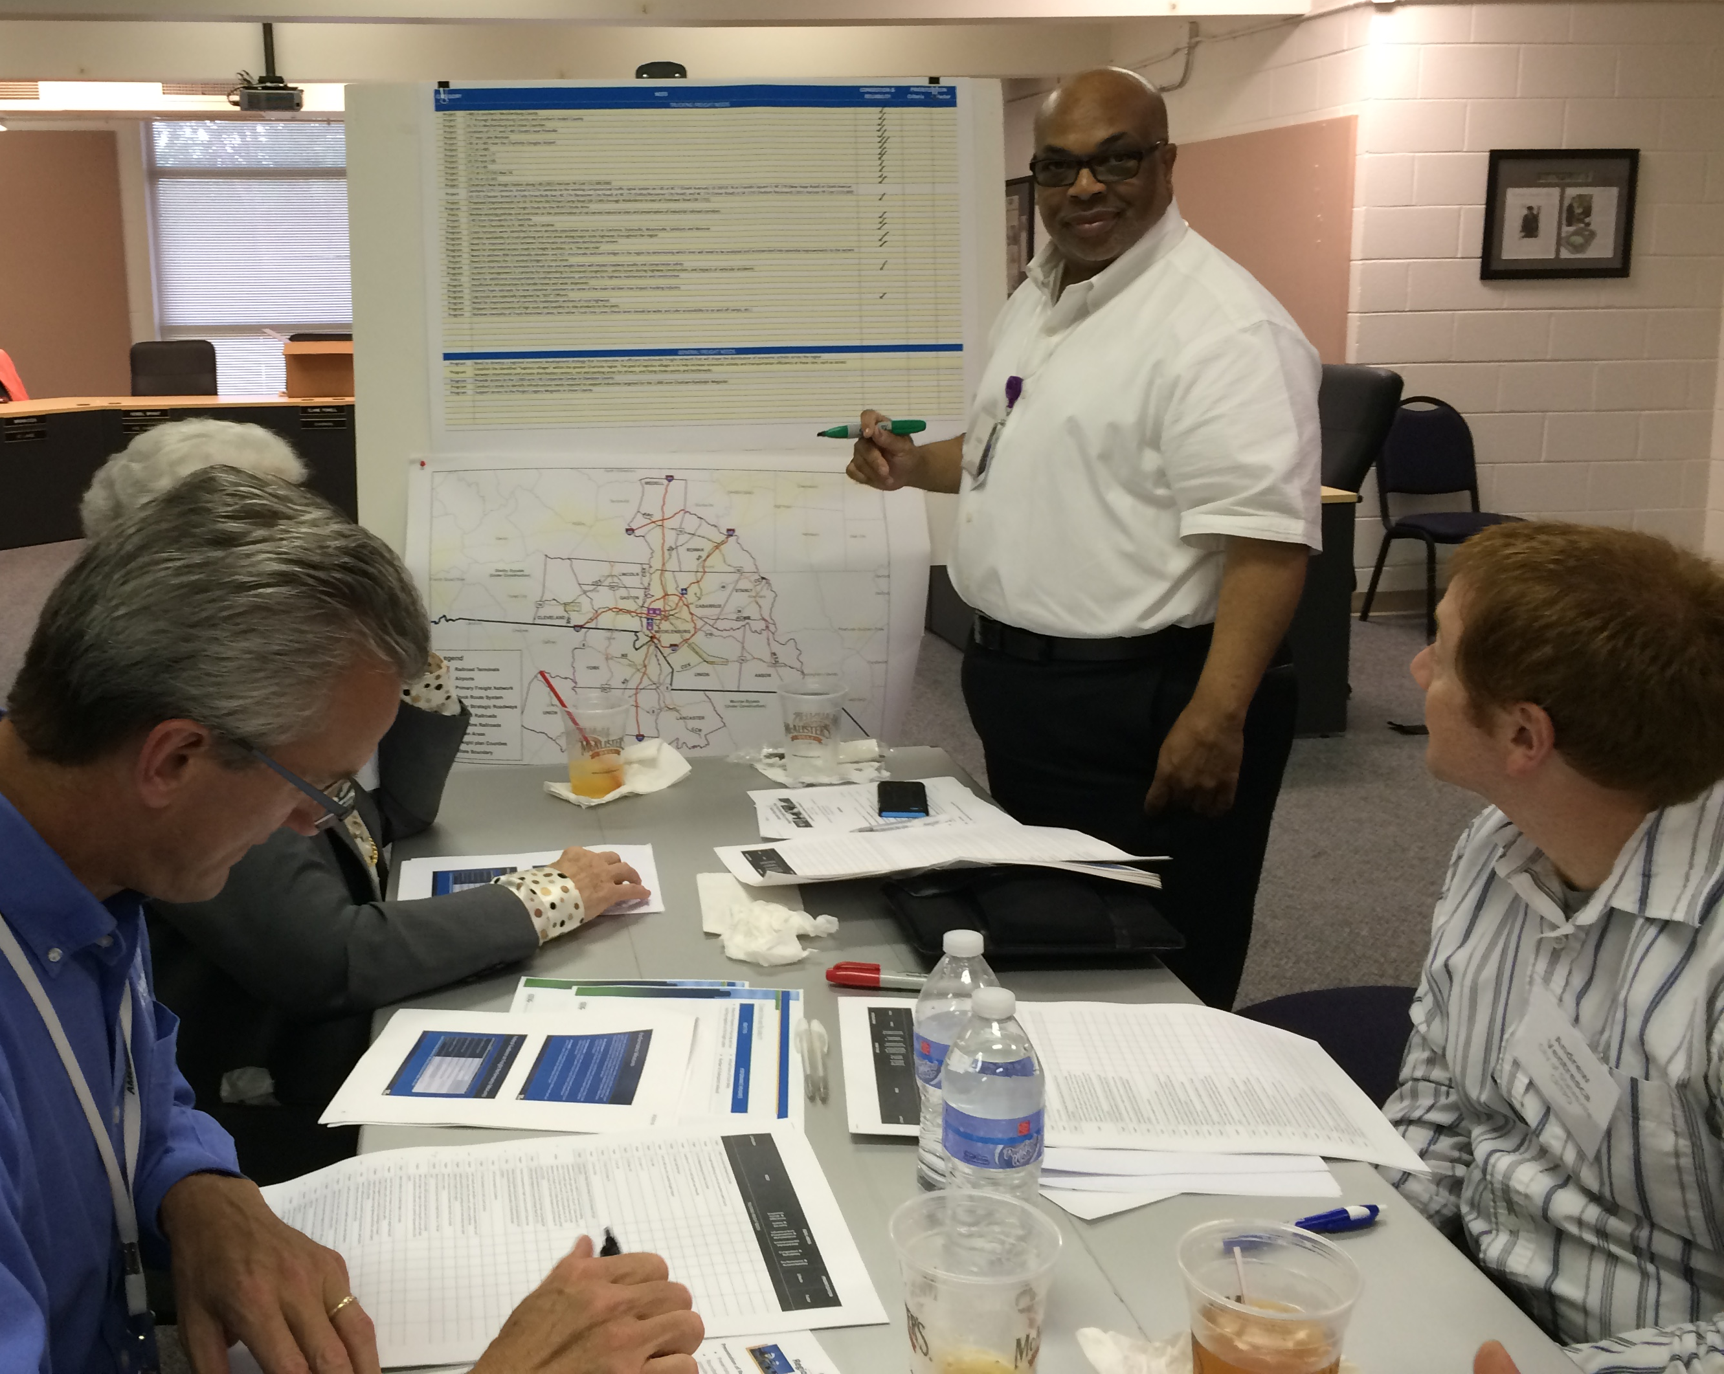
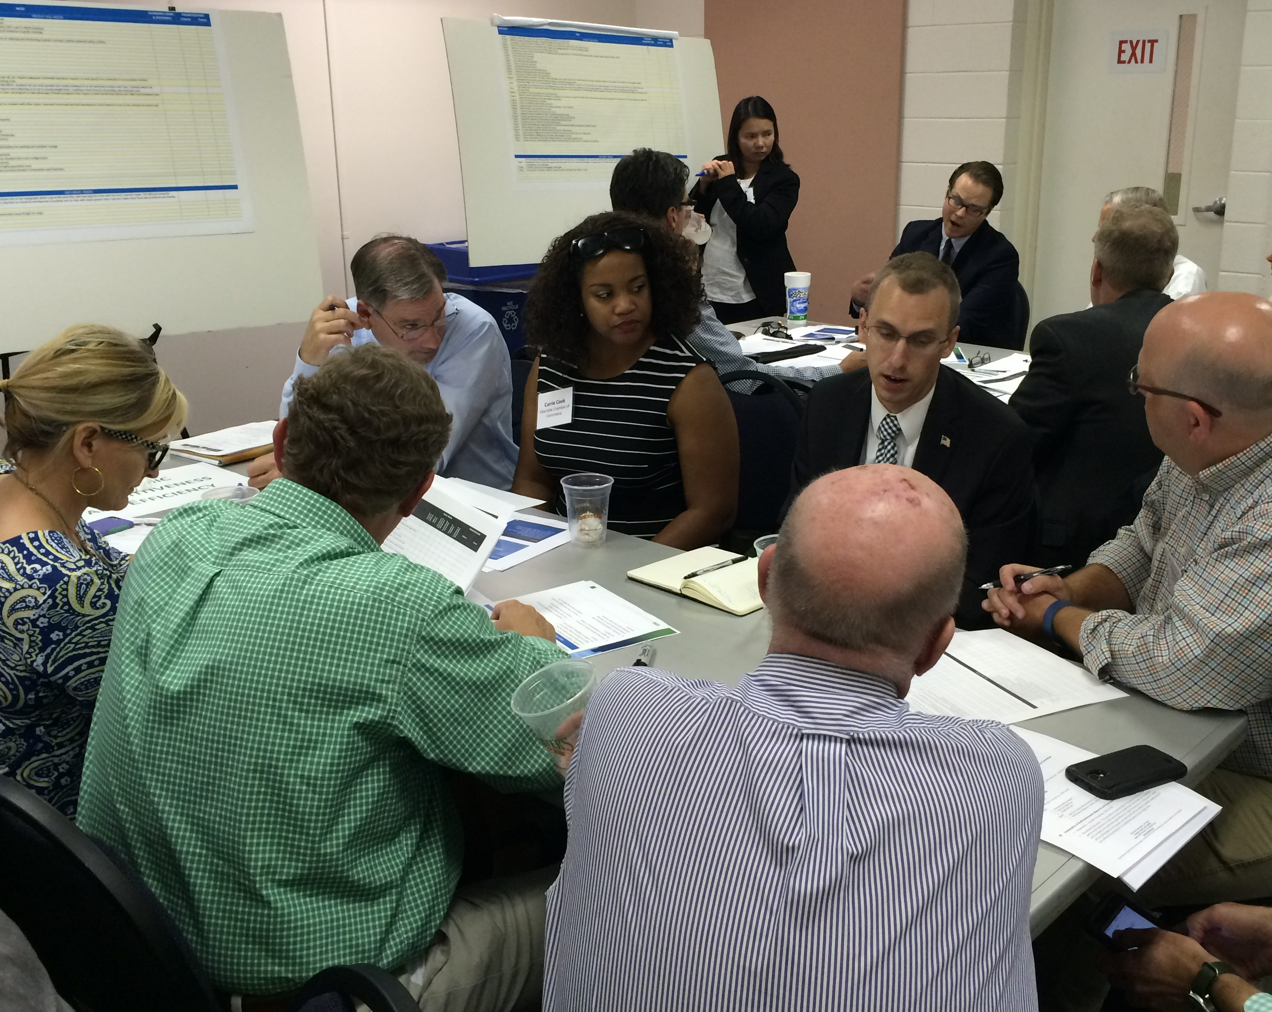
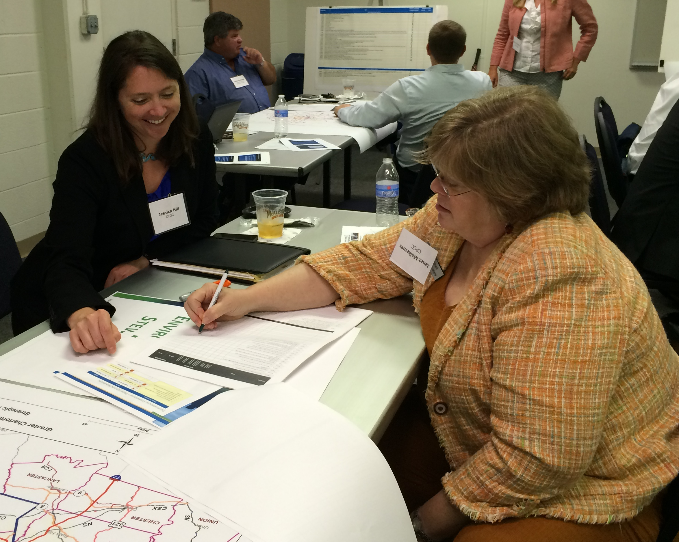
Stakeholder Outreach
Coordinating Committee
22 Members
Federal, State, and Local
Steering Committee
63 Members
Policy-level
Freight Advisory Committee
20 Members
Surveys/Interviews
Technical Oversight
Transportation & economic development partners
Private-sector freight
Guide implementation of Freight Plan
Web-based survey
Phone interviews
Private & public stakeholders
“Highest priorities for private sector freight are congestion relief and travel time reliability.”
Notes:
Stakeholder Outreach was an extensive effort led by the plan development team that leaned heavily on the collaboration of several committees.
The Coordinating Committee, representing our Transportation Planning Organizations within the region, as well as NCDOT, SCDOT and FHWA, did a phenomenal job of attending meetings, reviewing technical memoranda, and incorporating input from each of their organizations/agencies.
The Steering Committee represented a wide range of organizations, agencies, and companies throughout the region. Their participation included hearing updates on the plan development, receiving highlights from the technical memoranda, and participating in interactive work sessions to identify needs and opportunities for implementation of the Freight Plan’s recommendations.
The Freight Advisory Committee is a private sector focused group, established as part of the Freight Plan development but to also be participants in the implementation and championing of the Freight Plan Recommendations.
A series of surveys were also conducted, separate from the Committee activities. The Plan development team hosted both online surveys as well as one-on-one interviews with members of the community to drill down on some specific needs and issues facing freight mobility in the region. As noted on the slide, the highest priority from this community was planning for traffic congestion relief and improving/maintaining travel time reliability.

Slide 9
Regional Freight by the Numbers
ROADS
RAIL
AIR
I-85 & I-77
9
42%
Critical freight trucking corridors
Class I and Shortline
Railroads serve the region
Of all NC air cargo is handled by CLT
$31B in annual economic gains from Aviation
77%
5%
Of tonnage moved by Truck
Of freight tonnage moved by rail
Non-metal Minerals & Gravel
Top commodity by value & weight
moved by air
Cereal
Grains
Top commodities by weight moved by truck
Top commodity by weight moved by rail
Electronics
Notes:
Additional Freight Related data highlights that guide planners include some of these highlights:
Where is freight moving by truck? As expected, we see Interstates 85 and 77 as being major corridors for freight traveling by truck.
How much freight is moving by truck? We see about 77% of all tonnage moving by truck, compared with other modes, such as rail or air.
Which goods are going by truck? Non-metal Minerals and Gravel account for the most tonnage moving by truck. This signals high construction activity in the region
With consideration of rail:
This region is served by 9 different railroads, 2 Class 1 railroads (Norfolk Southern and CSX Transportation) and 7 shortline (smaller owners/operators).
Those railroads carry about 5% of all freight moving through the region.
The top commodity moving by rail are Cereal Grains.
With consideration of air transport:
An estimated 42% of all air cargo moving through North Carolina is handled at Charlotte Douglas International Airport
This accounts for an estimated $31B in economic gains for our study area
The top commodity by both dollar value and weight moving by air is electronic equipment.

Slide 10
Challenges and Opportunities
Motor Carrier Challenges
5 interstate & 3 off-interstate system bottlenecks
Roadway maintenance and capacity improvement needs far outweigh available funding.
Limited truck parking and highway bottlenecks are impacting efficiency of the freight network.
Incident management has become an increasingly hot topic on major corridors.
Aviation Challenge
High value commodities
Rail Challenges
4 system bottlenecks
At-grade-crossing safety
Only 5% of freight tonnage is moved by rail
Notes:
IN addition to the priorities of addressing truck congestion and improving travel time reliability, here are a few highlights of things we heard across all modes of transportation.
These are regional issues that may be incorporated into your local plans – specifically truck parking, highway bottlenecks and participating in incident management programs.
Though small in volume, airborne freight has by far the highest value per ton of any mode. Typical commodities include goods from the pharmaceutical, automotive, and high-tech manufacturing sectors as well as the consumer parcel delivery services. Moving goods by air is expensive and the industry responds to the forces of supply and demand. This is not unique to the region but an industry wide fact of life.
Because nearly every freight shipment travels by truck at some point in its delivery, challenges on the highway system can cause ripples through the state’s freight transportation system and the economy. Delay, safety, and access issues raise costs for shippers, carriers, manufacturers and consumers alike.

Slide 11
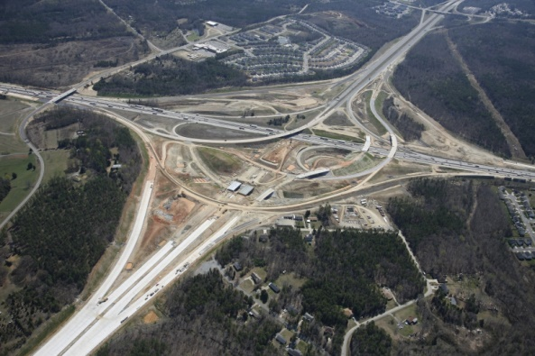
Regional Freight Plan Recommendations
INFRASTRUCTURE PROJECTS to improve the freight truck, rail and air networks
REGIONAL PROGRAMS to improve how freight systems operate
LOCAL POLICIES to encourage location efficiencies and promote region’s assets
Notes:
We have grouped recommendations into three categories: Projects, programs and policies they are focused on reducing congestion and bottlenecks, reducing crashes and improving safety for freight drivers and others, replacing or improving deficient infrastructure and improving our environment and communities.
Performance measures have been identified to track the success of investments either through reductions in congestion, crashes, increase carrying volumes, replacement or improvement of deficient infrastructure, and environment concerns.

Slide 12
Implementation of Recommendations
Public Sector
Transportation Planning Organizations
Local Governments
Economic Development Organizations
State DOTs
State Transportation Improvement Program
Local Land Use Zoning and Ordinances
Site Locations & Business Recruitment
CCOG
Coordination & Outreach
Long Range Transportation Plan
Notes:
The region's transportation planning organizations are charged with providing a continuing, coordinated, and comprehensive transportation planning process. Freight mobility is a critical component of the planning process and the plan's infrastructure recommendations will most likely be their responsibility for inclusion in their plans for funding consideration by State DOTs.
Most of the land use recommendations will fall under the purview of the region's local governments as the managers of land use planning and policies. Local governments will be able to use the plan's recommendations to help guide efficient land use decisions and policies that impact both the private sector and the community.
Economic development boards and chambers of commerce should use the plan's recommendations to retain existing business as well as attract new ones. They will also be better informed of the region's plan for the freight transportation system so that they may advise prospective clients on site locations that are near or on the freight network.
The NC and SC DOTs have or are in the process to complete a statewide freight plan. Our region's freight plan will inform both state plans of our region's priorities for projects, programs and policies to provide a safe, efficient, reliable and sustainable freight transportation system.
In order for the freight mobility plan to be a guiding document the region's MPOs/RPOs and local governments must recognize its value. Buy-in is critical because the region will need to act as a whole to improve the system and gain the maximum benefit from the recommendations. It cannot be a winners and loser’s mentality we must instead support each other to maximize our assets and grow our economy.
Beginning in January we will begin leading the project partners through adoption and acceptance of the plan and to raise awareness of the importance of the plan to others in our region. In addition, regional programs that span jurisdictional boundaries will be the responsibility of all but we will take the initial step to investigate the feasibility of a few such as ITS and IMS.

Slide 13
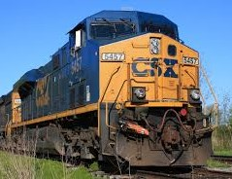
CCOG’s Anticipated Role
Undertake effort to educate the public on the importance of freight
Maintain Freight Plan data for sharing with partners
Establish protocol for continuation of Freight Advisory Committee
Investigate regional programs identified in the Freight Plan
Notes:
What was suggested to the Centralina Council of Governments for their role in plan implementation?
The overarching theme of these recommendations is to continue to sponsor and facilitate regional freight planning activities. These include:
Support an educational program to continue to raise the awareness of freight mobility in the region
House all transportation, economic, and land use data compiled for the Freight Plan to share with regional partners
Coordinate future activities with the Freight Advisory Committee
Investigate regional programs identified in the Freight Plan

Slide 14
Funding & Project Partners
Town of Cornelius
Town of Davidson
Town of Huntersville
Town of Matthews
Town of Mooresville
Town of Stallings
Town of Wadesboro
City of Albemarle
City of Belmont
City of Charlotte
City of Gastonia
City of Monroe
City of Mount Holly
City of Statesville
Cabarrus County
Gaston County
Iredell County
Lincoln County
Mecklenburg County
Stanly County
Notes:
Working closely to develop this plan were three freight committees with support from project and funding partners.
The Freight Plan is a multi-jurisdictional public-private collaboration effort led by the CCOG in partnership with Metropolitan Planning Organizations (MPOs), Rural Planning Organization (RPO), Federal Highway Administration, U.S. Department of Commerce Economic Development Administration, North Carolina Department of Transportation (NCDOT), South Carolina Department of Transportation (SCDOT), local governments, economic development organizations, and private rail and trucking companies, logistics and distribution firms. The Freight Plan documents the freight transportation system within the 14 counties of the Greater Charlotte Region which includes 10 counties in North Carolina and four counties in South Carolina.
Funding partners supported us financially – supporting the regional partnerships needed for collaboration in transportation planning.
Plan, or Project, partners are those who participated through time and input, as they are all participants in the implementation of the plan

Slide 15
Thank You!
For more information, please contact:
Jessica Hill
JHill@Centralina.org
(704) 348-2731
http://www.centralina.org/regional-planning/transportation/freight/
9815 David Taylor Drive
Charlotte, NC 28262 • Phone: 704-372-2416 Fax: 704-347-4710 • www.centralina.org

