Slide 1
Collaborating with Partners in Megaregions Planning
John Orr, Atlanta Region MPO Manager
Atlanta Regional Commission
March 23, 2017
Notes:
In Atlanta we are very fortunate that many of the concepts of megaregional planning evolved out of the leadership of Georgia Tech. Dr. Catherine Ross (3rd picture from the left) has influenced much of our thinking and been a regional leader encouraging ARC to think from a Megaregional perspective.
Also, being the headquarters to several fortune 500 companies, metro Atlanta has a broad perspective of business markets that cover the southeast and the nation.

Slide 2
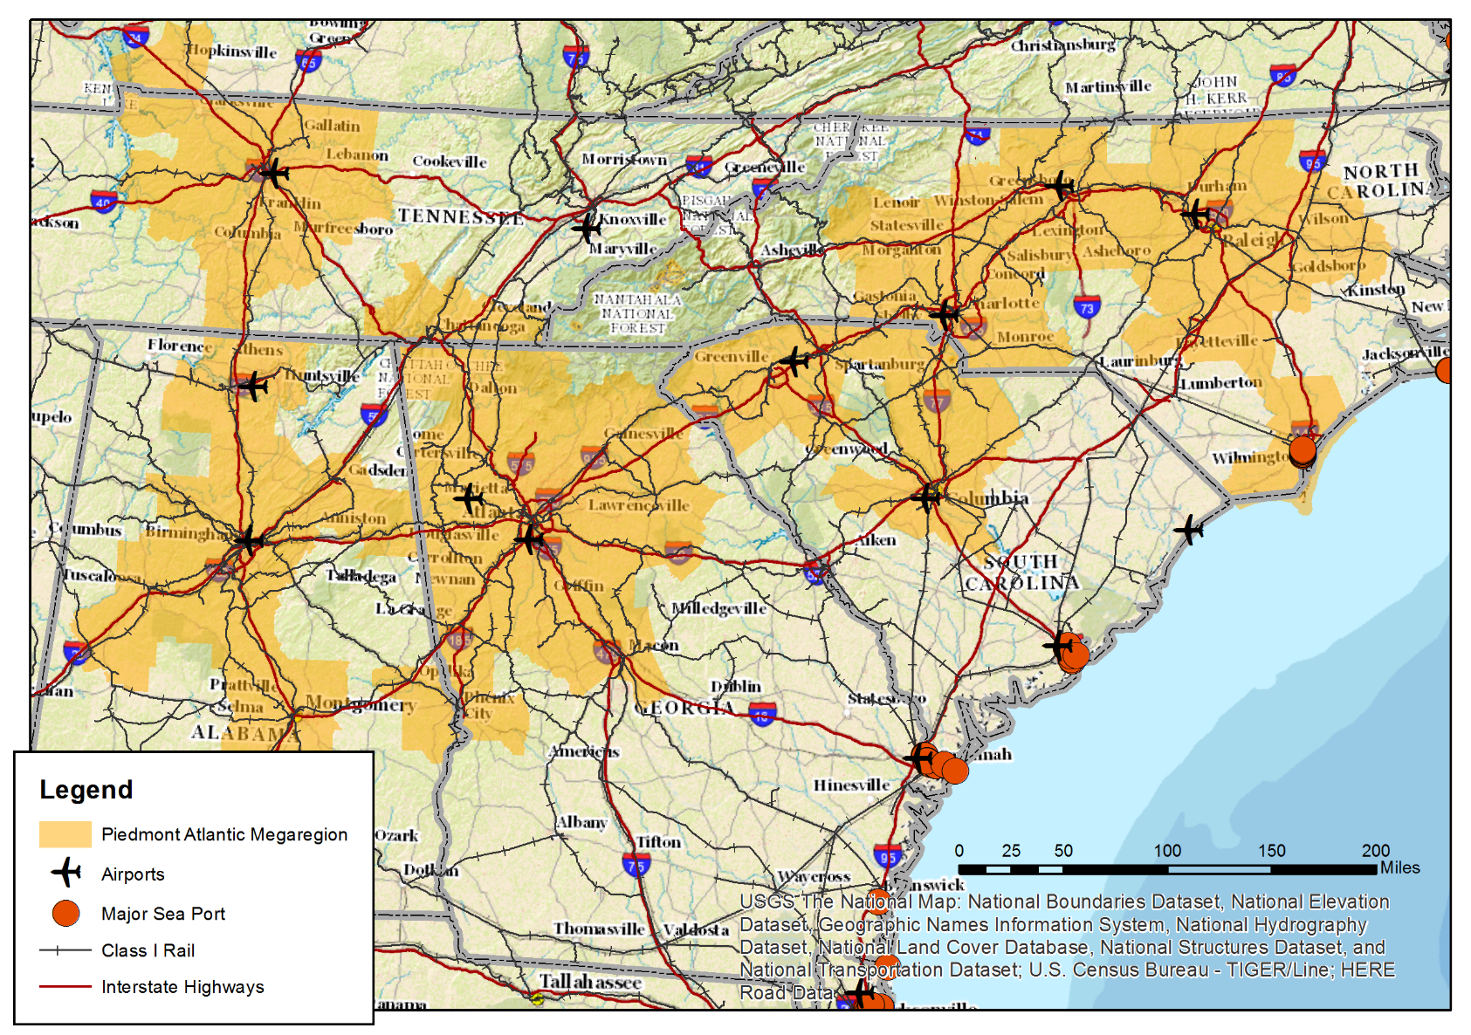
Piedmont Atlantic Megaregion

Slide 3
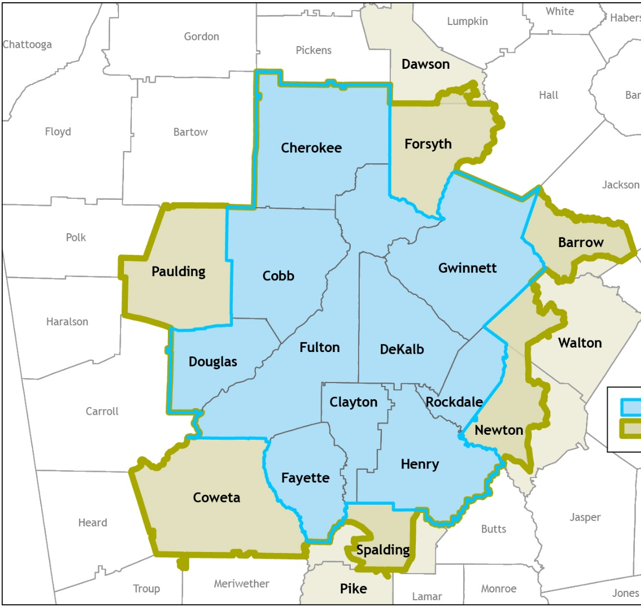
ARC is the Federally-Designated Metropolitan Planning Organization (MPO) for Transportation in the 20-County Atlanta Region
More than 5.5 million people
Population larger than 30 states
Economy larger than 33 states
Notes:
ARC wears multiple hats ranging from workforce training to aging services, but two of our important roles include acting as the federally designated Metropolitan Planning Organization for the 19 counties centered around the City of Atlanta. The MPO area includes all the counties highlighted here.
ARC is also the state-designated Regional Commission (RC) for 10 counties (in blue)
With more than 5 million people, metro Atlanta is home to more than half of the state’s population and more than 60% of its economy
Metro Atlanta’s population is larger than the populations of 30 states. Its gross domestic product is larger than those of 33 states, and is just slightly larger than that of Singapore or Belgium.
However, the expansion of the Atlanta region has made transportation planning challenging. Our region is only one county away from Alabama and we have increasingly noted the need to coordinate with other megaregional MPOs in addressing congestion and goods movement challenges.

Slide 4
Regional Goods Movement is the Foundation of the Economy and Megaregional Planning
Loading a container at CSX Fairburn Intermodal Yard
Notes:
Atlanta is the 3 largest inland port behind only Chicago, IL and Dallas, TX
Metro Atlanta has the nation’s fifth-largest concentration of supply chain companies with more than 1 million employed in Georgia logistics and associated industries.
The Atlanta region is a global logistics center with more than 130,000 supply chain jobs, the world’s busiest airport and a position as the global leader in supply chain management software.

Slide 5
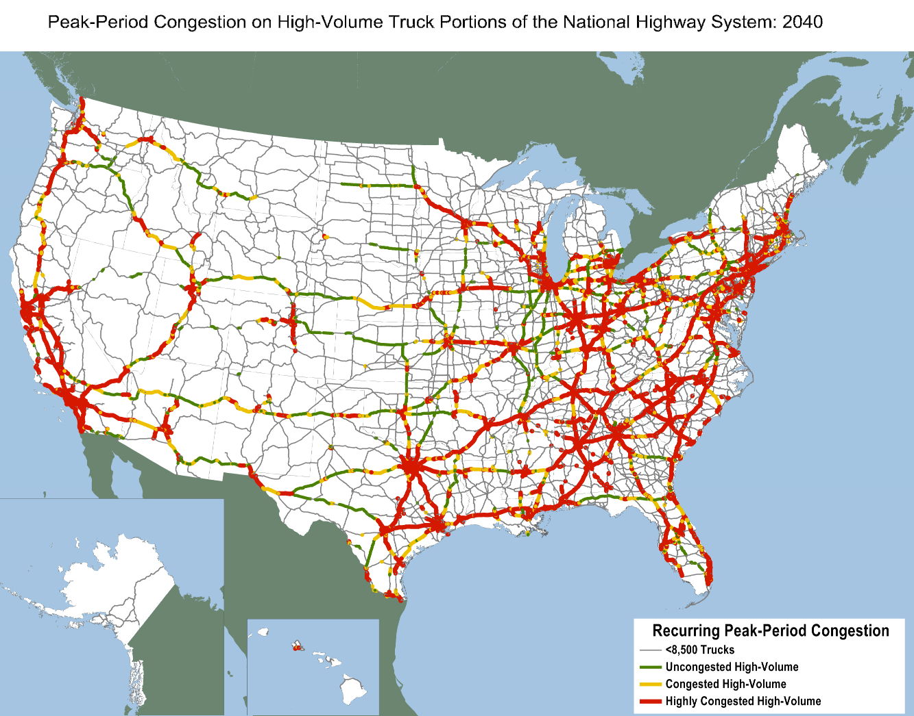
Motivation for Megaregion
Activities
Pursue Interstate Corridor Congestion Management

Slide 6
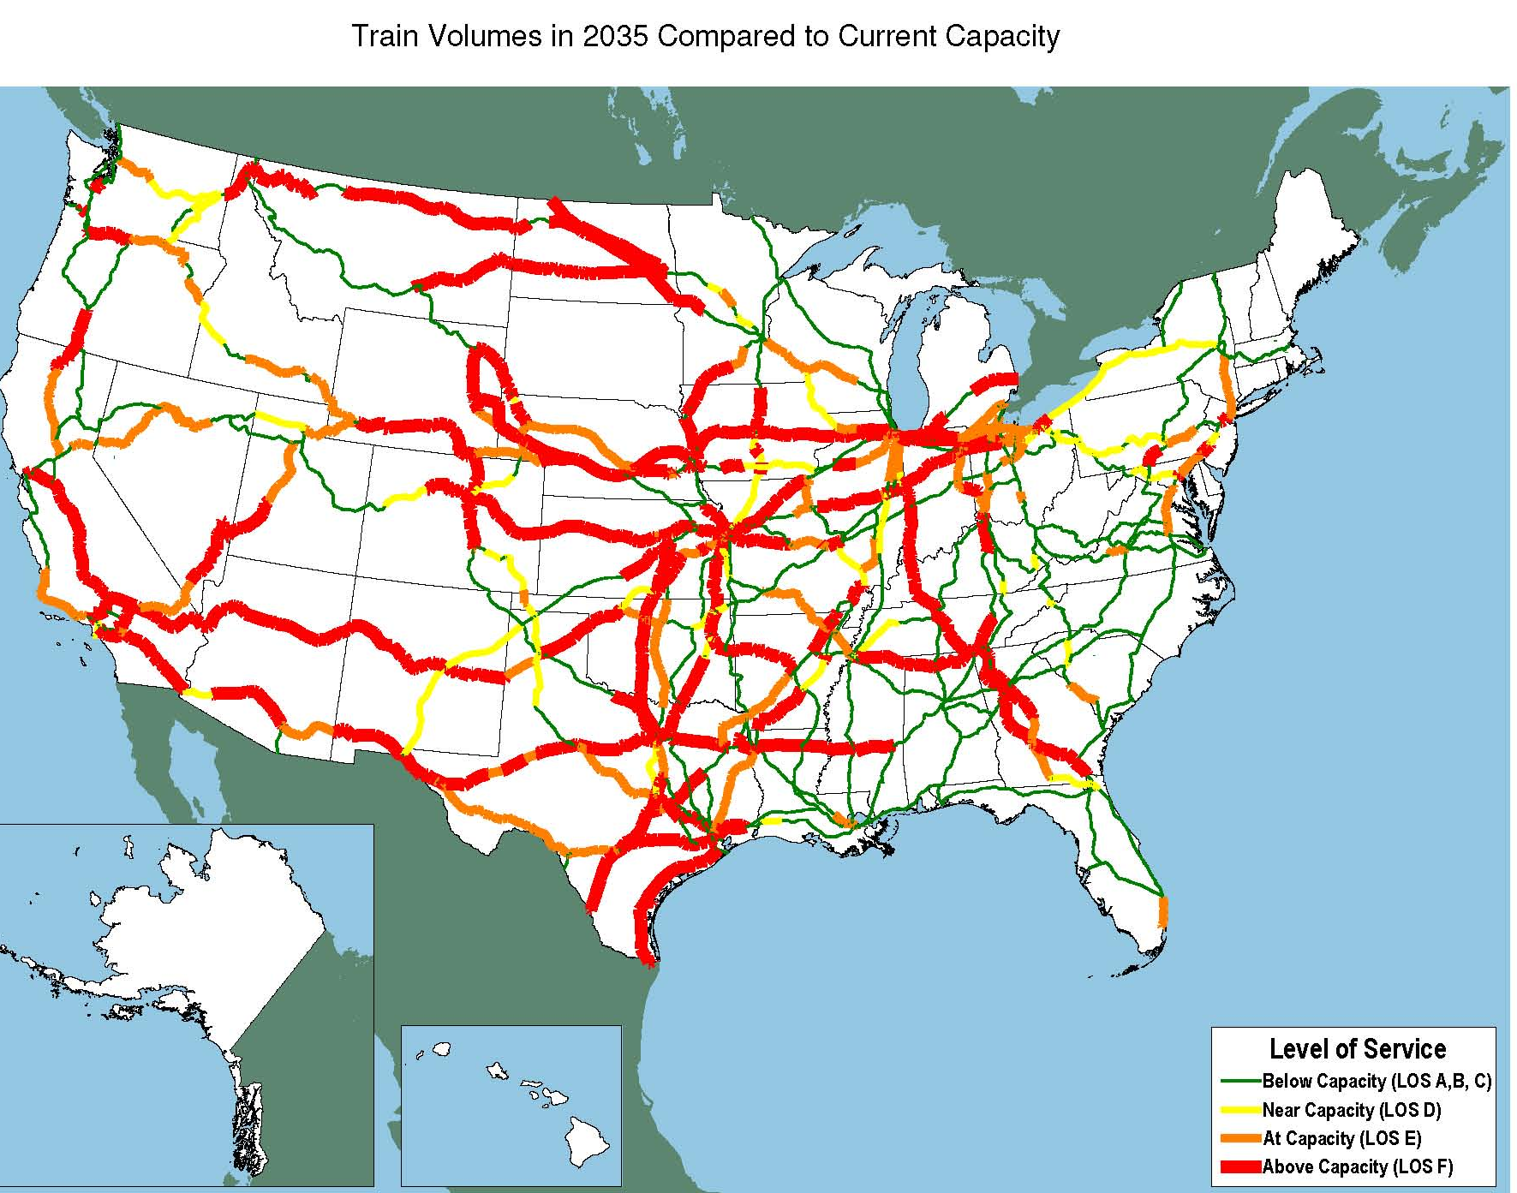
Motivation for Megaregion
Activities
Shift Freight From Truck to Rail

Slide 7
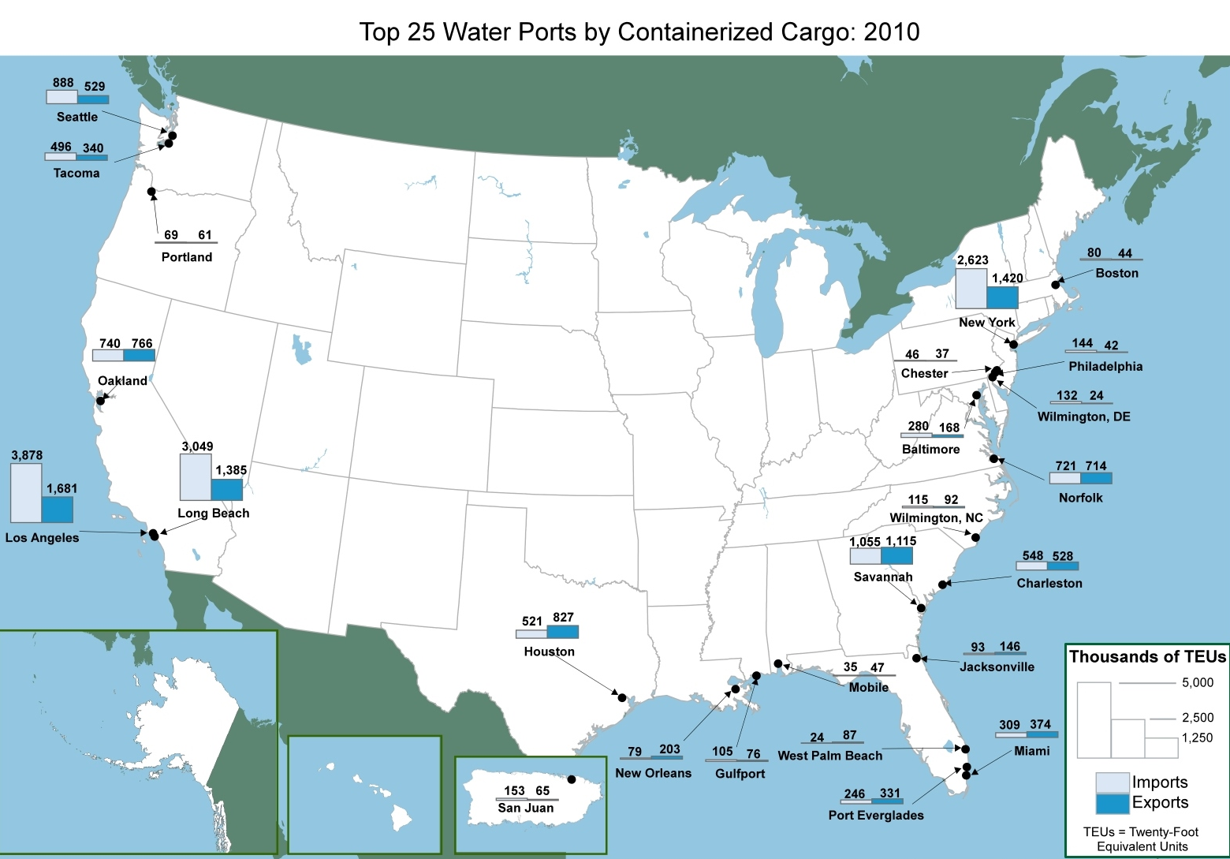
Motivation for Megaregion Activities
Supporting Export Industries

Slide 8
Collaborating with Partners
Notes:
ARC, Georgia Tech, Metro Atlanta Chamber reached out to US Dot through the Transportation Planning Capacity Building (TPCB) Program
Wanted to look at the broader impacts of goods movement in Atlanta and throughout the Piedmont Atlantic Megaregion (PAM)
Planning of the event took about 6 months with very heavy activity starting in July and leading up to the early November meeting
Identifying and inviting National MPO experts
Identifying and inviting state and regional peers from within PAM
Securing private sector involvement
Developing agenda
Developing materials
Lot’s of work and coordination on the part of ARC, Ga Tech, Metro Chamber, and Volpe Center (TPCB)

Slide 9
Understanding Megaregion Goods Movement Needs – Peer Exchanges in 2013 and 2017
November 6 -7, 2013 Connected Places. Private-Sector Perspective (Left to right):
Dave Williams, Metro Atlanta Chamber; Michelle Livingstone, The Home Depot; Page Siplon, Center of Innovation for Logistics
Notes:
Agenda Highlights
Private Sector Decision Making
Mike Orr, Genuine Parts
Real Life Challenges of Transportation Planning from Private Sector Perspective
Michelle Livingstone, The Home Depot
Page Siplon, Center of Innovation for Logistics
Transportation Infrastructure Impacts on Megaregions
Curtis Foltz, Georgia Ports Authority
Panama Canal Improvements
Louis Miller, H-JAIA
Importance of Air Logistics
Agencies Represented at Peer Exchange
Private Sector
Genuine Parts, The Home Depot, etc.
Peer MPOs
Birmingham, Nashville, Miami, San Diego
State DOTs
Georgia, North Carolina, Tennessee
Federal Partners
US DOT, Federal Highway, CDC
Non governmental
NARC, AMPO
Universities
National Center for Transportation Systems Productivity and Management (NCTSPM), Ga Tech, University of Mayland

Slide 10
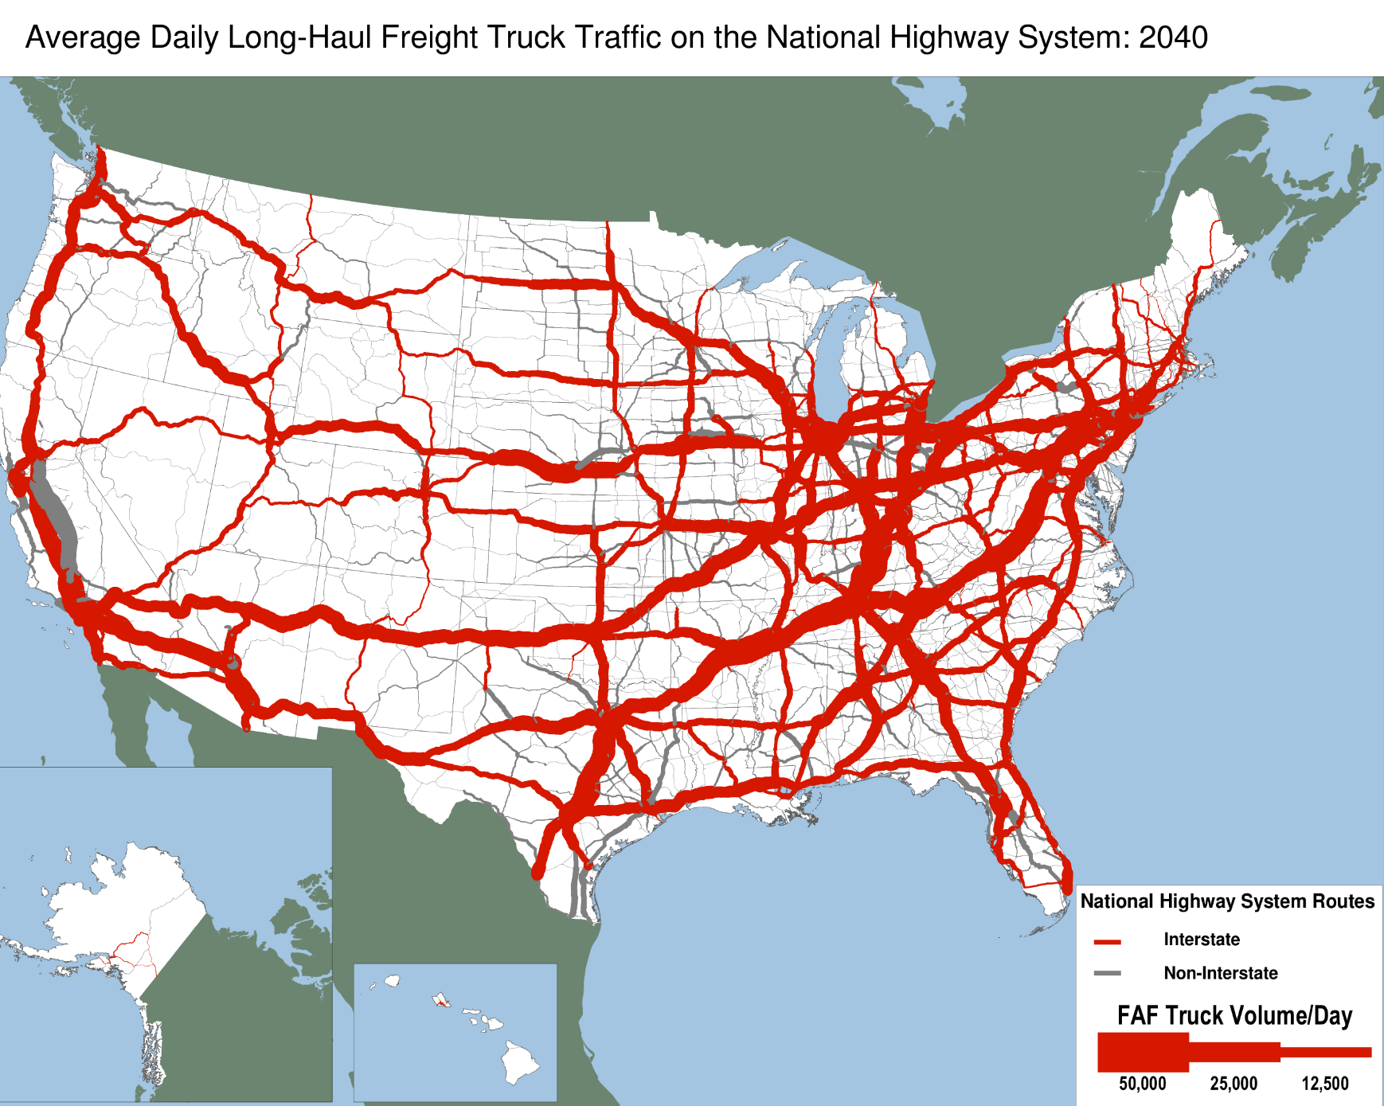
Megaregions /Areas of Interest
Nashville
Greenville
Birmingham
Savannah

Slide 11
How Megaregions Planning is Benefiting the Atlanta Region
Business needs and transportation planning responses
Collaboration With Other Regions
Understanding of Complex Goods Movement Patterns
Establishing Relationships
Notes:
Freight Volumes are increasing
Interstates won’t be able to handle all the growth
Need to plan intermodally
Road
Rail
Air
Water
Corridor Based
Struggle with states and cities seeing through the lens of megaregions
Still see each other as regional competitors and not partners on a global scale.
High speed rail
Great opportunity for megaregional cooperation
Size of megaregion is in the sweet spot for rail competitiveness
Would bring PAM closer together
Identify gateways to global commerce
Seaports
Airports
Land border crossings
Highway
Rail

Slide 12
Questions in Moving Forward in Megaregion Planning
Identifying the mutual benefits for regions
Increasing economic competitiveness?
More efficient freight networks?
Effective congestion management strategies?
Identifying partner regions with common interests and priorities
Notes:
UPRECEIVED A SHRP 2 ROUND 5 LEAD ADOPTER INCENTIVE GRANT. PART OF THE PROPOSAL IS TO INTEGRATE FREIGH CONSIDERATIONS INTO THE PLANNING PROCESS. ARC WANTS TO INCORPORATE MEGAREGIONS IN OUR DISCUSSIONS WITH FREIGHT STAKEHOLDERS AND IS CURRENTLY IN DISCUSSIONS WITH FHWA STAFF ON HOW THIS CAN BE ACCOMPLISHED – INCLUDING CONTINUING OUR PARTNERSHIP WITH GA Tech and Dr. Ross.

Slide 13
For Additional Information
John Orr, AICP
jorr@atlantargional.com
404.463.3265

